Slide 1
Effects of the Transmission Network on Electricity Markets

Slide 2
Introduction
No longer assume that all generators and loads are connected to the same bus
Need to consider:
  Congestion, constraints on flows
  Losses
Two forms of trading
  Bilateral or decentralized trading
  Pool or centralized trading

Slide 3
Bilateral or decentralized trading
Transactions involves only buyer and seller
Agree on price, quantity and other conditions
System operator
  Does not get involved directly in trading
  Maintains balance and security of the system
    Buys or sells limited amounts of energy to keep load and generation in balance
    Limits the amount of power that generators can inject at some nodes if security cannot be ensured by other means

Slide 4
Example of bilateral trading
Bus A
Bus B
G₁
L₁
G₂
L₂
G₃
G₁ sold 300 MW to L₁
G₂ sold 200 MW to L₂
Prices are a private matter
Quantities must be reported to system operator so it can check security
Notes:
Figure 6.1: Bilateral trading in a two-bus power system

Slide 5
Example of bilateral trading
Bus A
Bus B
G₁
L₁
G₂
L₂
G₃
G₁ sold 300 MW to L₁
G₂ sold 200 MW to L₂
If capacity of corridor ≥ 500 MW → No problem
If capacity of corridor < 500 MW → some of these transactions may have to be curtailed
Notes:
Figure 6.1: Bilateral trading in a two-bus power system

Slide 6
Which transaction should be curtailed?
Could use administrative procedures
  These procedures consider:
    Firm vs. non-firm transactions
    Order in which they were registered
    Historical considerations
  Do not consider relative economic benefits
  Economically inefficient
  Better to let the participants themselves decide what makes sense
Participants should purchase right to use the network when arranging a trade in energy
  Physical transmission rights
  Support actual transmission of power over a given link

Slide 7
Physical transmission rights
Bus A
Bus B
G₁
L₁
G₂
L₂
G₃
G₁ sold 300 MW to L₁ at 30 $/MWh
G₂ sold 200 MW to L₂ at 32 $/MWh
G₃ selling energy at 35 $/MWh
How much would L₁ and L₂ be willing to pay for transmission rights?
L₂ should not pay more than 3 $/MWh for transmission rights
L₁ should not pay more than 5 $/MWh for transmission rights
Notes:
Figure 6.1: Bilateral trading in a two-bus power system

Slide 8
Problems with physical rights
Parallel paths
Market power

Slide 9
Parallel paths
x_{A}
P
F^{A}
P
1
2
F^{B}
x_{B}
Notes:
Fig. 6.2: Illustration of Kirchoff’s Voltage Law

Slide 10
Parallel paths
A
C
B
Z
1
2
3
Y
D
Notes:
Fig. 6.3: Active power flows on parallel paths

Slide 11
Parallel paths
A
C
B
I
Z
1
II
2
3
Y
D
400 MW transaction between B and Y
Need to buy transmission rights on all lines
Notes:
Fig. 6.3: Active power flows on parallel paths

Slide 12
Parallel paths
A
C
B
I
Z
1
II
2
3
Y
400 MW transaction between B and Y
D
Not possible because exceeds capacities of lines 1-2 and 2-3
Notes:
Fig. 6.3: Active power flows on parallel paths

Slide 13
Counter-flows
A
C
B
200 MW transaction
between D and Z
III
Z
1
IV
2
3
Y
D
Notes:
Fig. 6.3: Active power flows on parallel paths

Slide 14
Resultant flows
A
C
B
Z
1
2
3
Y
D
The resultant flows are within the limits
Notes:
Fig. 6.3: Active power flows on parallel paths

Slide 15
Physical rights and parallel paths
Counter-flows create additional physical transmission rights
Economic efficiency requires that these rights be considered
Decentralized trading:
  System operator only checks overall feasibility
  Participants trade physical rights bilaterally
  Theory:
    Enough participants → market discovers optimum
  Practice:
    Complexity and amount of information involved are such that it is unlikely that this optimum can be found in time

Slide 16
Physical rights and market power
Bus A
Bus B
G₁
L₁
G₂
L₂
G₃
G₃ only generator at bus B
G₃ purchases transmission rights from A to B
G₃ does not use or resell these rights
Why?
Effectively reduces capacity from A to B
Allows G₃ to increase price at B
“Use them or lose them” provision for transmission rights: difficult to enforce in a timely manner

Slide 17
Centralized or Pool Trading
Producers and consumers submit bids and offers to a central market
Independent system operator selects the winning bids and offers in a way that:
  Optimally clears the market
  Respects security constraints imposed by the network
No congestion and no losses: uniform price
Congestion or losses: price depend on location where generator or load is connected

Slide 18
Borduria-Syldavia Interconnection
Borduria
Syldavia
D_{B}= 500MW
D_{S}= 1500 MW
Perfect competition within each country
No congestion or losses within each country
  Single price for electrical energy for each country
  Price = marginal cost of production
Notes:
Fig. 6.7: Supply functions for the electrical energy markets of Borduria and Syldavia

Slide 19
Borduria-Syldavia Interconnection
Borduria
Syldavia
D_{B}= 500MW
D_{S}= 1500 MW
$/MWh
$/MWh
43
15
13
10
500
MW
1500
MW
Notes:
Fig. 6.7: Supply functions for the electrical energy markets of Borduria and Syldavia

Slide 20
Borduria-Syldavia Interconnection
Borduria
Syldavia
D_{B}= 500MW
D_{S}= 1500 MW
Economic effects of an interconnection?
Notes:
Fig. 6.7: Supply functions for the electrical energy markets of Borduria and Syldavia

Slide 21
Can Borduria supply all the demand?
Borduria
Syldavia
D_{B}= 500MW
D_{S}= 1500 MW
Generators in Syldavia can sell at a lower price than generators in Borduria
Situation is not tenable
Not a market equilibrium
Notes:
Fig. 6.7: Supply functions for the electrical energy markets of Borduria and Syldavia

Slide 22
Market equilibrium
Borduria
Syldavia
D_{B}= 500MW
D_{S}= 1500 MW
Notes:
Fig. 6.7: Supply functions for the electrical energy markets of Borduria and Syldavia

Slide 23
Flow at the market equilibrium
Borduria
Syldavia
D_{B}= 500MW
D_{S}= 1500 MW
Notes:
Fig. 6.7: Supply functions for the electrical energy markets of Borduria and Syldavia

Slide 24
Graphical representation
Supply curve for Syldavia
Supply curve for Borduria
24.3 $/MWh
24.3 $/MWh
= 1433 MW
= 567 MW
= 933 MW
= 500 MW
= 1500 MW
= 2000 MW

Slide 25
Constrained transmission
What if the interconnection can carry only 400 MW?
  P_{B} = 500 MW + 400 MW = 900 MW
  P_{S} = 1500 MW - 400 MW = 1100 MW
Price difference between the two locations
Locational marginal pricing or nodal pricing

Slide 26
Graphical representation
35 $/MWh
16 $/MWh
= 900 MW
= 1100 MW
= 400 MW
= 500 MW
= 1500 MW
= 2000 MW
Notes:
Fig. 6.10: Graphical representation of the effect of congestion on the Syldavian and Bordurian electricity markets.

Slide 27
Summary

Slide 28
Summary

Slide 29
Winners and Losers
Winners:
  Bordurian generators
  Syldavian consumers
  Economies of both Borduria and Syldavia
    Better allocation of resources
Losers
  Bordurian consumers
  Syldavian generators
Congestion in the interconnection reduces these benefits

Slide 30
Congestion surplus
Consumer payments:
Producers revenues:
Congestion or merchandising surplus:

Slide 31
Congestion surplus
Notes:
Fig. 6.11: Consumers’ payments (solid line) and generators’ revenue (dashed line) as a function of the flow on the interconnection between Borduria and Syldavia.

Slide 32
Congestion surplus
Collected by the market operator in pool trading
Should not be kept by market operator in pool trading because it gives a perverse incentive
Should not be returned directly to network users because that would blunt the economic incentive provided by nodal pricing

Slide 33
Centralized trading in larger networks
Independent System Operator (ISO) runs the market:
  Receives offers from the generators
  Forecasts the load at each node
  Dispatches the generation to meet the load at minimum cost taking the network constraints into account → Optimal Power Flow (OPF)
  Determines the price of electricity at each node
  Generators are paid the price of electricity at their node
  Consumers pay the price of electricity at their node

Slide 34
Optimal Power Flow
B
C
Network
A
D
Generating units and loads are not all connected to the same bus
The economic dispatch may result in unacceptable flows or voltages in the network

Slide 35
Optimal Power Flow – 2 bus example
B
A
L_{A}
L_{B}
Maximum flow on each line: 100MW
50 $/MWh
100$/MWh
P_{A}
P_{B}
P_{A}^{MAX}
P_{B}^{MAX}

Slide 36
Acceptable ED solution
100 MW
0 MW
300 MW
B
A
L_{A} = 100 MW
100 MW
L_{B} = 200MW
The solution of this (trivial) economic dispatch is:
The flows on the lines are below the limit
The economic dispatch solution is acceptable

Slide 37
Unacceptable ED solution
200 MW
0 MW
500 MW
B
A
L_{A} = 100 MW
200 MW
L_{B} = 400MW
The solution of the economic dispatch is:
The resulting flows exceed their limit
The economic dispatch solution is not acceptable

Slide 38
OPF solution
100 MW
200 MW
300 MW
B
A
L_{A} = 100 MW
100 MW
L_{B} = 400MW
In this simple case, the solution of the economic dispatch
can be modified easily to produce acceptable flows.
This could be done mathematically by adding the following
inequality constraint:

Slide 39
3-bus example
A
B
1
2
10 $/MWh
P_{A}
P_{A}^{MAX} = 390MW
3
450 MW
Economic dispatch:
20$/MWh
P_{B}
P_{B}^{MAX}= 150 MW

Slide 40
Flows resulting from the economic dispatch
390MW
60MW
A
B
F^{max} = 200MW
1
2
F^{max} = 260MW
F^{max} = 200MW
3
450 MW
Assume that all the lines have the same reactance
Do these injection result in acceptable flows?

Slide 41
Calculating the flows using superposition
Because we assume a linear model, superposition is
applicable
390 MW
60 MW
1
2
3
450 MW
390 MW
60 MW
1
2
1
2
3
3
390 MW
60 MW

Slide 42
Calculating the flows using superposition (1)
390 MW
F_{A}
F_{B}
1
2
3
390 MW
F_{A} = 2 x F_{B} because the path 1-2-3 has twice the reactance
of the path 1-3
F_{A} + F_{B} = 390 MW
F_{A} = 260 MW
F_{B} = 130 MW

Slide 43
Calculating the flows using superposition (2)
60 MW
F_{D}
F_{C}
1
2
3
60 MW
F_{C} = 2 x F_{D} because the path 2-1-3 has twice the reactance
of the path 2-3
F_{C} + F_{D} = 60 MW
F_{C} = 40 MW
F_{D} = 20 MW

Slide 44
Calculating the flows using superposition (3)
390 MW
60 MW
130 MW
20 MW
1
260 MW
1
40 MW
2
2
3
3
390 MW
60 MW
390 MW
60 MW
110 MW
1
280 MW
170 MW
2
F^{max =} 260 MW
3
450 MW

Slide 45
Correcting unacceptable flows
390 MW
60 MW
1
280 MW
2
Must reduce flow F₁₋₃ by 20 MW
3
450 MW
Must use a combination of reducing the injection at bus 1 and increasing the injection at bus 2 to keep the load/generation balance
Decreasing the injection at 1 by 3 MW reduces F₁₋₃ by 2 MW
Increasing the injection at 2 by 3 MW increases F₁₋₃ by 1 MW
A combination of a 3 MW decrease at 1 and 3 MW increase at 2 decreases F₁₋₃ by 1 MW
To achieve a 20 MW reduction in F₁₋₃ we need to shift 60 MW of injection from bus 1 to bus 2

Slide 46
Check the solution using superposition
330 MW
120 MW
110 MW
40 MW
1
220 MW
1
80 MW
2
2
3
3
330 MW
120 MW
330 MW
120 MW
70 MW
1
260 MW
190 MW
2
F^{max =} 260 MW
3
450 MW

Slide 47
Comments (1)
The OPF solution is more expensive than the ED solution
  C_{ED} = 10 x 390 + 20 x 60 = $5,100
  C_{OPF} = 10 x 330 + 20 x 120 = $5,700
The difference is the cost of security
  C_{security} = C_{OPF} - C_{ED} = $600
The constraint on the line flow is satisfied exactly
  Reducing the flow below the limit would cost more

Slide 48
Comments (2)
We have used an “ad hoc” method to solve this problem
In practice, there are systematic techniques for calculating the sensitivities of line flows to injections
These techniques are used to generate constraint equations that are added to the optimization problem

Slide 49
Pool trading in a three-bus example
A
C
B
1
2
50 MW
60 MW
3
D
300 MW

Slide 50
Economic dispatch
A
125 MW
C
0 MW
B
285 MW
1
2
50 MW
60 MW
3
0 MW
D
300 MW

Slide 51
Superposition
360 MW
60 MW
1
2
3
300 MW
300 MW
1
2
3
300 MW
60 MW
60 MW
1
2
3
Notes:
Figure 6.14: Application of the superposition theorem to the calculation of the line flows in the three-bus system.

Slide 52
Flows with economic dispatch
A
125 MW
C
0 MW
B
285 MW
156 MW
1
2
204 MW
96 MW
50 MW
60 MW
3
0 MW
D
300 MW

Slide 53
Overload!
A
125 MW
C
0 MW
F^{MAX} = 126 MW
B
285 MW
156 MW
1
2
204 MW
96 MW
50 MW
60 MW
3
0 MW
D
300 MW

Slide 54
Correcting the economic dispatch
Additional generation at bus 2
0.6 MW
1 MW
1 MW
1
2
0.4 MW
3
Notes:
Figure 6.16: Effect of an incremental change in the generation at bus 2.

Slide 55
Parallel paths
x_{A}
P
F^{A}
P
1
2
F^{B}
x_{B}
Notes:
Fig. 6.2: Illustration of Kirchoff’s Voltage Law

Slide 56
Superposition
1
2
360 MW
60 MW
156 MW
204 MW
96 MW
3
300 MW
50 MW
50 MW
30 MW
1
2
20MW
3
1
2
310 MW
10 MW
126 MW
184 MW
116 MW
3
300 MW
Notes:
Figure 6.17: Superposition of the redispatch of generation from bus 1 to bus 2 (B) on the economic dispatch (A) to produce a constrained dispatch that meets the constraints on line flows (C).

Slide 57
Correcting the economic dispatch
Additional generation at bus 3
1 MW
0.4 MW
1
0.6 MW
2
3
1 MW
Notes:
Figure 6.18: Effect of an incremental change in the generation at bus 3.

Slide 58
Superposition
1
2
360 MW
60 MW
156 MW
204 MW
96 MW
3
300 MW
75 MW
30 MW
1
45 MW
2
1
2
3
285 MW
60 MW
75 MW
126 MW
159 MW
66 MW
3
225 MW
Notes:
Figure 6.19: Superposition of the redispatch of generation from bus 1 to bus 3 (B) on the economic dispatch (A) to produce a constrained dispatch that meets the constraints on line flows (C).

Slide 59
Cost of the dispatches
Economic dispatch: 2,647.50 $/h
Redispatch generator 2: 2,972.50 $/h
Redispatch generator 3: 2,835.00 $/h
Cost of security: 187.50 $/h

Slide 60
Transmission constrained dispatch
A
50 MW
C
0 MW
B
285 MW
126 MW
1
2
159 MW
66 MW
50 MW
60 MW
This is the dispatch that
the ISO will implement
3
75 MW
D
300 MW

Slide 61
Calculating the prices at each node
Nodal price:
  Cost of supplying an additional MW of load without violating the security constraints
Start from the OPF solution

Slide 62
Nodal prices
A
50 MW
C
0 MW
B
285 MW
126 MW
1
159 MW
2
66 MW
50 MW
60 MW
Node 1:
A is cheapest generator
3
75 MW
D
300 MW

Slide 63
Nodal prices
A
50 MW
C
0 MW
B
285 MW
126 MW
1
159 MW
2
60 MW
66 MW
50 MW
Node 3
A is cheaper than D
Increasing A would overload line 1-2
D is cheaper than C
Increase D by 1 MW
3
75 MW
D
300 MW

Slide 64
Nodal prices
A
50 MW
C
0 MW
B
285 MW
126 MW
1
159 MW
2
66 MW
50 MW
60 MW
Node 2
C is very expensive
Increasing A or D would overload line 1-2
?
3
75 MW
D
300 MW

Slide 65
Nodal price at node 2
0.6 MW
1 MW
1 MW
1
0.4 MW
2
3
1 MW
0.2 MW
1
0.8 MW
2
3
1 MW
Notes:
Figure 6.20: Incremental flows in the network due to an additional megawatt of load at bus 2 when this megawatt is produced at bus 1 (A) or at bus 3 (B).

Slide 66
Nodal price at node 2
Increase generation at node 3 AND decrease generation at node 1
1 MW
1
2
3
Notes:
Figure 6.21: Supplying an additional megawatt of load at bus 2 by increasing production at bus 3 and reducing it at bus 3.

Slide 67
Nodal price using superposition
0.6 MW
1 MW
1 MW
1
0.4 MW
2
3
1 MW
0.2 MW
1
0.8 MW
2
3
1 MW
Notes:
Figure 6.22: Application of the superposition theorem to the analysis of the conditions illustrated in Figure 6.17.

Slide 68
Observations
Generators A and D are marginal generators because they supply the next MW of load at the bus where they are located
Generators B and C are not marginal
Unconstrained system: 1 marginal generator
m binding constraints: m+1 marginal generators
Prices at nodes where there is no marginal generator are set by a linear combination of the prices at the other nodes

Slide 69
Summary for three-bus system
_{(= congestion surplus)}

Slide 70
Counter-intuitive flows
A
50 MW
C
π₁=7.50 $/MWh
0 MW
B
285 MW
π₂=11.25 $/MWh
126 MW
1
2
159 MW
66 MW
50 MW
60 MW
Power flows from
high price to low
price!
π₃=10.00 $/MWh
3
75 MW
D
300 MW
Notes:
Figure 6.24: Nodal marginal prices and flows in the three-bus system. Power in branch 2-3 flows from a higher marginal price to a lower marginal price.

Slide 71
Counter-intuitive prices
Prices at nodes without a marginal generator can be higher or lower than prices at the other nodes
Nodal prices can even be negative!
Predicting nodal prices requires calculations
Strategically placed generators can control prices
Network congestion helps generators exert market power

Slide 72
Counter-intuitive prices
Prices at nodes without a marginal generator can be higher or lower than prices at the other nodes
Nodal prices can even be negative!
Predicting nodal prices requires calculations
Strategically placed generators can control prices
Network congestion helps generators exert market power

Slide 73
Nodal prices and market power
A
C
B
1
F_{max} =65 MW
2
50 MW
60 MW
C desperate to produce
Bid 3 $/MWh
Other generators bid at marginal cost
3
D
300 MW

Slide 74
Unconstrained dispatch
A
35 MW
C
90 MW
B
285 MW
1
2
50 MW
60 MW
3
0 MW
D
300 MW

Slide 75
Constrained dispatch
A
32.5 MW
C
7.5 MW
B
285 MW
1
F_{max} =65 MW
2
50 MW
60 MW
3
85 MW
D
300 MW

Slide 76
Nodal prices
A
32.5 MW
C
7.5 MW
π₁=7.50 $/MWh
B
285 MW
π₂ = 3.00 $/MWh
1
F_{max} =65 MW
2
50 MW
60 MW
Low bid by C
Reduces price at bus 2
Increases price at bus 3
Very profitable for D!
3
85 MW
D
π₃=12.00 $/MWh
300 MW

Slide 77
D increases its bid to 20 $/MWh
A
47.5 MW
C
0 MW
π₁=7.50 $/MWh
B
285 MW
π₂ = -5.00 $/MWh
1
F_{max} =65 MW
2
50 MW
60 MW
D takes advantage of the constraint on line 2-3
D’s output cannot be less than 77.5 MW
Can essentially bid what it wants
π₃=20.00 $/MWh
3
77.5 MW
D
300 MW

Slide 78
Effect of losses on prices
1
2
G
D
Notes:
Figure 6.25: Two-bus system illustrating the calculation of the marginal cost of losses

Slide 79
Losses between Borduria & Syldavia
Minimization of the total cost
Notes:
Fig. 6.26: Total generation cost in the Borduria-Syldavia interconnection as a function of the flow on the interconnector when the losses in this interconnector are and are not taken into consideration. The coefficient of the interconnector is . The resistances of the internal lines of the Bordurian and Syldavian networks have been neglected. The demands in Borduria and Syldavia are 500 MW and 1500 MW respectively.

Slide 80
Mathematical Formulation of Nodal Pricing

Slide 81
Introduction
Independent System Operator needs systematic method to calculate prices
Constrained optimization problem
  Maximization of global welfare
  Takes generator bids as representing marginal costs
Assume perfect competition

Slide 82
One-bus network
Total demand of the consumers
Total production of the generators
Consumers’ benefit function
Producers’ cost function
Global welfare
Price
supply
Consumers’ surplus
Maximize
+
Subject to:
demand
Suppliers’ profit
= Social or global welfare
Quantity

Slide 83
One-bus network
Lagrangian:
Optimality conditions:
Consumption and production increase
up to the point where marginal value =
marginal cost = price

Slide 84
Network of infinite capacity with losses
: net injection at bus k
Network creates economic welfare by allowing trades between
nodes with positive injections and nodes with negative injections
Benefits of consumers at node k
- Cost of producers at node k
: Global welfare

Slide 85
Network of infinite capacity with losses
Welfare maximization:
Alternative formulations:
Assumes that:
Demands are insensitive to prices
Loads are constant
Hence consumers’ benefits are constant
Equivalent to Optimal Power Flow problem

Slide 86
Network of infinite capacity with losses
Constraints:
No constraints on network flows because infinite capacity
Total generation = total load + losses
or
Net injection = total losses in the branches of the network

Slide 87


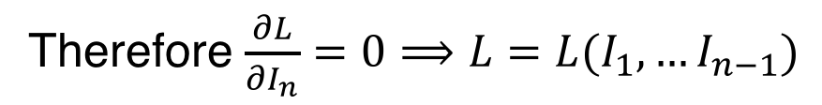
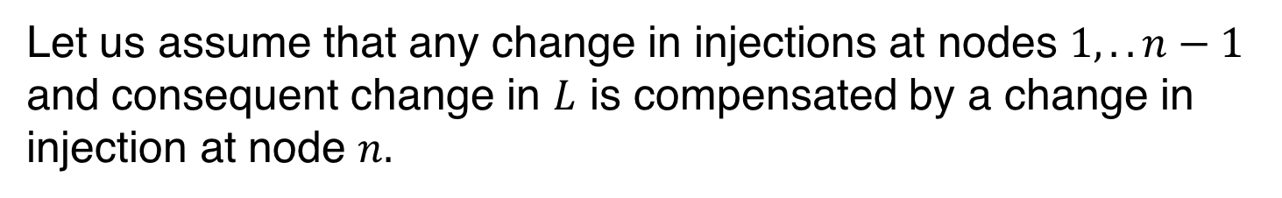
Why can we exclude the slack bus from L?
The power system is a closed system (conservation of energy)
$$dL=dI_{1}+…+dI_{n−1}+dI_{n}$$
or:
$$dI_{n}=dL−dI_{1}−…−dI_{n−1}$$
Let us assume that any change in injections at nodes $1,..n−1$
and consequent change in $L$ is compensated by a change in
injection at node $n.$
Therefore $\frac{∂L}{∂I_{n}}=0⟹L=L(I_{1}, …I_{n−1})$

Slide 88
Network of infinite capacity with losses

Slide 89
Network of infinite capacity with losses
Nodal price at bus k is related to the nodal price at the slack bus
If the injection at a bus increases the losses, the price at that node
will be less than the price at the slack bus
Penalizes the generators at that bus
Encourages consumers at that bus

Slide 90
Network of finite capacity
Limits on line flows:
(Bus n is the slack bus)

Slide 91
Network of finite capacity

Slide 92
Assume that only line i is congested
Price at all buses (except
slack bus) is affected by
the congestion on any one
line.

Slide 93
Solving this problem
As formulated, this is a non-linear optimization problem
Solution of non-linear problems is:
  Slow
  Not robust
    No convergence
    Solution may depend on the starting point
Need to linearize the problem
  Ignore losses (add them later as a correction)
  Linear expression for the flows as a function of the injections

Slide 94
Power Flow
To bus i
To bus j
Bus k
G

Slide 95
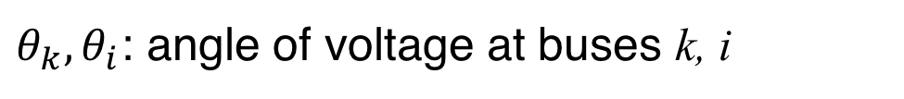
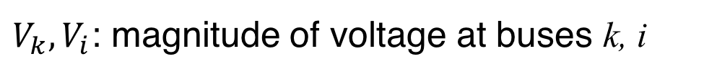
Power Flow Equations
For every node
k in the network
$V_{k},V_{i}$: magnitude of voltage at buses k, i
$θ_{k},θ_{i}$: angle of voltage at buses k, i
$G_{ki}$: Real part of element k, i of the admittance matrix
$B_{ki}$: Imaginary part of element k, i of the admittance matrix

Slide 96
Terms of the admittance matrix

Slide 97
DC Power Flow
Neglect reactive power
equations

Slide 98
DC Power Flow
Neglect resistance of
the branches

Slide 99
DC Power Flow
Assume all voltage
magnitudes = 1.0 p.u.

Slide 100


DC Power Flow
Assume all angles
are small
$$I_{i}^{}=\sum_{j=1}^{N}{y_{ij}(θ_{i}−θ_{j})}$$
Flow in line i-j:
$$F_{ij}^{}=y_{ij}(θ_{i}−θ_{j})$$

Slide 101
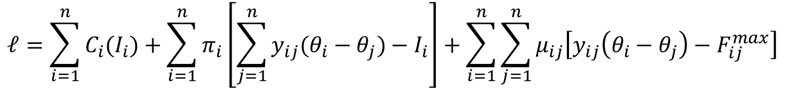
Network of finite capacity: DC model
Power balance for the
whole system
Introduce the voltage angles as variables
Line flows:
Line flow constraints:
Lagrangian function:
Power balance at each node
$$ℓ=\sum_{i=1}^{n}{C_{i}(I_{i})}+\sum_{i=1}^{n}{π_{i}\left[\sum_{j=1}^{n}{y_{ij}(θ_{i}−θ_{j})}−I_{i}\right]}+\sum_{i=1}^{n}{\sum_{j=1}^{n}{μ_{ij}\left[y_{ij}\left(θ_{i}−θ_{j}\right)−F_{ij}^{max}\right]}}$$

Slide 102
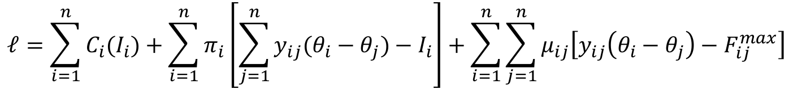
Network of finite capacity: DC model
$$ℓ=\sum_{i=1}^{n}{C_{i}(I_{i})}+\sum_{i=1}^{n}{π_{i}\left[\sum_{j=1}^{n}{y_{ij}(θ_{i}−θ_{j})}−I_{i}\right]}+\sum_{i=1}^{n}{\sum_{j=1}^{n}{μ_{ij}\left[y_{ij}\left(θ_{i}−θ_{j}\right)−F_{ij}^{max}\right]}}$$
(Slack at bus n)

Slide 103
Implementation
m binding constraints → m+1 marginal generators
  Price at these buses determined using
  m+1 known prices
  n-m-1 unknown prices
  m unknown Lagrange multipliers
Use the second optimality condition to determine these prices and shadow prices:

Slide 104
Implementation
(Slack at bus n)
K: set of buses where the price is known
U: set of buses where the price is unknown

Slide 105
Example
A
C
π₁=7.50 $/MWh
B
Congested lines
π₂ = ?
1
2
Marginal generators
at buses 1 and 3:
π₃=10.00 $/MWh
3
D
Notes:
Figure 6.24: Nodal marginal prices and flows in the three-bus system. Power in branch 2-3 flows from a higher marginal price to a lower marginal price.

Slide 106




Example
A
C
π₁=7.50 $/MWh
$$μ_{12}≠0$$
B
$$μ_{21}=0$$
π₂ = ?
1
2
$$μ_{13}=μ_{31}=0$$
$$μ_{23}=μ_{32}=0$$
π₃=10.00 $/MWh
3
D
Notes:
Figure 6.24: Nodal marginal prices and flows in the three-bus system. Power in branch 2-3 flows from a higher marginal price to a lower marginal price.

Slide 107
Example
Choose bus 3 as the slack bus

Slide 108
Example

Slide 109


Example
$π_{1}$=7.50 $/MWh
$π_{3}$=10.00 $/MWh

Slide 110
Interpretation of Lagrange multipliers
Marginal cost of the constraint on line i-j

Slide 111
AC Modeling
DC power flow:
  Only models the flows of active power
  Does not model the voltage magnitudes
  Ignores constraints on voltage magnitudes
  Considers only the active power injections
Because of these inaccuracies, operators impose conservative limits on line flows
Hinders market efficiency
However, full AC modeling is not yet feasible
Reliably clearing the market is more important than economic efficiency

Slide 112
Financial Transmission Rights

Slide 113
Managing transmission risks
Congestion and losses affect nodal prices
Additional source of uncertainty and risk
Market participants seek ways of avoiding risks
Need financial instruments to deal with nodal price risk

Slide 114
Contracts for difference
Centralized market
  Producers must sell at their nodal price
  Consumers must buy at their nodal price
Producers and consumers are allowed to enter into bilateral financial contracts
  Contracts for difference

Slide 115
Example of contract for difference
Borduria
Syldavia
Syldavia Steel
400 MW
400 MW
Borduria Power
Contract between Borduria Power and Syldavia Steel
  Quantity: 400 MW
  Strike price: 30 $/MWh
Other participants also trade across the interconnection

Slide 116
No congestion → market price is uniform
Borduria
Syldavia
Syldavia Steel
400 MW
400 MW
Borduria Power
π_{B} = 24.30 $/MWh
π_{S} = 24.30 $/MWh
Borduria Power sells 400 at 24.30 → gets $9,720
Syldavia Steel buys 400 at 24.30 →pays $9,720
Syldavia Steel pays 400 (30 - 24.30) = $2,280 to Borduria Power
Syldavia Steel net cost is $12,000
Borduria power net revenue is $12,000
They have effectively traded 400 MW at 30 $/MWh$

Slide 117
Congestion → Locational price differences
Borduria
Syldavia
Syldavia Steel
400 MW
400 MW
Borduria Power
π_{B} = 19 $/MWh
π_{S} = 35 $/MWh
Borduria Power sells 400 at 19.00 → gets $7,600
Syldavia Steel buys 400 at 35.00 → pays $14,000
Borduria Power expects 400 (30 -19) = $4,400 from Syldavia Steel
Syldavia Steel expects 400 (35 -30) = $2,000 from Borduria Power
Shortfall of $6,400
Basic contracts for difference break down with nodal pricing!

Slide 118
Financial Transmission Rights (FTR)
Observations:
  Shortfall in contracts for difference is equal to congestion surplus
  Congestion surplus is collected by the system operator
Concept:
  System operator sells financial transmission rights to users
  FTR contract for F MW between Borduria and Syldavia entitles the owner to receive:
  Holders of FTRs are indifferent about where they trade energy
  System operator collects exactly enough money in congestion surplus to cover the payments to holders of FTRs

Slide 119
Example of Financial Transmission Rights
Borduria
Syldavia
Syldavia Steel
400 MW
400 MW
Borduria Power
Contract between Borduria Power and Syldavia Steel
  Quantity: 400 MW
  For delivery in Syldavia (i.e. at the nodal price in Syldavia)
  Strike price: 30 $/MWh
To cover itself against location price risk, Borduria Power purchases 400 MW of financial transmission rights from the System Operator

Slide 120
Example of Financial Transmission Rights
Borduria
Syldavia
Syldavia Steel
400 MW
400 MW
Borduria Power
400 MW
π_{B} = 19 $/MWh
π_{S} = 35 $/MWh
Borduria Power sells 400 at 19.00 → gets $7,600
Syldavia Steel buys 400 at 35.00 → pays $14,000
The system operator collects 400 (35 -19) = $ 6,400 in congestion surplus
Borduria Power collects 400 (35 -19) = $6,400 from the system operator
Borduria Power pays Syldavia Steel 400 (35 -30) = $2,000
Syldavia Steel net cost is $12,000
Borduria power net revenue is $12,000
The books balance!

Slide 121
Financial transmission rights (FTR)
FTRs provide a perfect hedge against variations in nodal prices
Auction transmission rights for the maximum transmission capacity of the network
  The system operator cannot sell more transmission rights than the amount of power that it can deliver
  If it does, it will lose money!
  System Operator has no incentive to increase congestion
Proceeds of the auction help cover the investment costs of the transmission network
Users of FTRs must estimate the value of the rights they buy at auction

Slide 122
Financial transmission rights
FTRs are defined from point-to-point
No need for a direct branch connecting directly the points between which the FTRs are defined
Market participants do not need to be concerned about how the power flows from one location to another
  That’s the system operator’s job
FTRs automatically factor in the effect of Kirchoff’s voltage law

Slide 123
Another example of FTRs
A
50 MW
C
π₁=7.50 $/MWh
0 MW
B
285 MW
π₂=11.25 $/MWh
126 MW
1
2
159 MW
66 MW
50 MW
60 MW
Consumer at bus 3:
CFD with generator at bus 1
  100 MW at 8$/MWh
  Reference price: node 1
Purchased FTR for 100 MW
from node 1 to node 3
π₃=10.00 $/MWh
3
75 MW
D
300 MW
Notes:
Figure 6.24: Nodal marginal prices and flows in the three-bus system. Power in branch 2-3 flows from a higher marginal price to a lower marginal price.

Slide 124
Settlement
Consumer pays 100 MW x 10.00 $/MWh = $1,000 for extracting 100 MW at bus 3.
Generator collects 100 MW x 7.50 $/MWh = $750 for injecting 100 MW at bus 1.
Consumer pays 100 x (8.00 –7.50) = $50 to the generator to settle the contract for difference.
Consumer collects 100 x (10.00 –7.50) = $250 from the system operator for the FTRs
Consumer effectively pays $800 for 100 MW, which is equivalent to a price of 8.00 $/MWh.

Slide 125
Simultaneous feasibility
The system operator should not sell more FTRs than the transmission network can physically handle
The set of FTRs that it sells must meet the “simultaneous feasibility test”
  If flows corresponding to these FTRs are actually implemented, the system operating limits should be respected.
If this test is not satisfied, the system operator will not collect enough congestion surplus to cover its FTR obligations

Slide 126
Transmission constrained dispatch
A
50 MW
C
0 MW
B
285 MW
126 MW
1
2
159 MW
66 MW
50 MW
60 MW
This dispatch is feasible and
uses the maximum
transmission capacity
3
75 MW
D
300 MW

Slide 127
Maximum net feasible injections
285 MW
60 MW
1
2
3
225 MW

Slide 128
Feasible FTR combination A
60MW
285 MW
60 MW
225 MW
1
2
3
225 MW

Slide 129
Feasible FTR combination B
285 MW
60 MW
285 MW
1
2
60MW
3
225 MW

Slide 130
Feasible FTR combination C
10MW
285 MW
60 MW
275 MW
1
2
50MW
3
225 MW

Slide 131
Settlement with these FTR combinations
 | Transmission rights |  |  | Settlement
Combination | From bus | To bus | Amount [MW] | From bus price [$/MWh] | To bus price [$/MWh] | Revenue [$] | Total [$]
A | 1 | 3 | 225 | 7.50 | 10.00 | 562.50 | 787.50
 | 1 | 2 | 60 | 7.50 | 11.25 | 225.00
B | 1 | 3 | 285 | 7.50 | 10.00 | 712.50 | 787.50
 | 3 | 2 | 60 | 10.00 | 11.25 | 75.00
C | 1 | 3 | 275 | 7.50 | 10.00 | 687.50 | 787.50
 | 1 | 2 | 10 | 7.50 | 11.25 | 37.50
 | 3 | 2 | 50 | 10.00 | 11.25 | 62.50
These are settlements for financial contracts, not the physical injections
These combinations of FTRs use all the available transmission capacity

Slide 132
Congestion surplus
_{(= congestion surplus)}
Equal to the total value of the FTRs

Slide 133
Sensitivity to flow limits
A
50 MW
C
π₁=7.50 $/MWh
0 MW
B
285 MW
π₂=11.25 $/MWh
126 MW
1
2
159 MW
66 MW
50 MW
60 MW
π₃=10.00 $/MWh
3
75 MW
D
300 MW
Notes:
Figure 6.24: Nodal marginal prices and flows in the three-bus system. Power in branch 2-3 flows from a higher marginal price to a lower marginal price.

Slide 134
Reduced limit on line 2-3
A
47.5 MW
C
π₁=7.50 $/MWh
0 MW
B
285 MW
Π₂= 5.00 $/MWh
125 MW
1
2
157.5 MW
65 MW
50 MW
60 MW
π₃=10.00 $/MWh
3
77.5 MW
D
300 MW
Notes:
Figure 6.24: Nodal marginal prices and flows in the three-bus system. Power in branch 2-3 flows from a higher marginal price to a lower marginal price.

Slide 135
Value of FTRs
 | Transmission rights |  |  | Settlement
Combination | From bus | To bus | Amount [MW] | From bus price [$/MWh] | To bus price [$/MWh] | Revenue [$] | Total [$]
A | 1 | 3 | 225 | 7.50 | 10.00 | 562.50 | 412.50
 | 1 | 2 | 60 | 7.50 | 5.00 | -150.00
B | 1 | 3 | 285 | 7.50 | 10.00 | 712.50 | 412.50
 | 3 | 2 | 60 | 10.00 | 5.00 | -300.00
C | 1 | 3 | 275 | 7.50 | 10.00 | 687.50 | 412.50
 | 1 | 2 | 10 | 7.50 | 5.00 | -25.00
 | 3 | 2 | 50 | 10.00 | 5.00 | -250.00

Slide 136
Observations
Price at bus 2 is lower than prices at bus 1 and 3 because increasing the load at bus 2 would reduce the cost of congestion
Some of the FTRs have a negative value
This means that the owners of these FTRs have to pay the system operator!

Slide 137
Another FTR example
A
47.5 MW
C
π₁=7.50 $/MWh
0 MW
B
285 MW
Π₂= 5.00 $/MWh
125 MW
1
2
157.5 MW
65 MW
50 MW
60 MW
Consumer at bus 2:
CFD with generator at bus 1
  60 MW at 8$/MWh
  Reference price: node 1
Purchased FTR for 60 MW
from node 1 to node 2
π₃=10.00 $/MWh
3
77.5 MW
D
300 MW
Notes:
Figure 6.24: Nodal marginal prices and flows in the three-bus system. Power in branch 2-3 flows from a higher marginal price to a lower marginal price.

Slide 138
Settlement
Consumer pays 60 MW x 5.00 $/MWh= $300
Generator collects 60 MW x 7.50 $/MWh = $450
Consumer pays 60 x (8.00 –7.50) = $30 to the generator to settle the contract for difference.
Consumer pays 60 x (7.50 – 5.00) = $150 to the system operator for the FTRs
Consumer thus pays a total of $480, which is equivalent to the 8.00 $/MWh strike price in its contract for difference.

Slide 139
Congestion surplus
 | Bus 1 | Bus 2 | Bus 3
Load | 50 | 60 | 300
Generation | 332.5 | 0 | 77.5
Price | 7.50 | 5.00 | 10.00
$ to generators | 2,493.75 | 0 | 775 | 3268.75
$ from loads | 375 | 300 | 3000 | 3675
Net $ | -2118.75 | 300 | 2225 | $406.25
Less than the $412.50 total value of the FTRs
Why?
Because the system operator was not able to deliver the full
transmission capacity that it assumed when it sold the FTRs

Slide 140
Problems with financial transmission rights
There are many possible point-to-point transmission rights
Difficult to assess the value of all possible rights
Difficult to set up a market for point-to-point transmission rights

Slide 141
Flowgate rights (FGRs)
Observation:
  Typically, only a small number of branches are congested
Concept:
  Buy transmission rights only on those lines that are congested
  Theoretically equivalent to point-to-point rights
Advantage:
  Fewer rights need to be traded
  More liquid market
Difficulty:
  Identify the branches that are likely to be congested

Slide 142
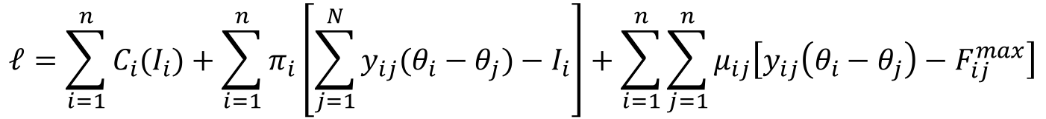
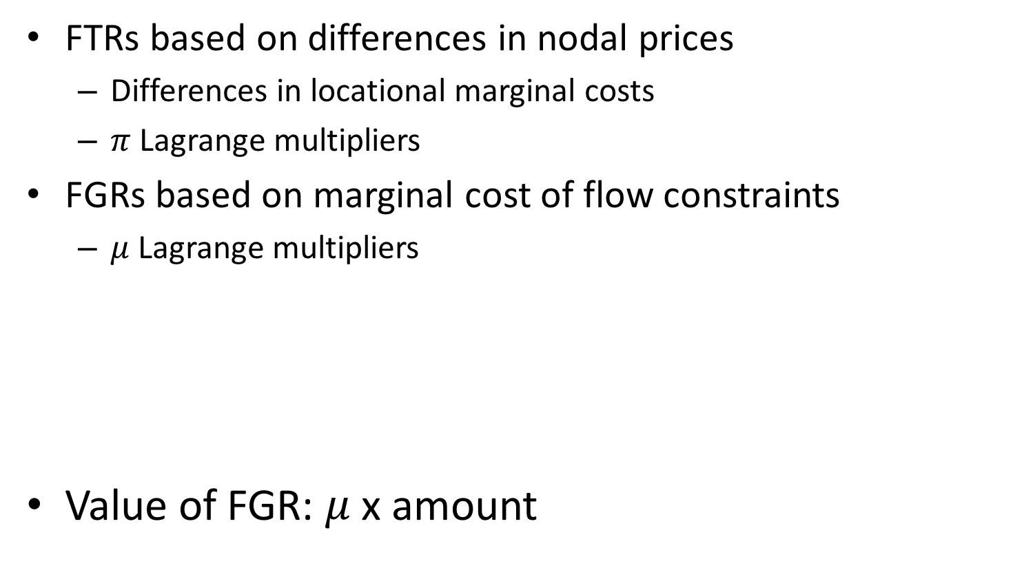
Flowgate rights
FTRs based on differences in nodal prices
  Differences in locational marginal costs
  $π$ Lagrange multipliers
FGRs based on marginal cost of flow constraints
  $μ$ Lagrange multipliers
Value of FGR: $μ$ x amount
$$ℓ=\sum_{i=1}^{n}{C_{i}(I_{i})}+\sum_{i=1}^{n}{π_{i}\left[\sum_{j=1}^{N}{y_{ij}(θ_{i}−θ_{j})}−I_{i}\right]}+\sum_{i=1}^{n}{\sum_{j=1}^{n}{μ_{ij}\left[y_{ij}\left(θ_{i}−θ_{j}\right)−F_{ij}^{max}\right]}}$$

Slide 143
FTRs vs. FGRs
Fewer potentially congested lines than point-to-point combinations of FTRs
More liquid market for FGRs than FTRs
Hard to predict the value of point-to-point FTRs
Hard to predict when a particular line will be congested
Must understand operation of the network when dealing with FGRs

