Slide 1
Organization of Electricity Markets
Daniel Kirschen

Slide 2
Differences between electricity and other commodities
Electricity is inextricably linked with a physical delivery system
  Physical delivery system operates much faster than any market
  Generation and load must be balanced at all times
  Failure to balance leads to collapse of system
  Economic consequences of collapse are enormous
  Balance must be maintained at almost any cost
  Physical balance cannot be left to a market

Slide 3
Differences between electricity and other commodities
Electricity produced by different generators is pooled
  Generator cannot direct its production to some consumers
  Consumer cannot choose which generator produces the energy it consumes
  Electrical energy produced by all generators is indistinguishable
Pooling is economically desirable
A breakdown of the system affects everybody

Slide 4
Differences between electricity and other commodities
Demand for electricity exhibits predictable daily, weekly and seasonal variations
  Similar to other commodities (e.g. coffee)
Electricity cannot be stored in large quantities
  Must be consumed when it is produced
Production facilities must be able to meet peak demand
Very low price elasticity of the demand in the short run
  Demand curve is almost vertical

Slide 5
Trading periods
How long should they be?
Forward markets
Spot market

Slide 6
Spot market for electrical energy
Demand side:
  Errors in load forecast
Supply side:
  Unpredicted generator outages
Gaps between load and generation must be filled quickly
Market mechanism: spot market
  Too slow
  Too expensive
    Need fast communication
    Need to reach lots of participants

Slide 7
Forward markets
Two approaches:
  Decentralized or bilateral trading
  Centralized trading (also known as “Pool Trading”)

Slide 8
Decentralized or bilateral trading
Bilateral trading is the classical form of trading
Involves only two parties:
  Seller
  Buyer
Trading is a private arrangement between these parties
Price and quantity negotiated directly between these parties
Nobody else is involved in the decision
Standard European approach to electricity markets

Slide 9
Bilateral trading
Unlike centralized trading, there is no “official price”
Occasionally facilitated by brokers or electronic market operators
Takes different forms depending on the time scale

Slide 10
Types of bilateral trading
Customized long-term contracts
  Flexible terms
  Negotiated between the parties
  Duration of several months to several years
  Advantage:
    Guarantees a fixed price over a long period
  Disadvantages:
    Cost of negotiations is high
  Worthwhile only for large amounts of energy

Slide 11
Types of bilateral trading
“Over the Counter” trading
  Smaller amounts of energy
  Delivery according to standardized profiles
  Advantage:
    Much lower transaction cost
  Used to refine position as delivery time approaches

Slide 12
Types of bilateral trading
Electronic trading
  Buyers and sellers enter bids directly into computerized marketplace
  All participants can observe the prices and quantities offered
  Automatic matching of bids and offers
  Participants remain anonymous
  Market organizer handles the settlement
  Advantages:
    Very fast
    Very cheap
    Good source of information about the market

Slide 13
Example of bilateral trading
Generating units owned by Borduria Power:

Slide 14
Example of bilateral trading
Trades of Borduria Power for 11 June from 2:00 pm till 3:00 pm
Net position: Sold 570 MW
Production capacity: 750 MW

Slide 15
Example of bilateral trading
Pending offers and bids on Borduria Power Exchange at mid-morning on 11 June for the period from 2:00 till 3:00 pm:

Slide 16
Example of bilateral trading
Electronic trades made by Borduria Power:
Net position: Sold 630 MW
Self schedule: Unit A: 500 MW
Unit B: 130 MW
Unit C: 0 MW

Slide 17
Example of bilateral trading
Unexpected problem: unit B can only generate 80 MW
Options: - Do nothing and pay the spot price for the missing energy
- Make up the deficit with unit C
- Trade on the power exchange
Buying is cheaper than producing with C
New net position: Sold 580 MW
New schedule: A: 500 MW, B: 80 MW, C: 0 MW

Slide 18
Centralized trading
All producers submit bids
All consumers submit offers
Market operator determines successful bids and offers and the market price
In many electricity markets, the demand side is passive. A forecast of demand is used instead.
Standard North American electricity market mechanism

Slide 19
Example of centralized trading
Bids and offers in the Electricity Pool of Syldavia for the period from 9:00 till 10:00 on 11 June:

Slide 20
Example of centralized trading

Slide 21
Example of centralized trading
Accepted offers
Market price
Accepted bids
Quantity traded

Slide 22
Example of centralized trading
Market price: 16.00 $/MWh
Volume traded: 450 MWh

Slide 23
Day-ahead centralized trading
In the previous example, each trading period was cleared separately
Reasons for not doing that:
  Operating constraints on generating units
    Minimum up and down times, ramp rates
  Savings achieved through scheduling
    Start-up and no-load costs
  Reduce risk for generators
    Uncertainty on generation schedule leads to higher prices

Slide 24
Centralized trading using Unit Commitment
Minimum
Cost
Schedule
Load
Forecast
Unit
Commitment
Program
Generators
Bids
Market
Prices

Slide 25
Generator Bids
All units are bid separately
Components:
  piecewise linear marginal price curve
  start-up price
  parameters (min MW, max MW, min up, min down,...)
Bids do not have to reflect costs
Bidding very low to “get in the schedule” is allowed

Slide 26
Load Forecast
Load is usually treated as a passive market participant
Assume that there is no demand response to prices
MW
Time

Slide 27
Generation Schedule
MW
Time

Slide 28
Marginal Units
Most expensive unit needed to meet the load at each period
MW
Time

Slide 29
Market price
Bid from marginal unit sets the market clearing price at each period
System Marginal Price (SMP)
All energy traded through the pool during that period is bought and sold at that price
MW
Time

Slide 30
Why trade all energy at the SMP?
Why not pay the generators what they bid?
  Cheaper generators would not want to “leave money on the table”
  Would try to guess the SMP and bid close to it
  Occasional mistakes → get left out of the schedule
  Increased uncertainty → increase in price

Slide 31
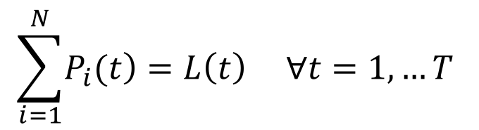
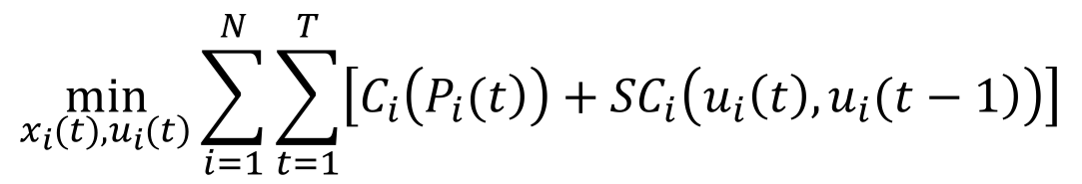
Formulation as an optimization problem
Objective function:
$$\min_{\left.x_{i}(t),u_{i}(t\right)}{\sum_{i=1}^{N}{\sum_{t=1}^{T}{\left[C_{i}\left(\left.P_{i}(t\right)\right)+{SC}_{i}\left(\left.u_{i}\left(t\right),u_{i}(t−1\right)\right)\right]}}}$$
Load generation balance constraint:
$$\sum_{i=1}^{N}{\left.P_{i}(t\right)}=L\left(t\right) ∀t=1,…T$$

Slide 32
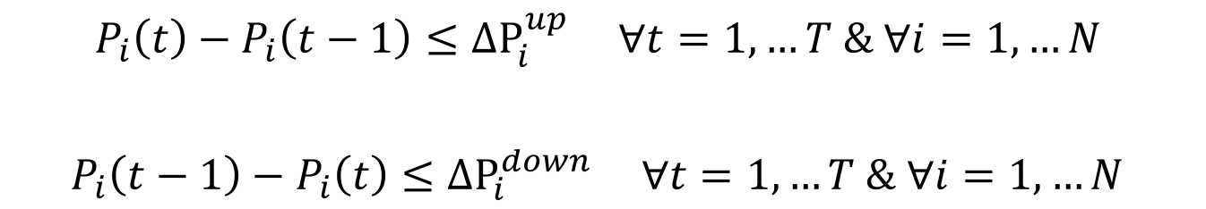
Formulation as an optimization problem
Generation limits:
$$P_{i}^{min}≤P_{i}\left(t\right)≤P_{i}^{max} ∀t=1,…T \& ∀i=1,…N$$
Ramp rate limits:
$$P_{i}\left(t\right)−P_{i}\left(t−1\right)≤{ΔP}_{i}^{up} ∀t=1,…T \& ∀i=1,…N$$
$P_{i}\left(t−1\right)−P_{i}\left(t\right)≤{ΔP}_{i}^{down} ∀t=1,…T \& ∀i=1,…N$

Slide 33
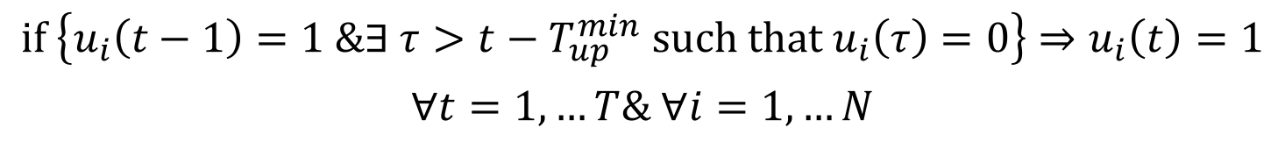
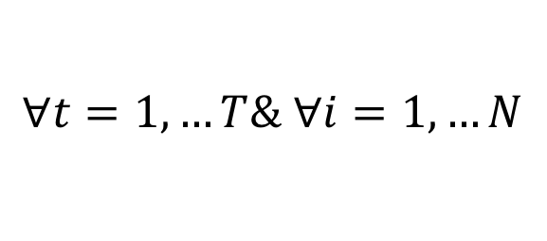
Formulation as an optimization problem
Minimum up time constraints
$$\text{if} \left\{u_{i}\left(t−1\right)=1 \&∃ τ>t−T_{up}^{min} \text{such} \text{that} u_{i}\left(τ\right)=0\right\}⇒u_{i}\left(t\right)=1$$
$$∀t=1,…T\& ∀i=1,…N$$
Minimum down time constraints
$$\text{if} \{u_{i}\left(t−1\right)=0 \& ∃ τ>t−T_{down}^{min} \text{such} \text{that} u_{i}\left(τ\right)=1\}⇒u_{i}\left(t\right)=0$$
$$∀t=1,…T\& ∀i=1,…N$$

Slide 34
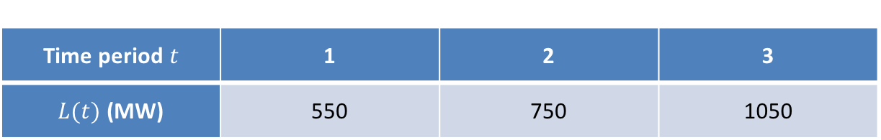
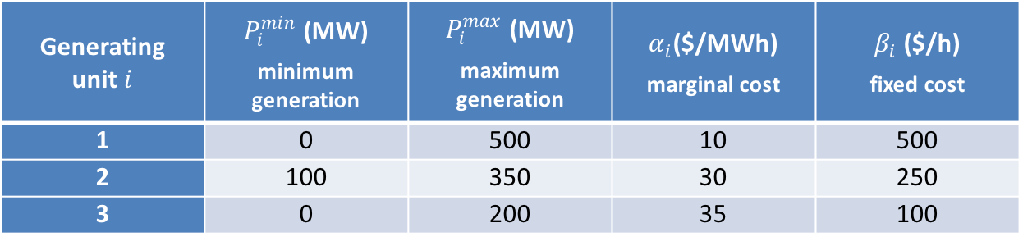
Example 3.3
Generating unit$i$ | $P_{i}^{min}$ (MW) minimum generation | $P_{i}^{max}$ (MW) maximum generation | $α_{i}$($/MWh) marginal cost | $β_{i}$ ($/h) fixed cost
1 | 0 | 500 | 10 | 500
2 | 100 | 350 | 30 | 250
3 | 0 | 200 | 35 | 100
Time period$t$ | 1 | 2 | 3
$L(t)$ (MW) | 550 | 750 | 1050

Slide 35
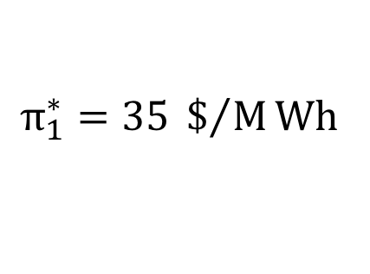
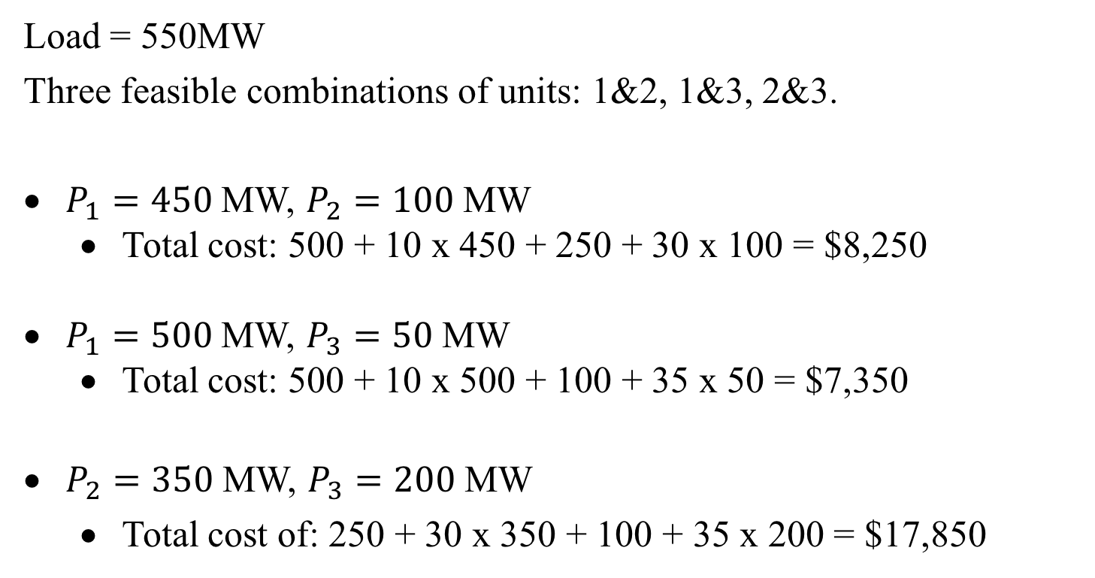
Example 3.3: Period 1
Load = 550MW
Three feasible combinations of units: 1&2, 1&3, 2&3.
$P_{1}=450$ MW, $P_{2}=100$ MW
  Total cost: 500 + 10 x 450 + 250 + 30 x 100 = $8,250
$P_{1}=500$ MW, $P_{3}=50$ MW
  Total cost: 500 + 10 x 500 + 100 + 35 x 50 = $7,350
$P_{2}=350$ MW, $P_{3}=200$ MW
  Total cost of: 250 + 30 x 350 + 100 + 35 x 200 = $17,850
$$π_{1}^{∗}=35 \$/MWh$$

Slide 36
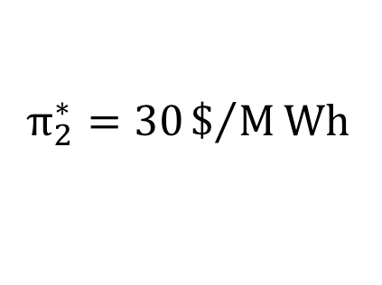
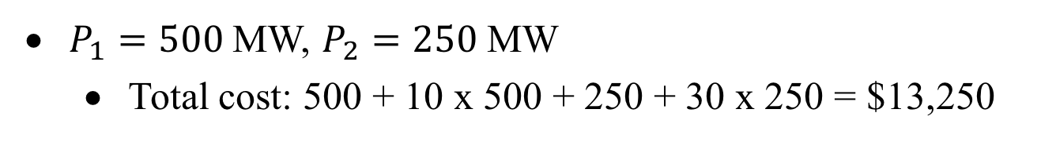
Example 3.3: Period 2
Load = 750MW
$P_{1}=500$ MW, $P_{2}=250$ MW
  Total cost: 500 + 10 x 500 + 250 + 30 x 250 = $13,250
$$π_{2}^{∗}=30\$/MWh$$

Slide 37
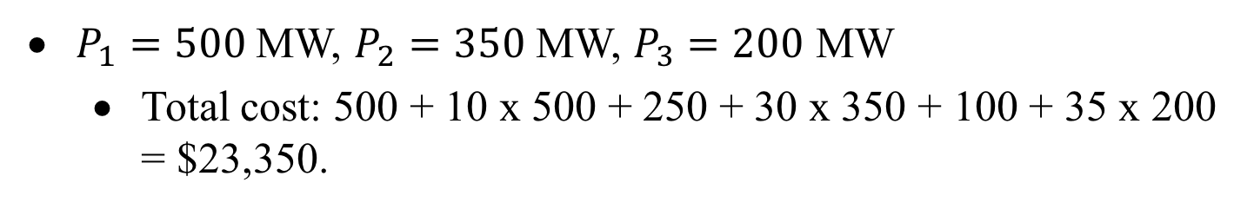
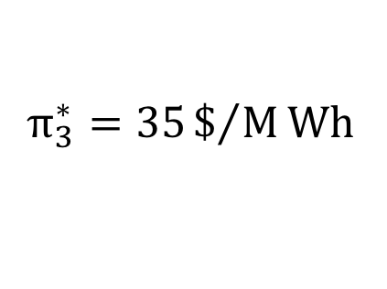
Example 3.3: Period 3
Load = 1050MW
$P_{1}=500$ MW, $P_{2}=350$ MW, $P_{3}=200$ MW
  Total cost: 500 + 10 x 500 + 250 + 30 x 350 + 100 + 35 x 200 = $23,350.
$$π_{3}^{∗}=35\$/MWh$$

Slide 38
Recovering the fixed costs
Period | Price $/MWh |  | Unit 1 | Unit 2 | Unit 3
1 | 35 | Output (MWh) | 500 | 0 | 50
 |  | Revenue ($) | 17500 | 0 | 1750
 |  | Cost ($) | 5500 | 0 | 1850
 |  | Profit ($) | 12000 | 0 | -100
2 | 30 | Output (MWh) | 500 | 250 | 0
 |  | Revenue ($) | 15000 | 7500 | 0
 |  | Cost ($) | 5500 | 7750 | 0
 |  | Profit ($) | 9500 | -250 | 0
3 | 35 | Output (MWh) | 500 | 350 | 200
 |  | Revenue ($) | 17500 | 12250 | 7000
 |  | Cost ($) | 5500 | 10750 | 7100
 |  | Profit ($) | 12000 | 1500 | -100

Slide 39
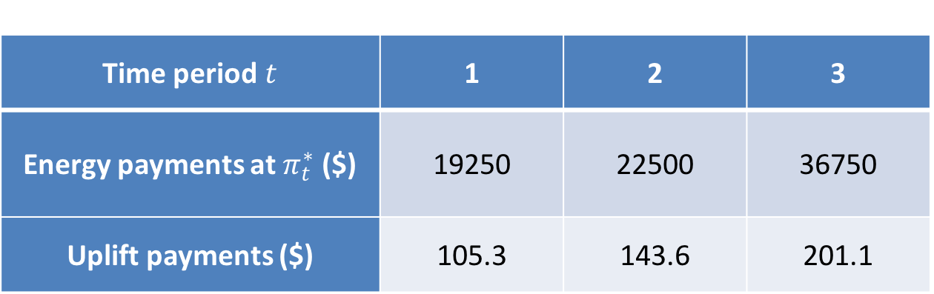
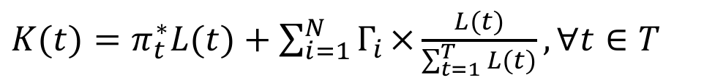
Uplift payments
$K(t)=π_{t}^{∗}L(t)+\sum_{i=1}^{N}{Γ_{i}}×\frac{L(t)}{\sum_{t=1}^{T}{L(t)}}, ∀t∈T$
Time period$t$ | 1 | 2 | 3
Energy payments at $π_{t}^{∗}$ ($) | 19250 | 22500 | 36750
Uplift payments ($) | 105.3 | 143.6 | 201.1

Slide 40
Centralized vs. bilateral trading
Centralized
  Economically unusual because administered centrally
  Price not transparent
  Facilitates security function
  Makes possible central optimization
  Historical origins in electricity industry
  Mostly US
  Except Pacific Northwest
Bilateral
  Economically purer
  Price set by the parties
  Hard bargaining possible
  Generator assume scheduling risk
  Must be coordinated with security function
  Mostly Europe
Both forms of trading can coexist: financial contracts

Slide 41

Spot market
Generation
surplus
Generation
deficit
Load
surplus
Load
deficit
System operator
Managed Spot Market
Control
actions
Spot
price
Bids to
increase
production
Bids to
increase
load
Bids to
decrease
production
Bids to
decrease
load

Slide 42
“Managed” spot market
Balance load and generation
Run by the system operator
Maintains the operational reliabilty of the system
Must operate on a sound economic basis
  Use competitive bids for generation adjustments
  Determine a cost-reflective spot price
Not a true market because price is not set through interactions of buyers and sellers
Indispensable for treating electricity as a commodity
Well-functioning spot market is essential
  Ensures that imbalances will be settled properly
Makes the development of other markets possible

Slide 43
Bidding in the spot market
Borduria Power’s position:
Borduria Power’s spot market bids:
Spot market assumed imperfectly competitive
Bids/offers can be higher/lower than marginal cost

Slide 44
Settlement process
Centralized trading:
  Market operator collects from consumers
  Market operator pays producers
  All energy traded at the market price for each trading period
Bilateral trading:
  Bilateral trades settled directly by the parties as if they had been performed exactly
Managed spot market:
  Produced more or consumed less → receive spot price
  Produced less or consumed more → pay spot price

Slide 45
Example of settlement
11 June between 2:00 pm and 3:00 pm
Spot price: 18.25 $/MWh
Unit B of Borduria Power could produce only 10 MWh instead of 80 MWh
Borduria Power thus had a deficit of 70 MWh for this hour
40 MW of Borduria Power’s spot market bid of 50 MW at 17.50 $/MWh was called by the operator

Slide 46
Borduria Power’s Settlement

