Slide 1

Modeling and Mitigating RF Vulnerabilities of Cellular Networks
for UAS Communication
Bob Iannucci, Ph.D.
Director, CyLab Mobility Research Center
Distinguished Service Professor, ECE
Ervin Teng
Ph.D. student, ECE
June, 2016

Slide 2
Network for a Cyber-Physical World
Network-as-participant
“Near-to-Near” (vs. peer-to-peer)
Today: latency too high
Future: embed virtualized,
movable, real-time
computing capability in the network
Cloud has unlimited
Computing
Storage
Energy
Space
Cyber-physically enabled future network: Automated marshaling of computing
Compute
Sense-Compute-Actuate
Latency
Phone, sensor, actuator layer: devices have limited
Computing
Storage
Energy
Space
Sense
Actuate
Physical World

Slide 3
Open, Programmable Wireless Network:
How do we get there?
Open instead of closed
Practical barrier: existing networks are closed and are resistant to study
Approach: telecom wireless network evolution has followed a somewhat different path than the evolution of the internet
Reality: current architecture evolved from circuit switching and assumption of wired last mile
  Characteristics of packet wireless are fundamentally different
  Architecture did not anticipate apps
Suggests need for cross-layer approach

Slide 4
Clean-Sheet Design
If we knew then what we know now…
CROSSMobile Challenge: create and study an idealized
open, programmable wireless network
... at interesting scale
Architecture
Compositional structure
  Dynamic trust
  Combined network + cloud
RAN-agnostic
  LTE, WiFi / IMS, LoRa, ...
  But RF-aware, power-aware
Applications
Emergency preparedness
  Rapid deployment
Smart cities
Air ←→ ground (drones)

Slide 5
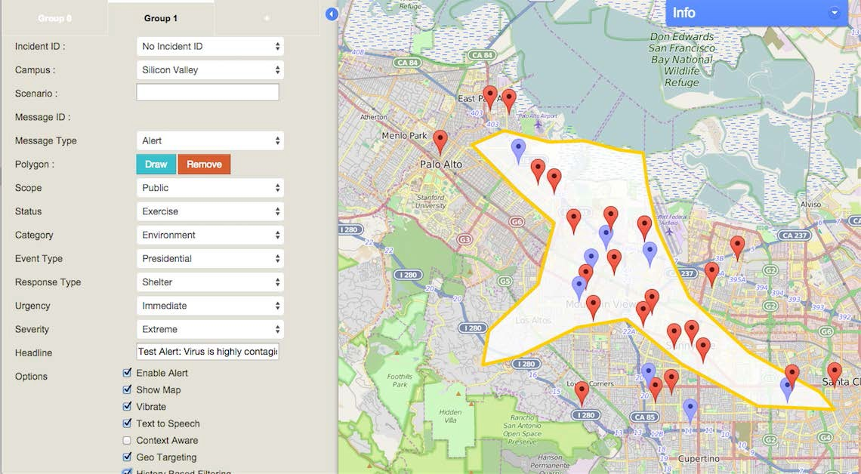
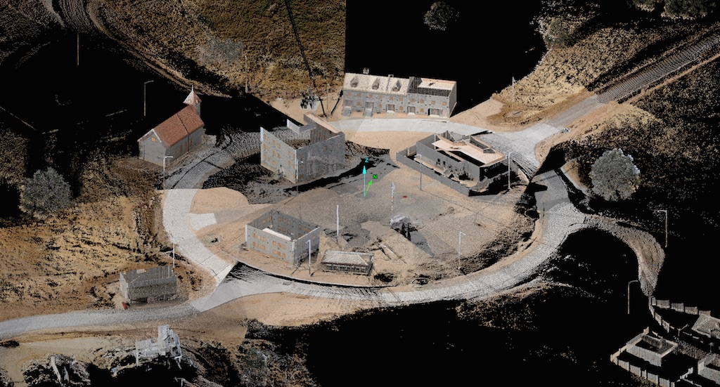
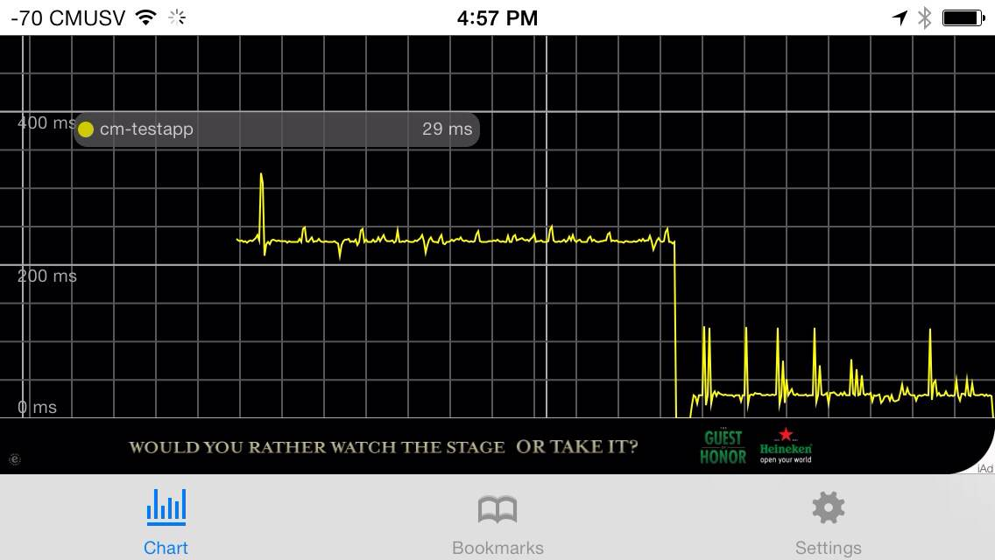
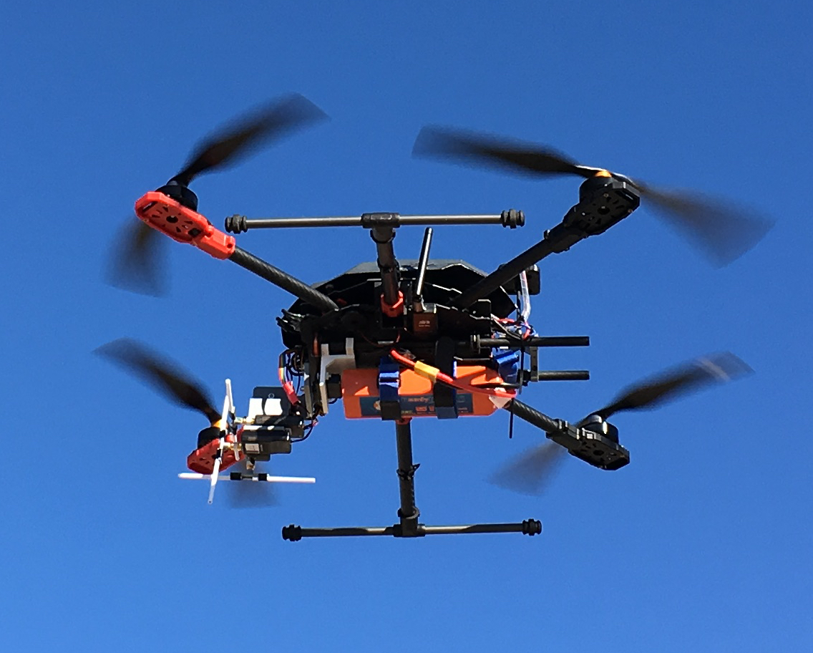
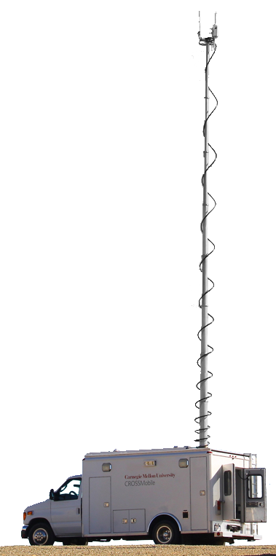
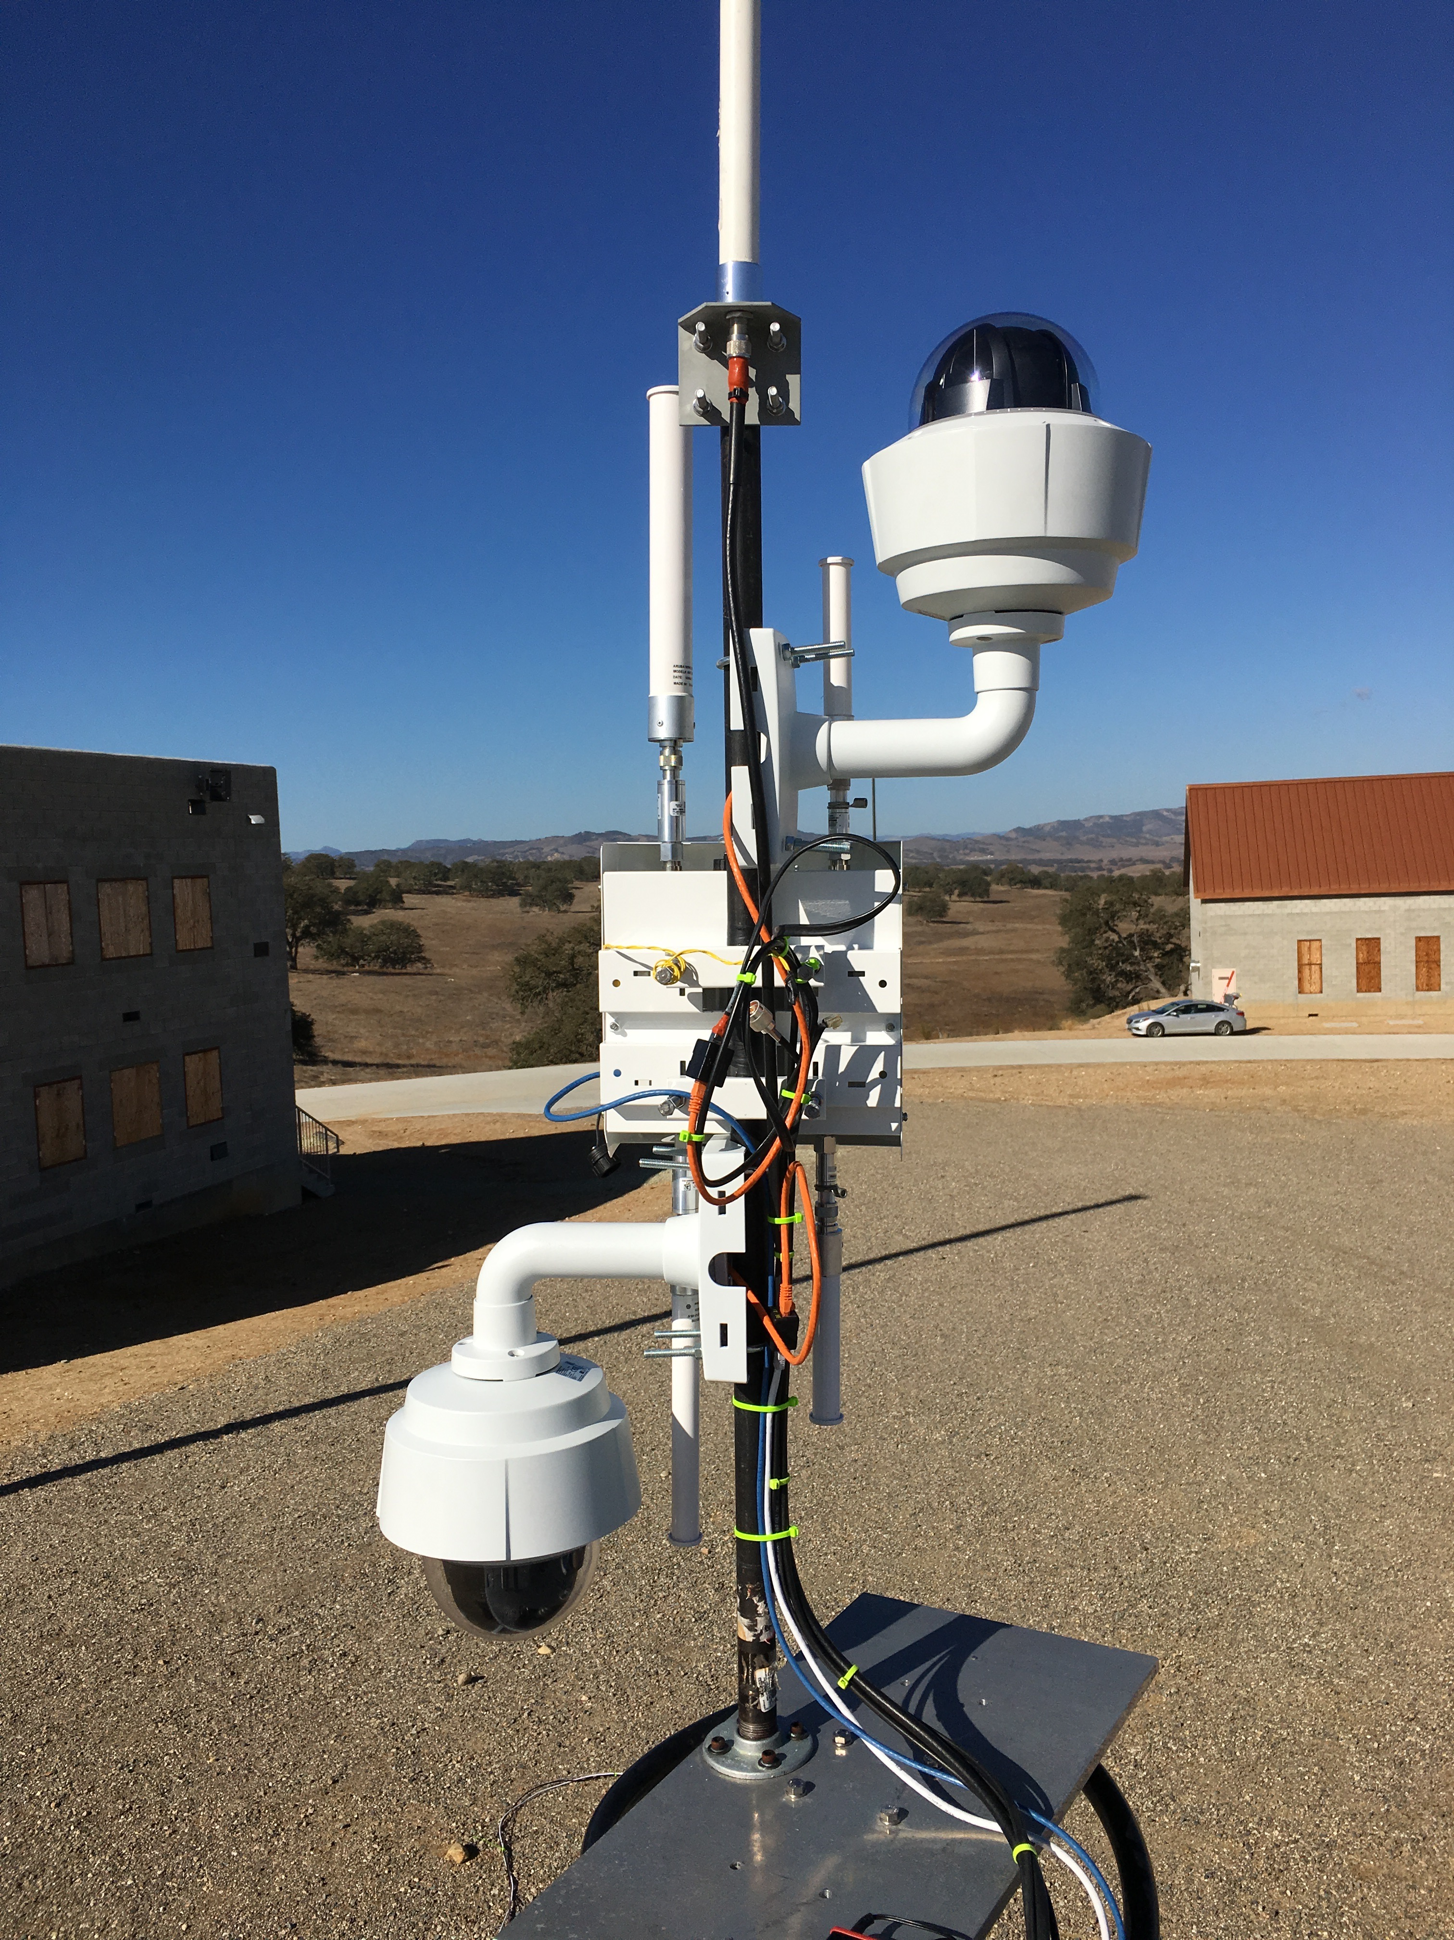
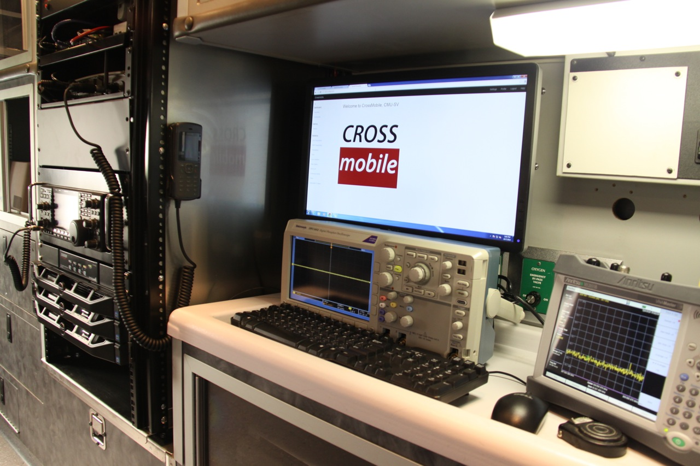
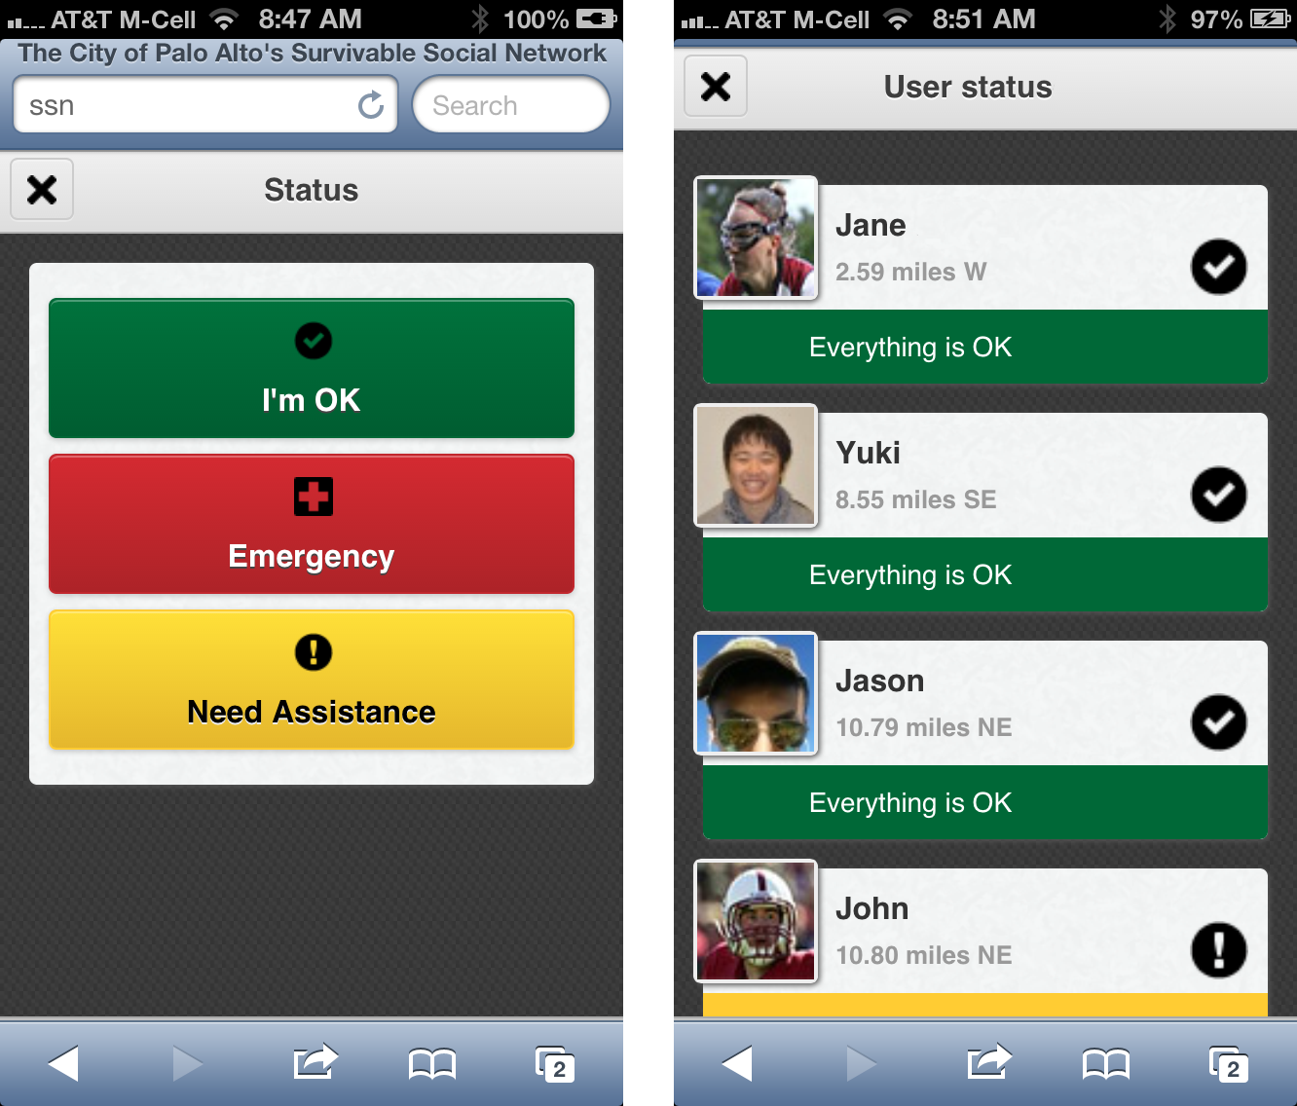
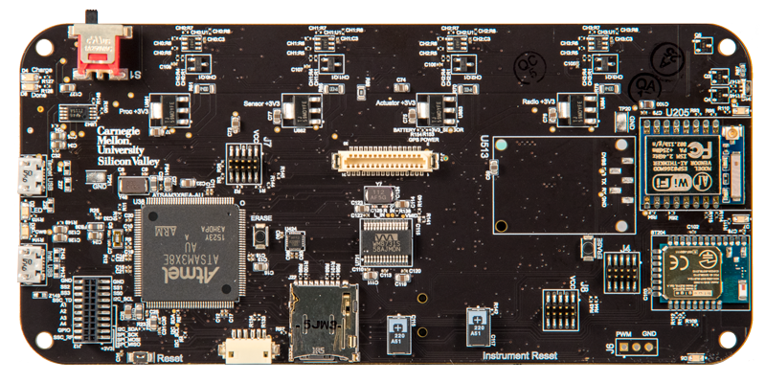
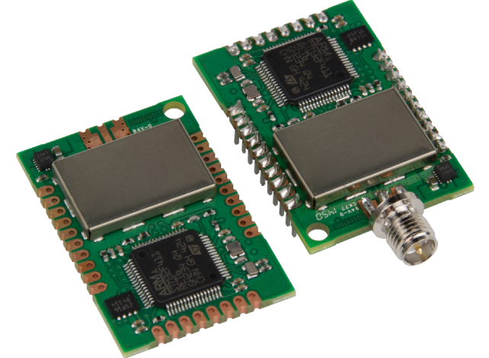
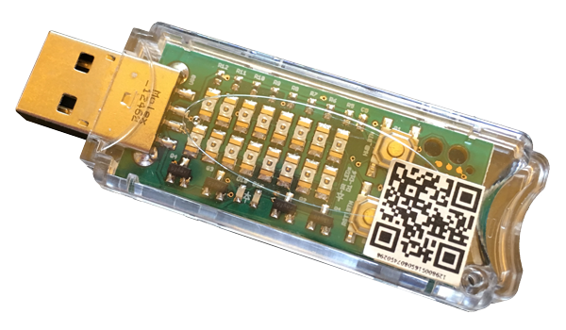
The CROSSMobile Project Today
Wireless Emergency
Alerts
In-situ measurements
and physics-based modeling
of environments
UAS + Cellular:
“Holes in the Sky”
Adaptation and Cooperation
Crowdsourced
Smart Cities™
The CROSSMobile™ Testbed
(GSM, LTE under
experimental license)
The Mobile Node
IoT: Low Power
Computing & Comms
Survivable Social Network
Indoor Positioning

Slide 6
Drones and the cyberphysical network

Slide 7
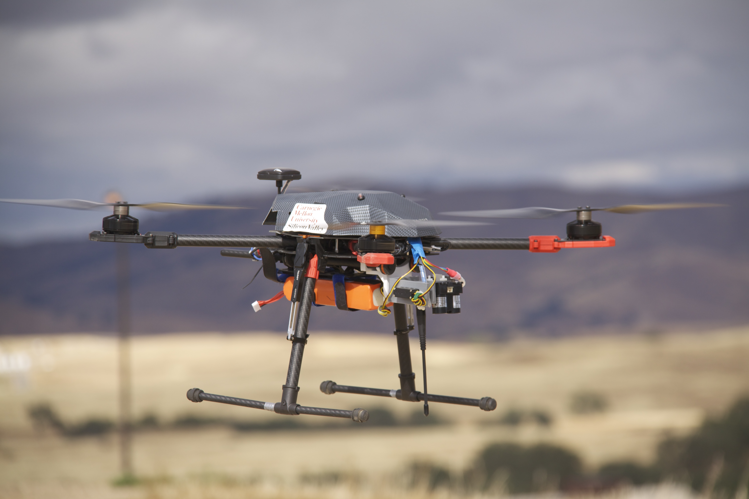
UAS and Communications
Unmanned aerial systems (UAS) depend on communications for non-line-of-sight (NLOS) operation
  Telemetry / first-person-view video
  Command and control / navigation
Reliable coverage is needed
  Point-to-point: not pervasive; propagation unknown
  Satellite: equipment, power, latency limitations
  Proprietary terrestrial: expensive to build
  Hastily formed: propagation unknown
  Cellular: propagation known?

Slide 8
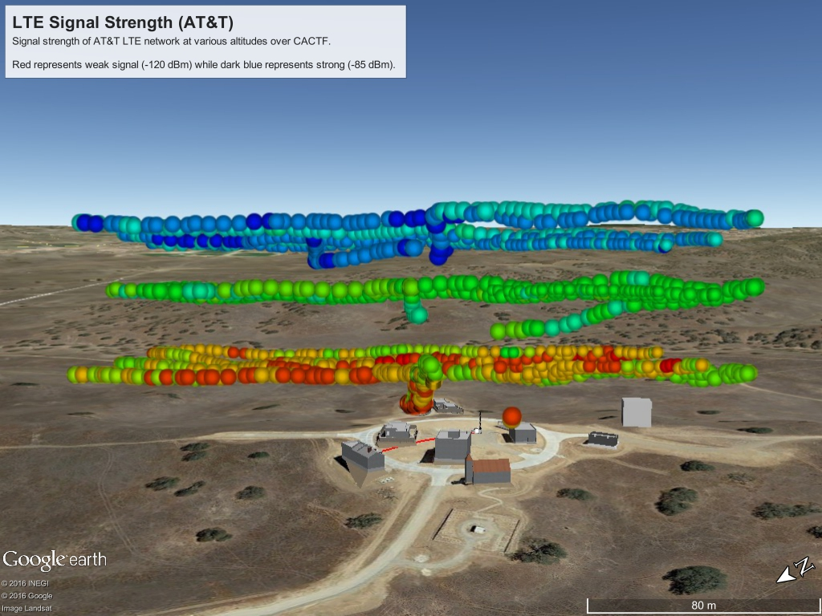
Sometimes Aerial Cellular Coverage is Good
120m AGL
80m AGL
40m AGL
Plot of LTE signal strength over small village, as measured by cellular phone from a UAS at various altitudes. Signal strength from nearby commercial cell sites increases as altitude increases above obstructing terrain.

Slide 9
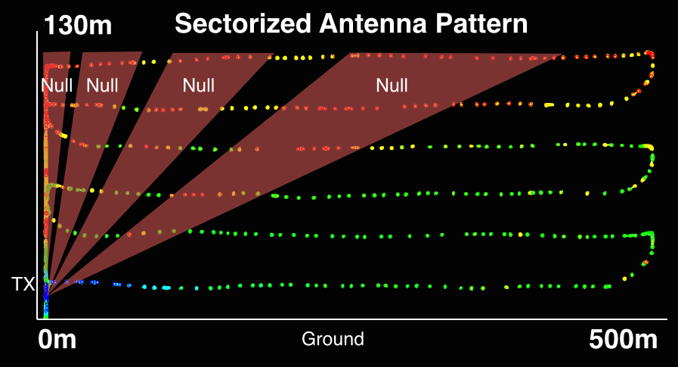
... But not Always
“Holes in the sky” are real and getting worse
Predictive models depend on knowledge of the environment and are computationally expensive and/or inaccurate
How can we avoid holes so as to maintain integrity of the RF link?
K. Daniel and C. Wietfeld, “Using Public Network Infrastructures for UAV Remote Sensing in Civilian Security Operations,” Homel. Secur. Aff., vol. 3, 2011.
Teng, E., Falcao, J. D., Dominguez, C. R., Mokaya, F., Zhang, P., & Iannucci, B. Aerial Sensing and Characterization of Three-Dimensional RF Fields. In Second International Workshop on Robotic Sensor Networks. Seattle, WA. 2015.

Slide 10
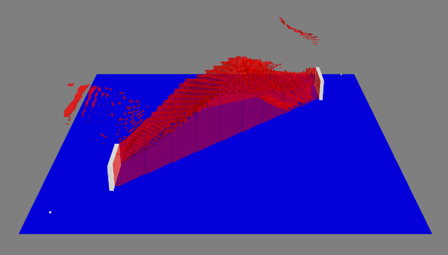
Holes are Real and
Attributable to Multiple Physical Effects
We seek to model the key physical effects that give rise to discrepancies between measured path loss and simple free-space path loss

Slide 11
If We Had This Knowledge,
How would we Apply It?
A. Network-Side
Modeling
(Re-)
Deployment
Validation

Slide 12

If We Had This Knowledge,
How would we Apply It?
B. UAS-Side
Bad Coverage
Predict intersection of flight path with areas of bad coverage (dynamic)
Dynamically re-plan flight path – see-and-avoid

Slide 13
Benefits
Mapping, Modeling and Mitigation of holes-in-the-sky will enable
  Networks to better serve aerial (UAS) clients
  UAS to anticipate RF propagation risks and pre-emptively mitigate their effects

Slide 14
Our Approach
Network-side studies
Cell Site Locations
Propagation Models
Location of Holes-in-the-Sky
Navigation
Obstacle Geometry
Camera Imagery
Range Imaging
UAS-side studies
Companion project

Slide 15
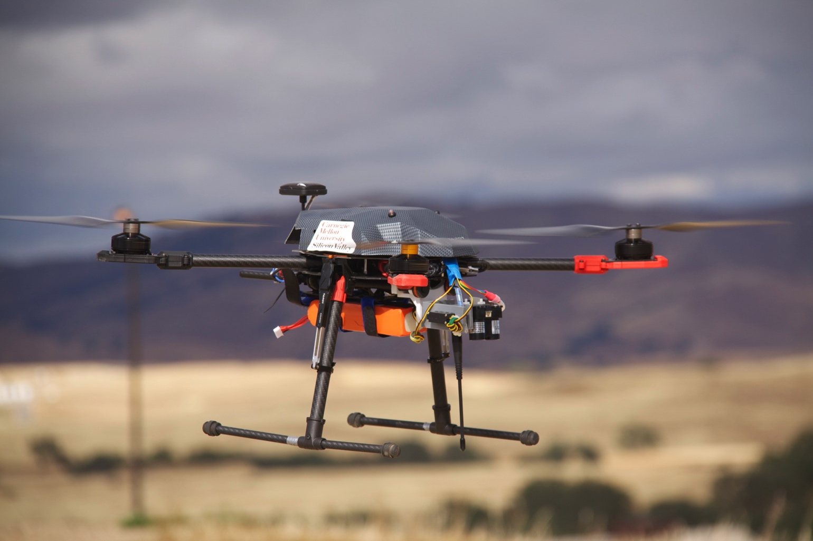
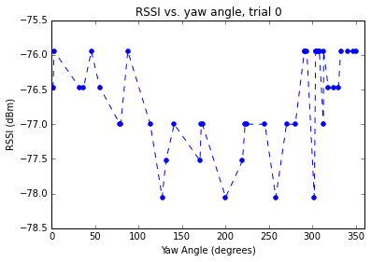
Measurement:
Custom-Designed ProbeQuad
Geo-referenced readings corrected for vehicle speed (measurement reporting latency), angle-of-attack, rotation
SBAS COTS GPS
3D printed antenna stabilization gimbal
Retractable landing gear
Consistency of measurements
across 360° rotation to within 2dB
Laser rangefinder for terrain mapping
½ wavelength 900MHz antenna

Slide 16
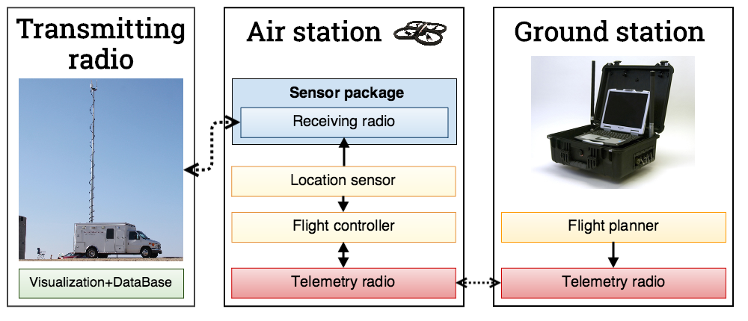
Measurement:
Ground Support System

Slide 17
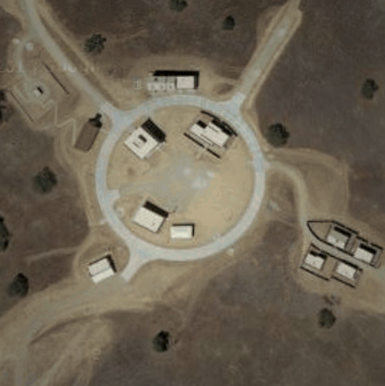
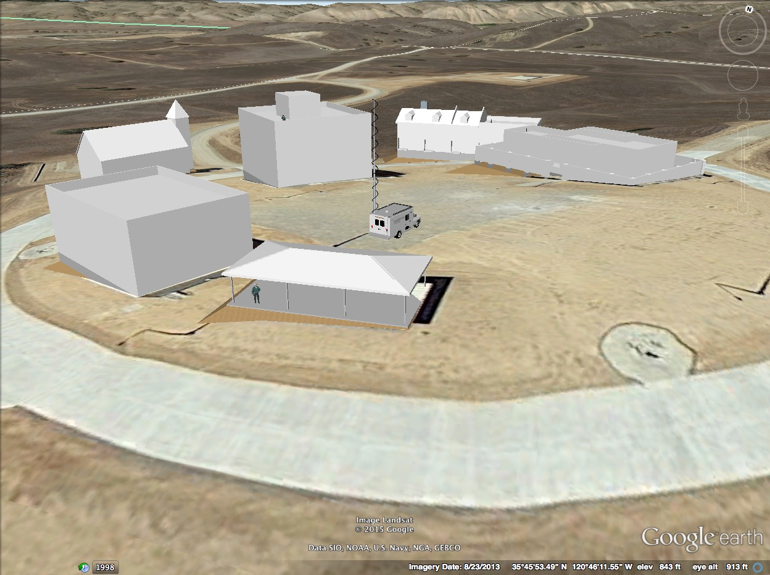
Experimental Venue: A Real, Physical Village at Camp Roberts
Above: 3D LIDAR-based model by Skye Corbett, USGS
Left: SketchUp 3D model by CROSSMobile team

Slide 18
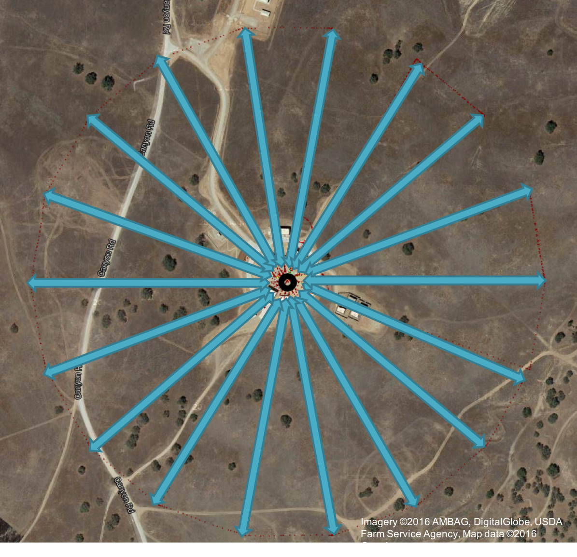
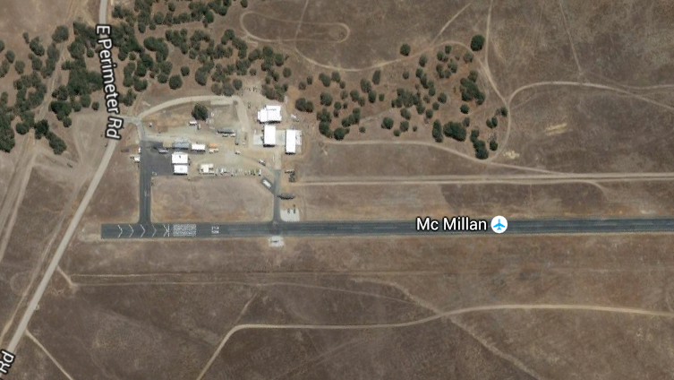
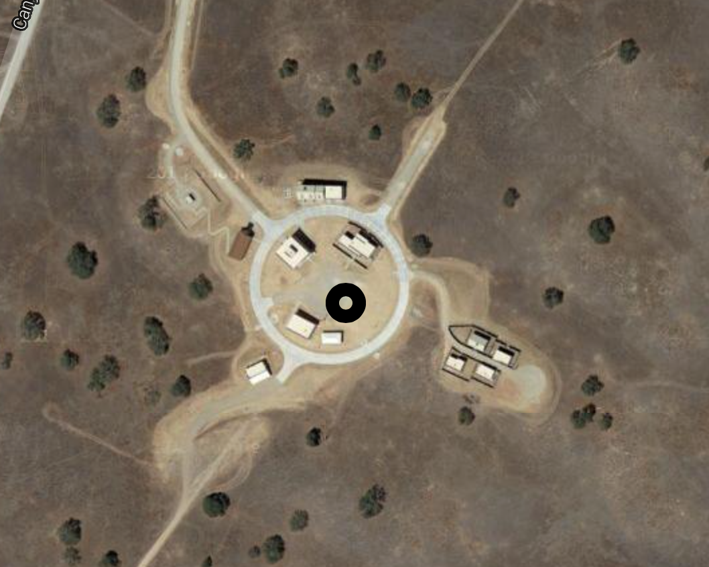
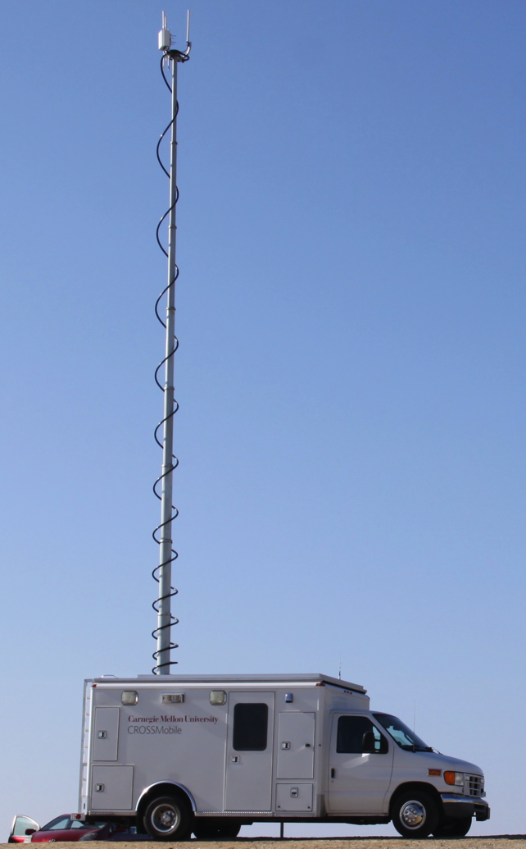
Typical Experiments
Altitude
Imagery ©2016 AMBAG, DigitalGlobe, USDA Farm Service Agency, Map data ©2016 Google
Open Field
Vertical Ladder Patterns
Vertical Dipole and Sectorized Antennas
Mock Village
Radial Patterns
Vertical Dipole Antenna

Slide 19
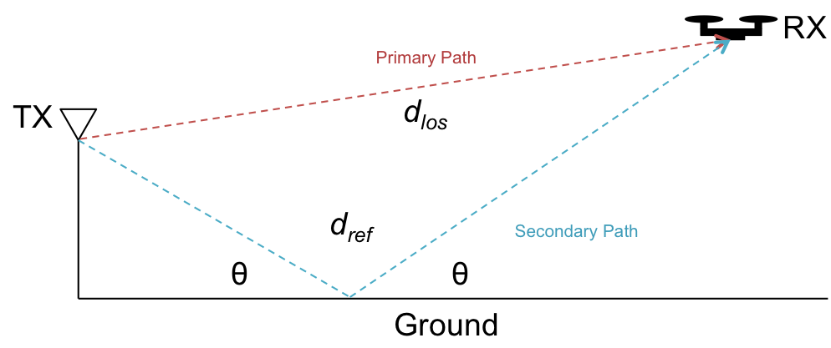
Effect 1: Two-Ray Interference
Beyond simple free-space path loss, we observe a clearly visible two-ray interference effect
Easy to model

Slide 20
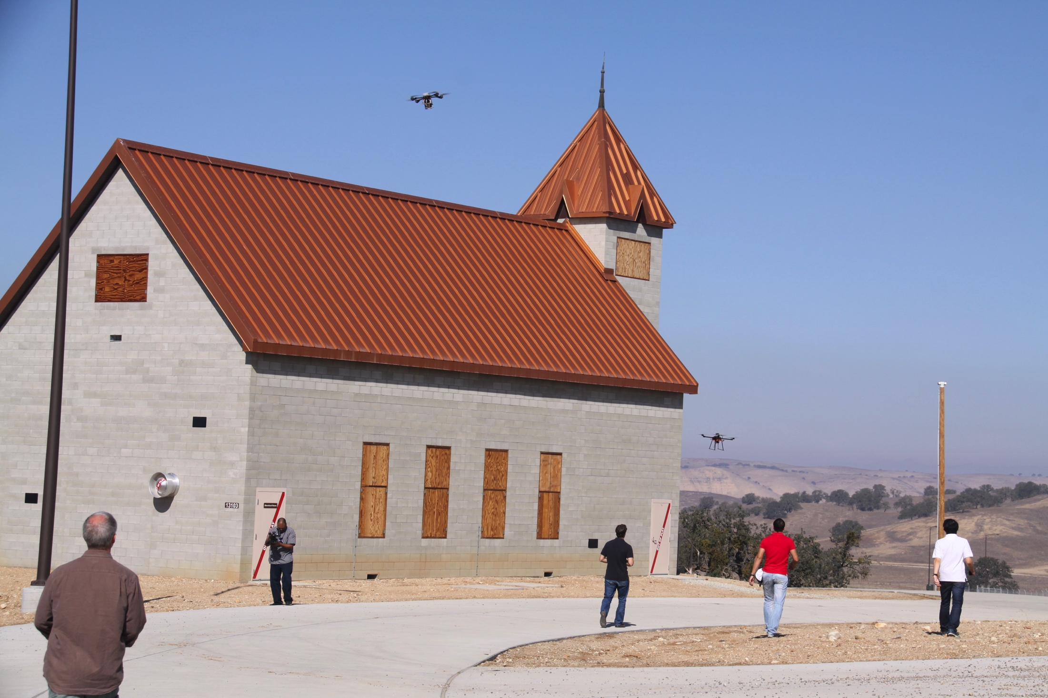
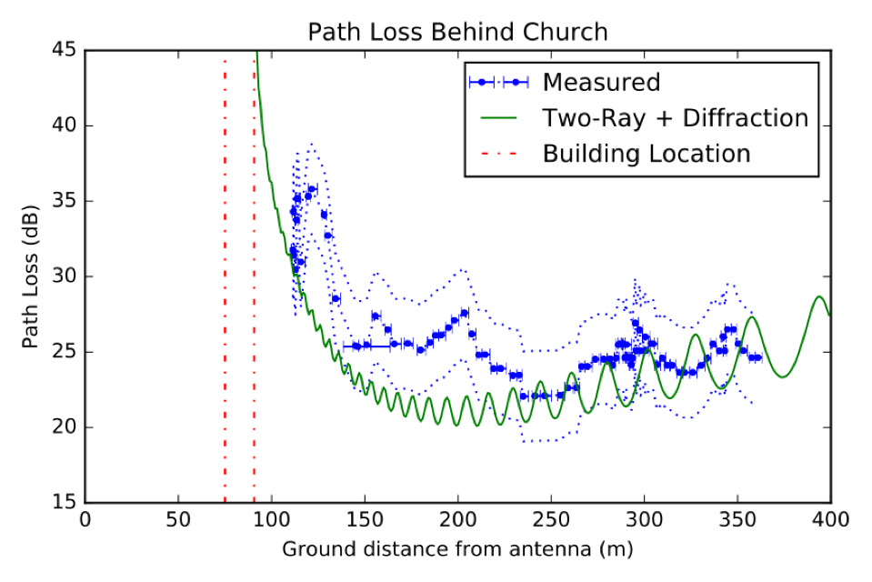
Effect 2: Fresnel Zone Incursions
Path loss and two-ray don’t account well for Fresnel Zone incursions
Here, the quad is flown below the roofline of an interfering building
Close in, blockage and diffraction must be modeled
Can approximate the geometry of obstacles (e.g., in this case, as a thin edge)

Slide 21
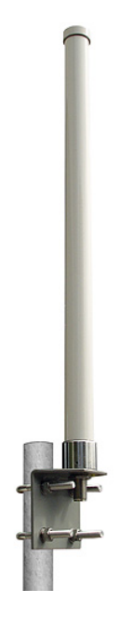
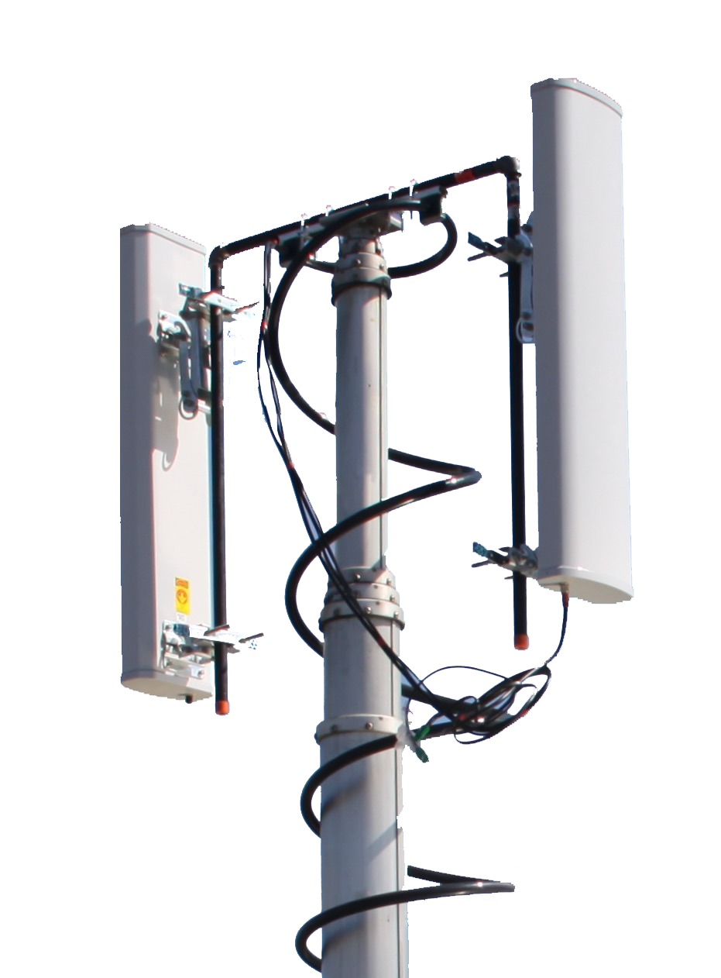
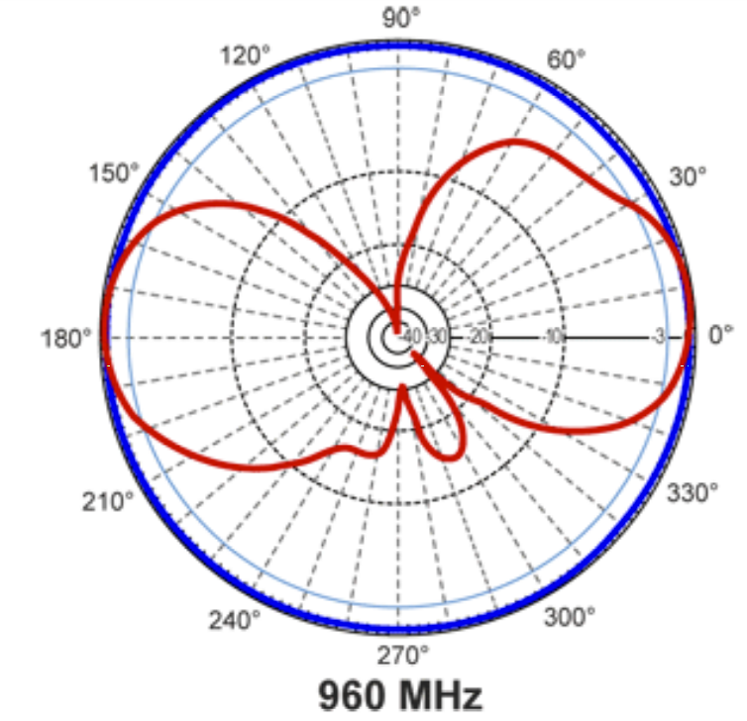
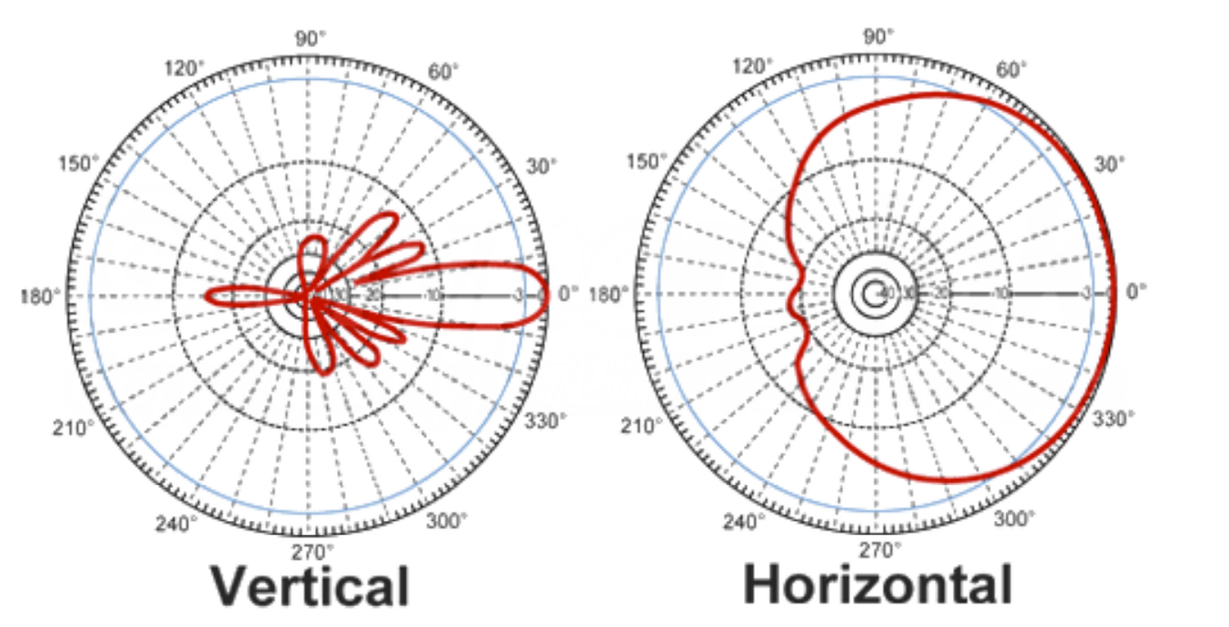
Effect 3: Antenna Pattern
Omni antennas show deep null above
Sector antennas show deep nulls at various angles
Both manifest as large volumes in which signal strength will be minimal
vs.
(typ.) L-Com DS HGV906U
900 MHz Omni
(typ.) L-Com DS HG913P-120
900 MHz Sector
(blue) Horizontal
(red) Vertical

Slide 22
Combining the Models
Case A: Open field:
  Free-space loss and two-ray ground reflection effects only: within 3.4 dB of measured path loss
Case B: Obstructions:
  Knife-edge approximation and Fresnel diffraction: within 9 dB of measured path loss
  More sophisticated approximation of geometry can improve accuracy
For UAS:
  Approximate terrain and obstacle geometry using camera, other sensors
  Apply propagation modeling to estimate path loss

Slide 23
Summary
Aerial coverage for cellular networks is questionable and getting worse
Holes-in-the-sky are attributable to multiple effects
Free-space path loss, two-ray reflection, Fresnel zone incursion and antenna pattern can be prioritized and modeled
Accurate modeling can lead to better performance:
  Network-side hole mitigations
  UAS-side mitigations
Modeling these based on scene analysis is showing promising results

Slide 24
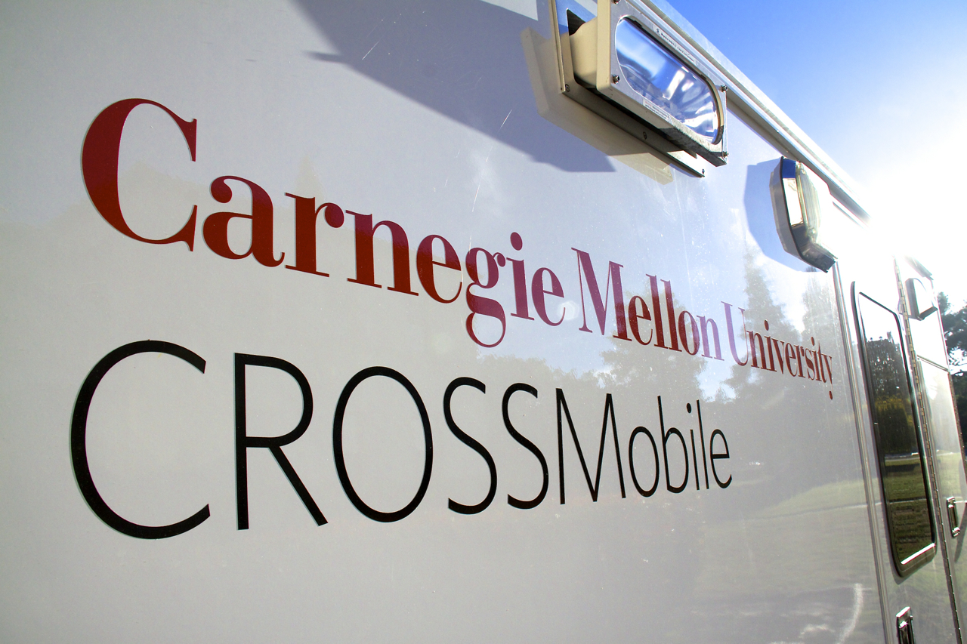
Thank you!

