Slide 1
Introduction to Optimization and Application to Economic Dispatch and Unit Commitment
Daniel Kirschen

Slide 2
Perspective
Conventional PS economics problems:
  Economic Dispatch (ED)
  Unit Commitment (UC)
  Optimal Power Flow (OPF)
Assume monopoly, vertically integrated utility
Why?
  Conceptually simpler
  Variants for competitive electricity markets
  Comparison with “benevolent monopolist”

Slide 3
Economic dispatch problem
A
B
C
L
Several generating units serving the load
What share of the load should each generating unit produce?
Consider the limits of the generating units
Ignore the limits of the network

Slide 4
Types of Power Plants
Thermal power plants
Renewable energy sources
Hydro power plants

Slide 5
Thermal power plants
  Burn a fuel to generate electric power
  Coal, oil, gas, biomass, uranium, ..
Economic characteristics:
  Substantial operating cost
  On/off status and power output can be changed
    Within limits
Nuclear units:
  Low operating cost but very limited flexibility
Typically multiple units in a power plant

Slide 6
Renewable energy sources
Wind, solar, geothermal, tidal
Economic characteristics:
  Negligible operating cost
  Intermittent (except geothermal)
  Stochastic (wind, solar)
  High investment cost per kW of capacity
  Use it or lose it

Slide 7
Hydro power plants
Economic characteristics
  Negligible operating cost
  Storage capability
Hydro with reservoir
  Controllable output
  Size of the reservoir is highly variable
    Days to years
“Run of the river” hydro
  No reservoir or negligible reservoir
  Uncontrollable output: use it or lose it

Slide 8

Concept of net load
-
=
actual load – uncontrolled renewable generation
= net load
= controllable generation
We’ll assume that the uncontrollable renewable generation
is known and dispatch the controllable generation to meet
the net load
Notes:
Northwest Power and Conservation Counci

Slide 9
Hydro-thermal coordination
Q: Would you rather generate a MWh using hydro or thermal generation?
A: It depends..
  If there is a reservoir (and it is not full) a MWh from hydro can be generated now or later
  It may have more value later, depending on how much the thermal MWh costs now and later
We will assume that the hydro production is given

Slide 10
Characteristics of the thermal units
B
T
G
J/h
Input
Fuel
Electric Power
(Input)
(Output)
MW
P_{min}
P_{max}
Thermal generating units
Consider the running costs only
Input / Output curve
  Fuel vs. electric power
Fuel consumption measured by its energy content
Upper and lower limit on output of the generating unit
Output

Slide 11
Cost Curve
Multiply fuel input by fuel cost
No-load cost
  Cost of keeping the unit running if it could produce zero MW
$/h
Cost
No-load cost
MW
P_{min}
P_{max}
Output

Slide 12
Incremental Cost Curve
Cost [$/h]
Incremental cost curve
Derivative of the cost curve
In $/MWh
Cost of the next MWh
∆F
∆P
MW
Incremental Cost
[$/MWh]
MW

Slide 13
Mathematical formulation
Objective: Minimize
Constraints
  Load / Generation balance:
  Unit Constraints:
A
B
C
L
This is an optimization problem

Slide 14
Introduction to Optimization

Slide 15
Objective
Achieving the best possible design or operating conditions requires a way of measuring the goodness of this result
We will call this measure our objective F
Examples:
  minimize cost of building a transformer
  minimize cost of supplying power
  minimize losses in a power system
  maximize profit from a bidding strategy

Slide 16
Decision Variables
The value of the objective is a function of some decision variables:
Examples of decision variables:
  Dimensions of the transformer
  Output of generating units, position of taps
  Parameters of bids for selling electrical energy

Slide 17
Optimization Problem
What value should the decision variables take so that is minimum or maximum?

Slide 18
Example: function of one variable
f(x*)
f(x)
x*
x
f(x) is maximum for x = x*

Slide 19
Minimization and Maximization
f(x*)
f(x)
x*
x
-f(x)
-f(x*)
If x = x* maximizes f(x) then it minimizes - f(x)

Slide 20
Minimization and Maximization
Maximizing f(x) is thus the same thing as minimizing g(x) = -f(x)
Minimization and maximization problems are thus interchangeable
Depending on the problem, the optimum is either a maximum or a minimum

Slide 21
Necessary Condition for Optimality
f(x)
f(x*)
x*
x

Slide 22
Necessary Condition for Optimality
f(x)
x*
x

Slide 23
Example
f(x)
x
For what values of x is ?
In other words, for what values of x is the necessary condition for optimality satisfied?

Slide 24
Example
f(x)
A
B
C
D
x
A, B, C, D are stationary points
A and D are maxima
B is a minimum
C is an inflexion point

Slide 25
How can we distinguish minima and maxima?
f(x)
A
B
C
D
x
The objective function is concave around a maximum

Slide 26
How can we distinguish minima and maxima?
f(x)
A
B
C
D
x
The objective function is convex around a minimum

Slide 27
How can we distinguish minima and maxima?
f(x)
A
B
C
D
x
The objective function is flat around an inflexion point

Slide 28
Necessary and Sufficient Conditions of Optimality
Necessary condition:
Sufficient condition:
  For a maximum:
  For a minimum:

Slide 29
Isn’t all this obvious?
Can’t we tell all this by looking at the objective function?
  Yes, for a simple, one-dimensional case when we know the shape of the objective function
  For complex, multi-dimensional cases (i.e. with many decision variables) we can’t visualize the shape of the objective function
  We must then rely on mathematical techniques

Slide 30
Feasible Set
The values that the decision variables can take are usually limited
Examples:
  Physical dimensions of a transformer must be positive
  Active power output of a generator may be limited to a certain range (e.g. 200 MW to 500 MW)
  Reactive power output of a generator may be limited to a certain range (e.g. -100 MVAr to 150 MVAr)

Slide 31
Feasible Set
f(x)
x^{MIN}
A
x^{MAX}
D
x
Feasible Set
The values of the objective function outside
the feasible set do not matter

Slide 32
Two-Dimensional Case
f(x₁,x₂)
x₁*
x₁
x₂*
x₂
f(x₁,x₂) is minimum for x₁*, x₂*

Slide 33
Necessary Conditions for Optimality
f(x₁,x₂)
x₁*
x₁
x₂*
x₂

Slide 34
Multi-Dimensional Case
At a maximum or minimum value of
we must have:
A point where these conditions are satisfied is called a stationary point

Slide 35
Sufficient Conditions for Optimality
f(x₁,x₂)
minimum
maximum
x₁
x₂

Slide 36
Sufficient Conditions for Optimality
f(x₁,x₂)
Saddle point
x₁
x₂

Slide 37
Sufficient Conditions for Optimality
Calculate the Hessian matrix at the stationary point:

Slide 38
Sufficient Conditions for Optimality
Calculate the eigenvalues of the Hessian matrix at the stationary point
If all the eigenvalues are greater or equal to zero:
  The matrix is positive semi-definite
  The stationary point is a minimum
If all the eigenvalues are less or equal to zero:
  The matrix is negative semi-definite
  The stationary point is a maximum
If some or the eigenvalues are positive and other are negative:
  The stationary point is a saddle point

Slide 39
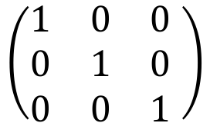

Calculating eigenvalues
The eigenvalues of a matrix A are such that:
$$det\left(λI−A\right)=0$$
$$\left(\begin{matrix}1 & 0 & 0 \\ 0 & 1 & 0 \\ 0 & 0 & 1\end{matrix} \right)$$
Where I is the identity matrix:

Slide 40
Contours
f(x₁,x₂)
F₂
F₁
x₁
F₁
F₂
x₂

Slide 41
Contours
A contour is the locus of all the point that give the same value
to the objective function
x₂
x₁
Minimum or maximum

Slide 42
Example 1
is a stationary
point

Slide 43
Example 1
Sufficient conditions for optimality:
must be positive definite (i.e. all eigenvalues must be positive)
The stationary point
is a minimum

Slide 44
Example 1
x₂
C=9
C=4
C=1
x₁
Minimum: C=0

Slide 45
Example 2
is a stationary
point

Slide 46
Example 2
Sufficient conditions for optimality:
The stationary point
is a saddle point

Slide 47
Example 2
x₂
C=0
C=9
C=4
C=1
C=-9
C=-4
C=-1
C=-4
C=-9
x₁
C=1
C=4
C=9
This stationary point is a saddle point
C=0

Slide 48
In practice..
In practice we don’t check the sufficient conditions for optimality
If the problem is convex a stationary point will be a minimum
Or we rely on the nature of the problem to “ensure” that a stationary point will be a minimum or a maximum

Slide 49
Optimization with Constraints

Slide 50
Optimization with Equality Constraints
There are usually restrictions on the values that the decision variables can take
Objective function
Equality constraints

Slide 51
Number of Constraints
N decision variables
M equality constraints
If M > N, the problems is over-constrained
  There is usually no solution
If M = N, the problem is determined
  There may be a solution
If M < N, the problem is under-constrained
  There is usually room for optimization

Slide 52
Example 1
x₂
Minimum
x₁

Slide 53
Example 2: Economic Dispatch
x₁
x₂
G₁
G₂
L
Cost of running unit 1
Cost of running unit 2
Total cost
Optimization problem:

Slide 54
Solution by substitution
Unconstrained minimization

Slide 55
Solution by substitution
Difficult
Usually impossible when constraints are non-linear
Provides little or no insight into solution
 Solution using Lagrange multipliers

Slide 56
Gradient

Slide 57
Properties of the Gradient
Each component of the gradient vector indicates the rate of change of the function in that direction
The gradient indicates the direction in which a function of several variables increases most rapidly
The magnitude and direction of the gradient usually depend on the point considered
At each point, the gradient is perpendicular to the contour of the function

Slide 58
Example 3
y
x

Slide 59
Example 4
y
x

Slide 60
Lagrange multipliers

Slide 61
Lagrange multipliers

Slide 62
Lagrange multipliers

Slide 63
Lagrange multipliers
The solution must be on the constraint
To reduce the value of f, we must move
in a direction opposite to the gradient

Slide 64
Lagrange multipliers
We stop when the gradient of the function
is perpendicular to the constraint because
moving further would increase the value
of the function
At the optimum, the gradient of the
function is parallel to the gradient
of the constraint

Slide 65
Lagrange multipliers
At the optimum, we must have:
Which can be expressed as:
In terms of the co-ordinates:
The constraint must also be satisfied:
is called the Lagrange multiplier

Slide 66
Lagrangian function
To simplify the writing of the conditions for optimality,
it is useful to define the Lagrangian function:
The necessary conditions for optimality are then given
by the partial derivatives of the Lagrangian:

Slide 67
Example

Slide 68
Example

Slide 69
Example
x₂
Minimum
1
4
x₁

Slide 70
Important Note!
If the constraint is of the form:
It must be included in the Lagrangian as follows:
And not as follows:

Slide 71
Application to Economic Dispatch
x₁
x₂
G₁
G₂
L
Equal incremental cost
solution

Slide 72
Incremental Cost
Cost curves:
x₁
x₂
Incremental
cost curves:
x₁
x₂

Slide 73
Interpretation of this solution
x₁
x₂
-
L
-
+
If < 0, reduce λ
If > 0, increase λ

Slide 74
Physical interpretation
x
The incremental cost is the cost of
one additional MW for one hour.
This cost depends on the output of
the generator.
x

Slide 75
Physical interpretation

Slide 76
Physical interpretation
It pays to increase the output of unit 2 and decrease the
output of unit 1 until we have:
The Lagrange multiplier λ is thus the cost of one more MW
at the optimal solution.
This is a very important result with many applications in
economics.

Slide 77
Generalization
Lagrangian:
One Lagrange multiplier for each constraint
n + m variables: x₁, …, x_{n} and λ₁, …, λ_{m}

Slide 78
Optimality conditions
n equations
m equations
n + m equations in
n + m variables

Slide 79
Optimization with inequality constraints
Objective function
Equality constraints
Inequality constraints

Slide 80
Example: Economic Dispatch
x₁
x₂
G₁
G₂
L
Equality constraints
Inequality constraints

Slide 81
Example: Economic Dispatch
Family of ellipses
x₂
Ellipse tangent to equality constraint at A
Inequality constraints are satisfied
x₂^{max}
A
x₂^{min}
x₁
x₁^{min}
x₁^{max}

Slide 82
Example: Economic Dispatch
What is the solution for a larger load?
x₂
Ellipse tangent to equality constraint at B
Inequality constraints are NOT satisfied!
x₂^{max}
A
B
x₂^{min}
x₁^{min}
x₁^{max}
x₁

Slide 83
Example: Economic Dispatch
C is the solution because it is the point on
the equality constraint that satisfies the
inequality constraints at minimum cost
x₂
x₂^{max}
C
A
B
x₂^{min}
x₁^{min}
x₁^{max}
x₁

Slide 84
Binding Inequality Constraints
A binding inequality constraint is an inequality constraint that is satisfied exactly
Example:
  If we must have x₁ ≤ x₁^{max}
  And at the solution we have x₁ = x₁^{max}
  Then the constraint x₁ ≤ x₁^{max} is said to be binding
ALL of the inequality constraints must be satisfied
Only a FEW will be binding (or active) at any given time
But we don’t know ahead of time which inequality constraints will be binding!
All equality constraints are always binding

Slide 85
Solution using Lagrange multipliers
Lagrangian function:

Slide 86
Optimality Conditions
(Known as the Karush Kuhn Tucker (KKT) conditions
Complementary Slackness Conditions

Slide 87
Complementary slackness conditions
Two possibilities for each constraint j:
OR

Slide 88
Warning!
Difficulty with the complementary slackness conditions
  They tell us that an inequality constraint is either binding or non-binding
  They DON’T tell us which constraints are binding and non-binding
  The binding constraints have to be identified through trial and error

Slide 89
Example

Slide 90
Example
x₂
x₁

Slide 91
Example

Slide 92
Example
KKT conditions do not tell us if inequality constraint is binding
Must use a trial and error approach
Trial 1: Assume inequality constraint is not binding ➔μ = 0
From solution of example without inequality constraint, we
know that the solution is then:
This solution is thus not an acceptable solution

Slide 93
Example
Trial 2: Assume that the inequality constraint is binding
All KKT conditions are satisfied. This solution is acceptable

Slide 94
Example: graphical solution
x₂
Solution of problem
with inequality constraint
Solution of problem
without inequality
constraint
x₁
Solution of problem
without constraints

Slide 95
Application to Economic Dispatch
x₁
x₂
G₁
G₂
L

Slide 96
Application to Economic Dispatch
KKT Conditions:

Slide 97
Application to Economic Dispatch
KKT Conditions (continued):

Slide 98
Solving the KKT Equations
Case #1: No generator is at a limit
No inequality constraint is binding and all μ’s are equal to zero
All generators operate at the same incremental cost

Slide 99
Solving the KKT Equations
Case #2: Generator 1 is at its upper limit; Other limits not binding
All generators do NOT operate at the same incremental cost!
The incremental cost of unit 1 is lower…. Why?
If that was possible, more power would be produced by unit 1

Slide 100
Solving the KKT Equations
Case #3: Generator 1 is at its lower limit; other limits not binding
Again, all generators do NOT operate at the same incremental cost!
The incremental cost of unit 1 is higher… Why?
If that was possible, less power would be produced by unit 1

Slide 101
Physical Interpretation of Lagrange Multipliers
= 0
= 0
Marginal cost of equality constraint
Marginal cost of inequality constraint

Slide 102
Physical Interpretation of Lagrange Multipliers
Constraints always increase the cost of a solution
The Lagrange multipliers give the incremental cost of the binding constraints at the optimum
They are sometimes called shadow costs
Non-binding inequality constraints have a zero incremental cost

Slide 103
Economic Dispatch
Example of Calculation Using Lagrange Multipliers

Slide 104
Economic Dispatch Example
A load of 800 MW is supplied by three generating units.
The cost characteristics of these generating units are
given by the following expressions:
C₁ = 100 + 8 P₁ + 0.1 P₁² [$/h] 230 ≤ P₁ ≤ 400 MW
C₂ = 200 + 7 P₂ + 0.06 P₂² [$/h] 100 ≤ P₂ ≤ 500 MW
C₃ = 250 + 9 P₃ + 0.07 P₃² [$/h] 100 ≤ P₃ ≤ 260 MW
Calculate the optimal economic dispatch.

Slide 105
Example: Form the Lagrangian

Slide 106
Example: Optimality Conditions
Set the partial derivatives of the Lagrangian with respect to the
decision variables and λ to zero:
(1)
(2)
(3)
(4)

Slide 107
Example: Optimality Conditions
Set the partial derivatives of the Lagrangian with respect to the
μ’s to zero:

Slide 108
Example: Optimality Conditions
Set the partial derivatives of the Lagrangian with respect to the
μ’s to zero:

Slide 109
Example: Complementary slackness

Slide 110
Example: First Trial (1)
Assume that none of the inequality constraints is binding
This means that all the μ‘s are zero
Set the μ’s equal to zero in the optimality conditions.
Equations (1) to (3) become:

Slide 111
Example: First Trial (2)
Inserting these expressions in Equation (4), we get:
With L = 800MW, we get:
Replacing λ in the equations on the previous slide, we have:
Not a valid solution
→ trial fails

Slide 112
Example: Second Trial (1)
We must try another combination of binding constraints.
6 inequality constraints → 2⁶ = 64 possible combinations
Realistic system → ridiculously large number of combinations
Must use information from previous trials
Let us try:

Slide 113
Example: Second Trial (2)
However, we must check that the μ‘s meet the
complementary slackness conditions

Slide 114
Example: Second Trial (3)

Slide 115
Example: Second Trial (4)
The constraint
should not be binding!
What is happening?
First trial:

Slide 116
Example: Second Trial (5)
In the second trial, we “pushed” P₁ towards its lower limit and P₃
towards its upper limit. However, there was no need to push P₃
because increasing P₁ would naturally reduce P₃ below its limit.
Second trial:

Slide 117
Example: Third Trial (1)

Slide 118
Example: Third Trial (2)
Solution that satisfies all the optimality conditions:
← Cost of an extra MW of load
← Value of reducing by 1MW

Slide 119
Example: Optimal Solution
Third trial:

Slide 120
Practical Economic Dispatch

Slide 121
Equal Incremental Cost Dispatch
P_{A}
P_{B}
P_{C}
+

Slide 122
Lambda search algorithm

Slide 123
Linear Cost Curves
P_{A}
P_{B}
P_{A}^{MAX}
P_{B}^{MAX}
P_{A}
P_{B}
P_{A}^{MAX}
P_{B}^{MAX}

Slide 124
Linear Cost Curves
P_{A}
P_{B}
P_{A}^{MAX}
P_{B}^{MAX}
P_{A}
P_{B}
P_{A}^{MAX}
P_{B}^{MAX}

Slide 125
Linear Cost Curves
P_{A}
P_{B}
P_{A}^{MAX}
P_{B}^{MAX}
P_{A}
P_{B}
P_{A}^{MAX}
P_{B}^{MAX}

Slide 126
Linear Cost Curves
The output of the unit with the lowest incremental cost (in this case unit A) is increased first (it is “loaded” first)
The output of the other units is not increased until unit A is loaded up to its maximum
The output of the unit with second lowest incremental cost is then increased (i.e. the “second cheapest” unit)
And so on until the generation meets the load

Slide 127
Linear cost curves with minimum generation
P_{A}
P_{B}
P_{A}^{MIN}
P_{A}^{MAX}
P_{B}^{MIN}
P_{B}^{MAX}
P_{A}
P_{B}
P_{A}^{MIN}
P_{A}^{MAX}
P_{B}^{MIN}
P_{B}^{MAX}

Slide 128
Linear cost curves with minimum generation
All generating units are first loaded up to their minimum generation
The generating units are then loaded in order of incremental cost

Slide 129
Piecewise Linear Cost Curves
P_{A}
P_{B}
P_{A}
P_{B}

Slide 130
Economic Dispatch with Piecewise Linear Cost Curves
P_{A}
P_{B}
P_{A}
P_{B}

Slide 131
Economic Dispatch with Piecewise Linear Cost Curves
P_{A}
P_{B}
P_{A}
P_{B}

Slide 132
Economic Dispatch with Piecewise Linear Cost Curves
P_{A}
P_{B}
P_{A}
P_{B}

Slide 133
Economic Dispatch with Piecewise Linear Cost Curves
P_{A}
P_{B}
P_{A}
P_{B}

Slide 134
Economic Dispatch with Piecewise Linear Cost Curves
P_{A}
P_{B}
P_{A}
P_{B}

Slide 135
Economic Dispatch with Piecewise Linear Cost Curves
All generators except one are at breakpoints of their cost curve
The marginal generator is between breakpoints to balance the load and generation
Not well-suited for lambda-search algorithm
Very fast table lookup algorithm:
  Rank all the segments of the piecewise linear cost curves in order of incremental cost
  First dispatch all the units at their minimum generation
  Then go down the table until the generation matches the load

Slide 136
Example
0.7
0.5
0.3
30
80
120
150
P_{A}
If P_{load} = 210MW
The optimal economic dispatch is:
P_{A} = 120MW
P_{B} = 90 MW
λ = 0.6
0.8
0.6
0.1
20
70
110
140
P_{B}

Slide 137
Local and Global Optima

Slide 138
Which one is the real maximum?
f(x)
A
D
x

Slide 139
Which one is the real optimum?
x₂
A
D
x₁
B
C

Slide 140
Local and Global Optima
The optimality conditions are local conditions
They do not compare separate optima
If I find an optimum can I be sure that it is the global optimum?
In general, to find the global optimum, we must find and compare all the optima
In large problems, this can be very difficult and time consuming

Slide 141
Convexity
If the feasible set is convex and the objective function is convex, there is only one minimum and it is thus the global minimum

Slide 142
Examples of Convex Feasible Sets
x₂
x₂
x₁
x₁
x₂
x₁
x₁
x₁^{min}
x₁^{max}

Slide 143
Example of Non-Convex Feasible Sets
x₂
x₂
x₁
x₁
x₂
x₁
x₁
x₁
x₁ª
x₁^{b}
x₁^{c}
x₁^{d}

Slide 144
Example of Convex Feasible Sets
A set is convex if, for any two points belonging to the set, all the
points on the straight line joining these two points belong to the set
x₂
x₂
x₁
x₁
x₂
x₁
x₁
x₁^{min}
x₁^{max}

Slide 145
Example of Non-Convex Feasible Sets
x₂
x₂
x₁
x₁
x₂
x₁
x₁
x₁
x₁ª
x₁^{b}
x₁^{c}
x₁^{d}

Slide 146
Example of Convex Function
f(x)
x

Slide 147
Example of Convex Function
x₂
x₁

Slide 148
Example of Non-Convex Function
f(x)
x

Slide 149
Example of Non-Convex Function
x₂
A
D
x₁
B
C

Slide 150
Definition of a Convex Function
f(x)
z
f(y)
x_{a}
y
x_{b}
x
A convex function is a function such that, for any two points x_{a} and x_{b}
belonging to the feasible set and any k such that 0 ≤ k ≤1, we have:

Slide 151
Example of Non-Convex Function
f(x)
x

Slide 152
Importance of Convexity
If we can prove that a minimization problem is convex:
  Convex feasible set
  Convex objective function
➔Then, the problem has one and only one solution
Proving convexity is often difficult
Power system problems are usually not convex
➔There may be more than one solution to power system optimization problems

Slide 153
Unit Commitment
Daniel Kirschen

Slide 154
Economic Dispatch: Problem Definition
Given load
Given set of units on-line
How much should each unit generate to meet this load at minimum cost?
A
B
C
L

Slide 155
Unit Commitment
Given load profile
(e.g. values of the load for each hour of a day)
Given set of units available
When should each unit be started, stopped and how much should it generate to meet the load at minimum cost?
?
?
?
G
G
G
Load Profile

Slide 156
Typical summer and winter loads

Slide 157
A Simple Example
Unit 1:
    P_{Min} = 250 MW, P_{Max} = 600 MW
    C₁ = 510.0 + 7.9 P₁ + 0.00172 P₁² $/h
Unit 2:
    P_{Min} = 200 MW, P_{Max} = 400 MW
    C₂ = 310.0 + 7.85 P₂ + 0.00194 P₂² $/h
Unit 3:
    P_{Min} = 150 MW, P_{Max} = 500 MW
    C₃ = 78.0 + 9.56 P₃ + 0.00694 P₃² $/h
What combination of units 1, 2 and 3 will produce 550 MW at minimum cost?
How much should each unit in that combination generate?

Slide 158
Cost of the various combinations

Slide 159
Observations on the example:
Far too few units committed:
Can’t meet the demand
Not enough units committed:
Some units operate above optimum
Too many units committed:
Some units below optimum
Far too many units committed:
Minimum generation exceeds demand

Slide 160
Effect of the no-load cost
Example:
Economic dispatch looks only at marginal cost:
This example considered the total cost
The no-load cost affects the solution
No-load cost

Slide 161
Another Example
Optimal generation schedule for a load profile
Decompose the profile into a set of period
Assume load is constant over each period
For each time period, which units should be committed to generate at minimum cost during that period?
Load
1000
500
Time
0
6
12
18
24

Slide 162
Optimal combination for each hour

Slide 163
Matching the combinations to the load
Load
Unit 3
Unit 2
Unit 1
Time
0
6
12
18
24

Slide 164
Unit commitment as an optimization problem
Minimize total cost over time horizon
  Total cost = running cost + startup cost
Constraints
  Unit constraints
  System constraints
Time horizon is divided in a set of optimization periods:
During each period:
  The load is assumed constant
  The decision variables are constant

Slide 165
Notations
Status of unit i at period t
Unit i is ON during period t
Unit i is OFF during period t
Power produced by unit i during period t
Running cost of unit i during period t
Startup cost of unit i during period t
Number of available generating units
Number of periods in the optimization horizon

Slide 166
Running cost
Cost of generating power with a given unit
Depends on the power output of the unit
Same cost function as used in economic dispatch
Includes the no-load cost

Slide 167
Start-up cost
Thermal generating units:
  Coal, gas, oil, biomass
These units must be “warmed up” before they can be brought on-line
Warming up a unit requires fuel and therefore costs money
Incurred only during the first period when the unit is turned on

Slide 168
Start-up cost
Start-up cost depends on time unit has been off
  If the unit has not been off for a long time, the water will still be warm
  Hot start vs. cold start
α_{i} + β_{i}
α_{i}
t_{i}^{OFF}

Slide 169
Effect of the start-up cost
Need to “balance” start-up costs and running costs
Example:
  Diesel generator: low start-up cost, high running cost
  Coal plant: high start-up cost, low running cost
Issues:
  How long should a unit run to “recover” its start-up cost?
  Start-up one more large unit or a diesel generator to cover the peak?
  Shutdown one more unit at night or run several units part-loaded?

Slide 170
Objective function
Running cost
Startup cost
Decision
variables

Slide 171
Unit Constraints
Constraints that affect each unit individually:
  Maximum generating capacity
  Minimum stable generation
  Minimum “up time”
  Minimum “down time”
  Ramp rate

Slide 172
Unit Constraints
Minimum up time
  Once a unit is running it may not be shut down immediately:
Minimum down time
  Once a unit is shut down, it may not be started immediately

Slide 173
Unit Constraints
Maximum ramp rates
  To avoid damaging the turbine, the electrical output of a unit cannot change by more than a certain amount over a period of time:
Maximum ramp up rate constraint:
Maximum ramp down rate constraint:

Slide 174
System Constraints
Constraints that affect more than one unit
  Load/generation balance
  Reserve generation capacity
  Emission constraints
  Network constraints

Slide 175
Load/Generation Balance Constraint
At all times, the power produced by the generating
units must be equal to the load

Slide 176
Reserve Constraint
Unanticipated loss of a generating unit or an interconnection causes unacceptable frequency drop if not corrected
Need to increase production from other units to keep frequency drop within acceptable limits
Rapid increase in production only possible if committed units are not all operating at their maximum capacity
Some of the capacity of the generating units must be kept “in reserve”

Slide 177
Reserve Constraint
Contribution of unit i to reserve at period t (“headroom”)
Reserve requirement at period t
Load generation balance
Reserve constraint at period t

Slide 178
How much reserve?
Protect the system against “credible outages”
Reserve requirement:
  Capacity of largest unit or interconnection
  Percentage of peak load

Slide 179
Types of Reserve
Spinning reserve
  Primary
    Quick response for a short time
  Secondary
    Slower response for a longer time
Tertiary reserve
  Replace primary and secondary reserve to protect against another outage
  Provided by units that can start quickly
    e.g. gas turbines
  Also called scheduled or off-line reserve

Slide 180
Cost of Reserve
Reserve has a cost even when it is not called
  More units scheduled than required
    Units not operated at their maximum efficiency
    Extra start up costs
  Must build units capable of rapid response
  Cost of reserve proportionally larger in small systems
    Important driver for the creation of interconnections between systems

Slide 181
Emission Constraints
Amount of pollutants that generating units can emit may be limited
Pollutants:
  SO₂, NO_{x}
Various forms:
  Limit on each plant at each hour
  Limit on plant over a year
  Limit on a group of plants over a year
  Etc…

Slide 182
Network Constraints
Transmission network may have an effect on the commitment of units
  Some units must run to provide voltage support
  The output of some units may be limited because their output would exceed the transmission capacity of the network
A
B
Cheap generators
May be “constrained off”
More expensive generator
May be “constrained on”

Slide 183
Why can’t we treat each period separately?
Large units are efficient but have a substantial startup cost
  Need to “amortize” this startup cost over the optimization horizon
Some constraints create a link between the periods
  Minimum up- and down-time constraint
  Ramping constraints

Slide 184
Economic Dispatch vs. Unit Commitment
Generation scheduling or unit commitment is a more general problem than economic dispatch
Economic dispatch is a sub-problem of generation scheduling
Unit commitment must strike a balance between cheaper inflexible units and more expensive flexible units

Slide 185
Flexible Plants
Power output can be adjusted (within limits)
Examples:
  Coal-fired
  Oil-fired
  Open cycle gas turbines
  Combined cycle gas turbines
  Hydro plants with storage
Status and power output can be optimized
Thermal units

Slide 186
Inflexible Plants
Power output cannot be adjusted for technical or commercial reasons
Examples:
  Nuclear
  Run-of-the-river hydro
  Renewables (wind, solar,…)
  Combined heat and power (CHP, cogeneration)
Output treated as given when optimizing

Slide 187
Solving the Unit Commitment Problem
Decision variables:
  Status of each unit at each period:
  Output of each unit at each period:
Combination of integer and continuous variables

Slide 188
Optimization with integer variables
Continuous variables
  Can follow the gradients or use LP
  Any value within the feasible set is OK
Discrete variables
  There is no gradient
  Can only take a finite number of values
  Problem is not convex
  Must try combinations of discrete values

Slide 189
How many combinations are there?
Examples
  3 units: 8 possible states
  N units: 2^{N} possible states
111
110
101
100
011
010
001
000

Slide 190
How many solutions are there anyway?
Optimization over a time horizon divided into intervals
A solution is a path linking one combination at each interval
How many such paths are there?
T=
1
2
3
4
5
6

Slide 191
How many solutions are there anyway?
Optimization over a time horizon divided into intervals
A solution is a path linking one combination at each interval
How many such path are there?
Answer:
T=
1
2
3
4
5
6

Slide 192
The Curse of Dimensionality
Example: 5 units, 24 hours
Processing 10⁹ combinations/second, this would take 1.9 10¹⁹ years to solve
There are 100’s of units in large power systems...
Many of these combinations do not satisfy the constraints

Slide 193
How do you Beat the Curse?
Brute force approach won’t work!
Need to be smart
Try only a small subset of all combinations
Can’t guarantee optimality of the solution
Try to get as close as possible within a reasonable amount of time

Slide 194
Main Solution Techniques
Characteristics of a good technique
  Solution close to the optimum
  Reasonable computing time
  Ability to model constraints
Possible techniques
  Priority list / heuristic approach
  Dynamic programming
  Lagrangian relaxation
  Mixed Integer Programming
Heuristic techniques (e.g particle swarm optimization) are a waste of time
State of the art

Slide 195
A Simple Unit Commitment Example

Slide 196
Unit Data
Unit | P_{min} (MW) | P_{max} (MW) | Min up (h) | Min down (h) | No-load cost ($) | Marginal cost ($/MWh) | Start-up cost ($) | Initial status
A | 150 | 250 | 3 | 3 | 0 | 10 | 1,000 | ON
B | 50 | 100 | 2 | 1 | 0 | 12 | 600 | OFF
C | 10 | 50 | 1 | 1 | 0 | 20 | 100 | OFF

Slide 197
Cost curves
C(p)
C
B
A
p

Slide 198
Demand Data
Reserve requirements are not considered

Slide 199
Feasible Unit Combinations (states)
Combinations |  |  | P_{min} | P_{max}
A | B | C
1 | 1 | 1 | 210 | 400
1 | 1 | 0 | 200 | 350
1 | 0 | 1 | 160 | 300
1 | 0 | 0 | 150 | 250
0 | 1 | 1 | 60 | 150
0 | 1 | 0 | 50 | 100
0 | 0 | 1 | 10 | 50
0 | 0 | 0 | 0 | 0
 | 1 | 2 | 3
 | 150 | 300 | 200

Slide 200
Transitions between feasible combinations
A | B | C
1 | 1 | 1
1 | 1 | 0
1 | 0 | 1
1 | 0 | 0
0 | 1 | 1
 | 1 | 2 | 3
Initial State

Slide 201
Infeasible transitions: Minimum down time of unit A
A | B | C
1 | 1 | 1
1 | 1 | 0
1 | 0 | 1
1 | 0 | 0
0 | 1 | 1
 | 1 | 2 | 3
Initial State
 | T_{D} | T_{U}
A | 3 | 3
B | 1 | 2
C | 1 | 1

Slide 202
Infeasible transitions: Minimum up time of unit B
A | B | C
1 | 1 | 1
1 | 1 | 0
1 | 0 | 1
1 | 0 | 0
0 | 1 | 1
 | 1 | 2 | 3
Initial State
 | T_{D} | T_{U}
A | 3 | 3
B | 1 | 2
C | 1 | 1

Slide 203
Feasible transitions
A | B | C
1 | 1 | 1
1 | 1 | 0
1 | 0 | 1
1 | 0 | 0
0 | 1 | 1
 | 1 | 2 | 3
Initial State

Slide 204
Operating costs
1 | 1 | 1
1 | 1 | 0
1 | 0 | 1
1 | 0 | 0
4
3
7
2
6
1
5

Slide 205
Economic dispatch
State | Load | P_{A} | P_{B} | P_{C} | Cost
1 | 150 | 150 | 0 | 0 | 1500
2 | 300 | 250 | 0 | 50 | 3500
3 | 300 | 250 | 50 | 0 | 3100
4 | 300 | 240 | 50 | 10 | 3200
5 | 200 | 200 | 0 | 0 | 2000
6 | 200 | 190 | 0 | 10 | 2100
7 | 200 | 150 | 50 | 0 | 2100
Unit | P_{min} | P_{max} | No-load cost | Marginal cost
A | 150 | 250 | 0 | 10
B | 50 | 100 | 0 | 12
C | 10 | 50 | 0 | 20

Slide 206
Operating costs
1 | 1 | 1
1 | 1 | 0
1 | 0 | 1
1 | 0 | 0
4
$3200
3
7
$3100
$2100
2
6
$3500
$2100
1
5
$1500
$2000

Slide 207
Start-up costs
1 | 1 | 1
1 | 1 | 0
1 | 0 | 1
1 | 0 | 0
4
$3200
$0
$700
3
$0
7
$3100
$600
$2100
$600
2
$0
6
$100
$3500
$2100
$0
$0
1
5
$1500
$2000
Unit | Start-up cost
A | 1000
B | 600
C | 100

Slide 208
Accumulated costs
1 | 1 | 1
1 | 1 | 0
1 | 0 | 1
1 | 0 | 0
$5400
4
$3200
$5200
$0
$7300
$700
3
$0
7
$3100
$600
$2100
$600
$5100
$7200
2
$0
6
$100
$3500
$2100
$1500
$0
$7100
$0
1
5
$1500
$2000

Slide 209
Total costs
1 | 1 | 1
1 | 1 | 0
1 | 0 | 1
1 | 0 | 0
4
$7300
3
7
$7200
2
6
$7100
1
5
Lowest total cost

Slide 210
Optimal solution
1 | 1 | 1
1 | 1 | 0
1 | 0 | 1
1 | 0 | 0
2
$7100
1
5

Slide 211
Notes
This example is intended to illustrate the principles of unit commitment
Some constraints have been ignored and others artificially tightened to simplify the problem and make it solvable by hand
Therefore it does not illustrate the true complexity of the problem
The solution method used in this example is based on dynamic programming. This technique is no longer used in industry because it only works for small systems (< 20 units)

Slide 212
Linear Programming (LP)

Slide 213
Motivation
Many optimization problems are linear
  Linear objective function
  All constraints are linear
Non-linear problems can be linearized:
  Piecewise linear cost curves
  DC power flow
Efficient and robust method to solve such problems

Slide 214
Piecewise linearization of a cost curve
P_{A}

Slide 215
Mathematical formulation
n
minimize Σ c_{j} x_{j}
j =1
n
subject to: Σ a_{ij} x_{j} ≤ b_{i}, i = 1, 2, . . ., m
j =1
n
Σ h_{ij} x_{j} = d_{i}, i = 1, 2, . . ., p
j =1
Decision variables: x_{j}
Constants: c_{j}, a_{ij}, b_{i}, h_{ij}, d_{i}

Slide 216
Example 1
y
Maximize x + y
4
Subject to:
x ≥ 0; y ≥ 0
3
x ≤ 3
Feasible Region
y ≤ 4
2
x + 2 y ≥ 2
1
0
x
0
1
2
3
Example borrowed from Piyush Kumar of Florida State University)

Slide 217
Example 1
Maximize x + y
y
Subject to:
x ≥ 0; y ≥ 0
4
x ≤ 3
3
y ≤ 4
x + 2 y ≥ 2
2
1
0
x
0
1
2
3
x + y = 0

Slide 218
Example 1
Maximize x + y
y
Subject to:
x ≥ 0; y ≥ 0
4
x ≤ 3
3
y ≤ 4
x + 2 y ≥ 2
2
Feasible Solution
1
0
x
0
1
2
3
x + y = 1

Slide 219
Example 1
Maximize x + y
y
Subject to:
x ≥ 0; y ≥ 0
4
x ≤ 3
3
y ≤ 4
x + 2 y ≥ 2
2
1
Feasible Solution
0
x
0
1
2
3
x + y = 2

Slide 220
Example 1
Maximize x + y
y
Subject to:
x ≥ 0; y ≥ 0
4
x ≤ 3
3
y ≤ 4
x + 2 y ≥ 2
2
1
0
x
0
1
2
3
x + y = 3

Slide 221
Example 1
Maximize x + y
Optimal Solution
y
Subject to:
x ≥ 0; y ≥ 0
4
x ≤ 3
3
x + y = 7
y ≤ 4
x + 2 y ≥ 2
2
1
0
x
0
1
2
3

Slide 222
Solving a LP problem (1)
Constraints define a polyhedron in n dimensions
If a solution exists, it will be at an extreme point (vertex) of this polyhedron
Starting from any feasible solution, we can find the optimal solution by following the edges of the polyhedron
Simplex algorithm determines which edge should be followed next

Slide 223
Which direction?
Maximize x + y
Optimal Solution
y
Subject to:
x ≥ 0; y ≥ 0
4
x ≤ 3
3
x + y = 7
y ≤ 4
x + 2 y ≥ 2
2
1
0
x
0
1
2
3

Slide 224
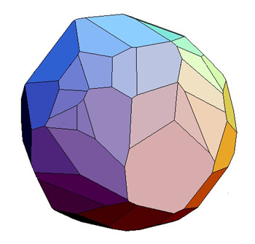
3D Polyhedron

Slide 225
Solving a LP problem (2)
If a solution exists, the Simplex algorithm will find it
But it could take a long time for a problem with many variables!
  Interior point algorithms

Slide 226
Interior point methods
Extreme points
(vertices)
Constraints
(edges)
Simplex: search from vertex to
vertex along the edges
Interior-point methods: go through
the inside of the feasible space

Slide 227
Conclusions
Robustness of LP is an enormous advantage
  If there is a solution, it will be found
Many non-linear optimization problems are linearized so they can be solved using LP
Very efficient implementation of LP solution algorithms are available in commercial solvers

Slide 228
Sequential Linear Programming (SLP)
Used if more accuracy is required
Algorithm:
  Linearize
  Find a solution using LP
  Linearize again around the solution
  Repeat until convergence

Slide 229
Mixed Integer Linear Programming

Slide 230
LP formulation of Economic Dispatch
A
B
C
L
P_{A}=x₁
P_{A}^{MAX}
P_{B}=x₂
P_{B}^{MAX}
P_{C}=x₃
P_{C}^{MAX}

Slide 231
LP formulation of Economic Dispatch
Objective function is linear
All constraints are all linear
All variables are real
→ Problem can be solved using standard linear programming

Slide 232
LP formulation of Economic Dispatch
P_{A}=x₁
P_{A}^{MIN}
P_{A}^{MAX}
P_{B}=x₂
P_{B}^{MIN}
P_{B}^{MAX}
P_{C}=x₃
P_{C}^{MIN}
P_{C}^{MAX}

Slide 233
Can we use LP for unit commitment?
P_{A}=x₁
P_{A}^{MIN}
P_{A}^{MAX}
P_{B}=x₂
P_{B}^{MIN}
P_{B}^{MAX}
P_{C}=x₃
P_{C}^{MIN}
P_{C}^{MAX}

Slide 234
Can we use LP for unit commitment?
P_{A}=x₁
P_{A}^{MIN}
P_{A}^{MAX}
P_{B}=x₂
P_{B}^{MIN}
P_{B}^{MAX}
The variables no longer have
a continuous domain.
Standard linear programming
is no longer applicable.
P_{C}=x₃
P_{C}^{MIN}
P_{C}^{MAX}

Slide 235
Integer Programming
Integer programming:
  All decision variables are integers
  Special case: binary variables {0,1}
Mixed Integer Programming
  Some decision variables are integer or binary
  Other variables are real
Mixed Integer Linear Programming (MILP)
  Objective function and constraints are linear
Mixed Integer Non-Linear Programming (MINLP)

Slide 236
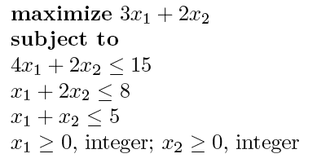
Example
Except for the fact that the variables are integer, this looks very much like a linear programming problem.

Slide 237
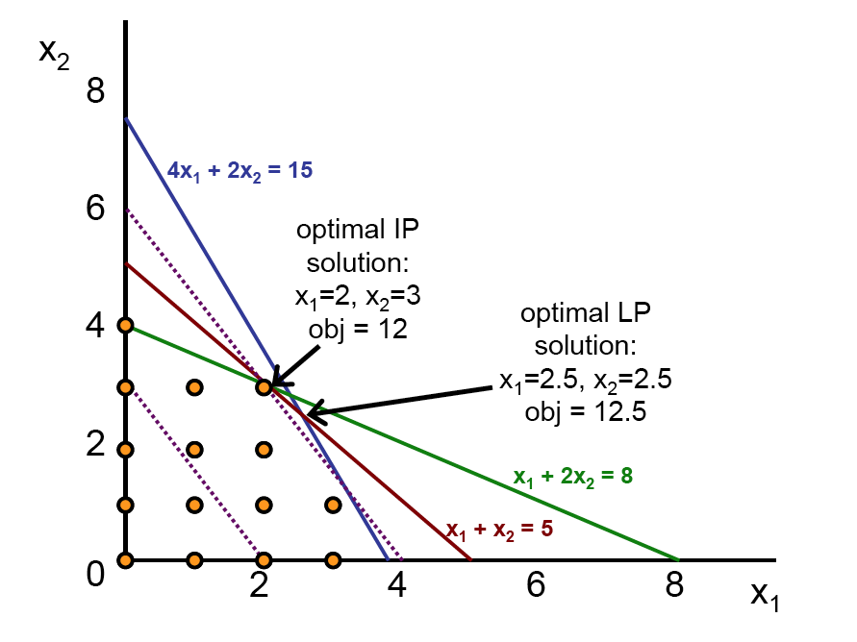
Example

Slide 238
LP Relaxation
The LP solution “relaxes” the
constraints that all variables
can only take integer values

Slide 239
LP Relaxation
The relaxed LP solution is always
“better” than the solution of
original problem!
(Lower objective for minimization
problem, higher for maximization)

Slide 240
Solution of the integer problem
Can we find it by simply
“rounding” the LP solution
to the nearest integer?

Slide 241
Integer Programming Example

Slide 242
Naïve rounding off
x₂
-c^{T}
x₁
LP solution
IP solution
The optimal integer solution can be far away from the LP solution

Slide 243
Finding the integer solution
Large number of integer variables
Vast number of possible integer solutions
Need a systematic procedure to search this solution space
Fix the variables to the nearest integer one at a time
“Branch and Bound” algorithm

Slide 244
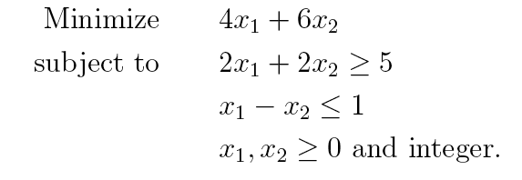
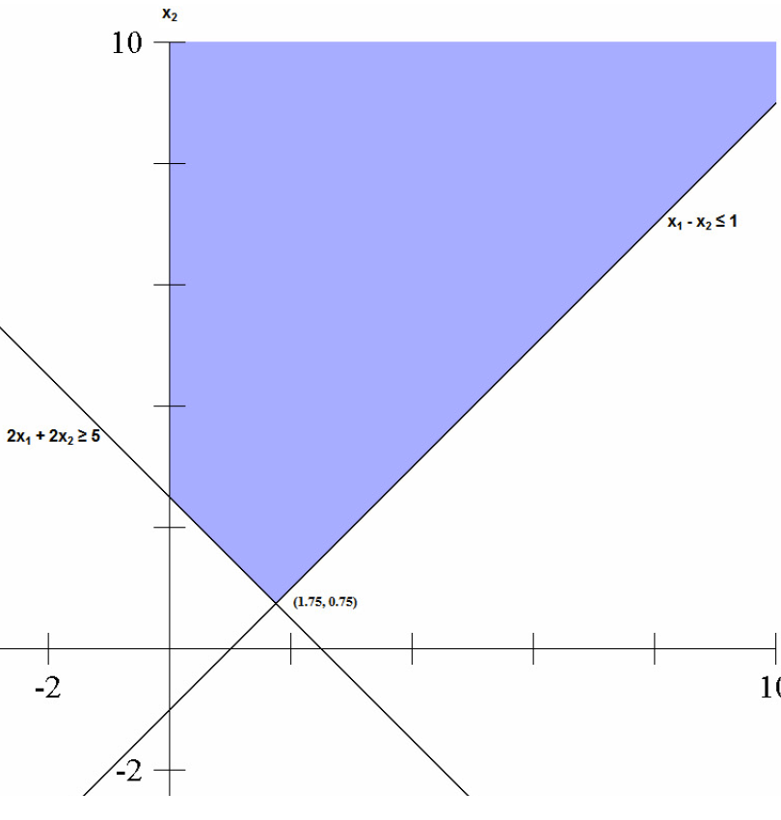
Another example
Relaxed LP solution: (1.75, 0.75)

Slide 245
Branch on x₁
Problem 0
Problem 1
Problem 2

Slide 246
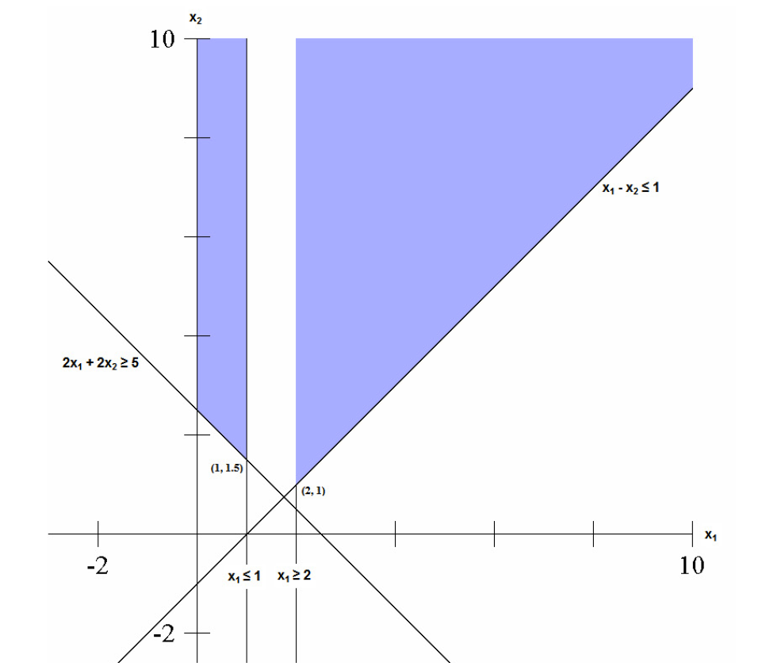
Branch on x₁
Problem 1
Problem 2
Solution of
Problem 1
Solution of Problem 2

Slide 247
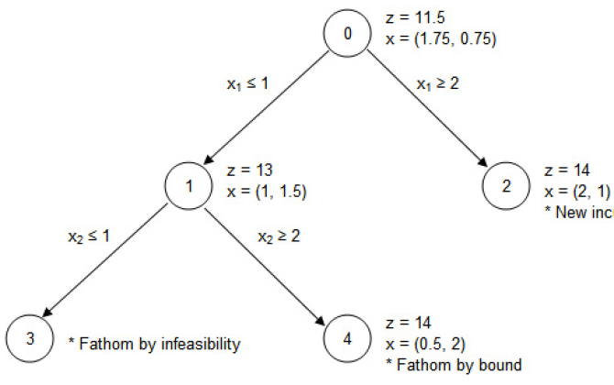
Search Tree: first layer
Solution of Problem 1:
x₁ integer
x₂ real
Not a feasible solution yet
Can still branch on x₂
Solution of Problem 2:
x₁ & x₂ integer
Feasible solution of
the original problem
Bound on the optimum
Best solution so far

Slide 248
Branch on x₂
Problem 1
Problem 3
Problem 4

Slide 249
Branch on x₂ for Problem 1
Problem 1
Problem 2
Problem 4
x₂ = 2
x₂ = 1
Problem 3

Slide 250
Branch on x₂ for Problem 1
Problem 1
Problem 2
Solution of
Problem 4
Problem 4
x₂ = 2
x₂ = 1
Problem 3
No solution!

Slide 251
Search Tree: second layer
No solution
No integer solution yet

Slide 252
Branch and Bound: what next?
Optimal solution
Solution of relaxed problem 4 is bounded by solution of problem 2. No point in going further
Can’t go any further in this direction
No solution

Slide 253
Comments on Branch and Bound
Search tree gets very big if there are more than a few integer or binary variables
Even with the bounds provided by the relaxed solutions, exploring the tree usually takes a ridiculous amount of time
Clever mathematicians have developed techniques to identify “cuts”
  Constraints based on the structure of the problem that eliminate part of the search tree
  “Branch and Cut” algorithm

Slide 254
Mixed Integer Linear Programming
Start with linear programming formulation
Use branch and cut algorithm for integer and binary variables
Each node of the search tree involves the solution of an LP problem

Slide 255
Duality Gap
Finding the optimal solution for a large problem can take too much time even with branch and cut
Best solution of relaxed problem provides a bound on the solution
Duality gap: Difference between best solutions of relaxed problem and actual problem
Stop searching the tree if duality gap is sufficiently small

