Slide 1
Generation Expansion
Daniel Kirschen

Slide 2
The investor’s perspective
Generation is no longer a monopoly activity
No captive customers
Competing companies with other technologies
Will a new plant generate enough profit from the sale of energy to justify the investment?

Slide 3
The consumer’s perspective
In a competitive environment, no generator is responsible for serving all the consumers
Will selling electrical energy be sufficiently profitable to encourage investors to build enough generation capacity?
Do investors need an extra incentive to build enough generation capacity?

Slide 4
The Investor’s Perspective

Slide 5
Example 1: Investing in a coal plant
Data for a coal plant
Is it worth building a 500MW plant?
Assume a utilization factor of 80%
Assume average price of electrical energy is 32 $/MWh

Slide 6
Example 1 (continued)
Investment cost:
1021 $/kW x 500 MW = $510,500,000
Estimated annual production:
0.8 x 500 MW x 8760 h/year = 3,504,000 MWh
Estimated annual production cost:
3,504,000 MWh x 9419 Btu/kWh x 1.25 $/MBtu = $41, 255, 220
Estimated annual revenue:
3,504,000 MWh x 32 $/MWh = $112,128,000

Slide 7
Example 1 (continued)
Total net cash flow over 30 years:
- $510,500,000 + 30 x $70,872,780 = $1,615,683,400
Is this plant profitable enough?

Slide 8
Example 1 (continued)
Time value of money
A dollar now is worth more to me than a dollar next year or
How much interest should I be paid to invest my dollar for one year rather than spend it now?
This interest should take inflation into account
Apply this concept to investments
Calculate Internal Rate of Return (IRR) of net cash flow stream
Standard accounting formula (use a spreadsheet)
Gives more weight to profit in the early years than in the later years
Example: IRR = 13.58%

Slide 9
Example 1 (continued)
Is an IRR of 13.58% good enough?
Compare it to the Minimum Acceptable Rate of Return (MARR) of the investor
If IRR ≥ MARR → investment is OK
If IRR < MARR →investment is not worth making
How do firms set their MARR?
Specializes in high risk investments
→ set MARR high
Specializes in low risk investments
→ set MARR lower

Slide 10
Example 1 (continued)
What are the risks?
Average price of electricity may be less than 32 $/MWh
Utilization factor may be less than 80%
Recalculate the IRR for various conditions
Utilization factor
MARR

Slide 11
Example 2: CCGT Plant
Investment cost | 533 $/kW
Expected plant life | 30 years
Heat rate at rated output | 6,927 Btu/kWh
Expected fuel cost | 3.00 $/MBtu

Slide 12
Example 2: CCGT Plant
Annual production:
0.8 x 500 MW x 8760 hours/year = 3,504,000 MWh
Annual revenue:
3,504,000 MWh x 32 $/MWh = $ 112,128,000
Investment cost:
533 $/kW x 500 MW = $266,500,000
Annual production cost:
3,504,000 MWh x 6,927 Btu/kWh x 3.00 $/MBtu = $72,816,624

Slide 13
Example 2: CCGT Plant
Year | CCGT Plant Investment (A) | Coal Plant Investment (B) | CCGT Plant Production Cost (C) | Coal Plant Production Cost (D) | Incremental Net Cash Flow (A)-(B)+(C)-(D)
0 | $266,500,000 | $ 510,500,000 | 0 | 0 | - $ 244,000,000
1 | 0 | 0 | $ 72,816,624 | $ 41,255,220 | $ 31,561,404
2 | 0 | 0 | $ 72,816,624 | $ 41,255,220 | $ 31,561,404
3 | 0 | 0 | $ 72,816,624 | $ 41,255,220 | $ 31,561,404
… | … | … | … | … | …
30 | 0 | 0 | $ 72,816,624 | $ 41,255,220 | $ 31,561,404
→ IRR =12.56%.

Slide 14
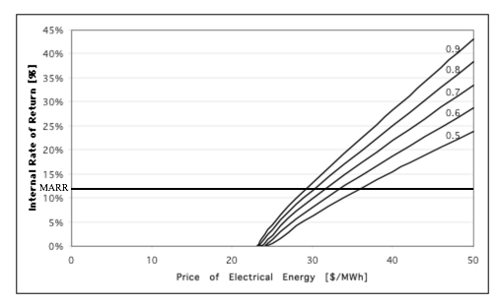
Example 2: CCGT Plant

Slide 15
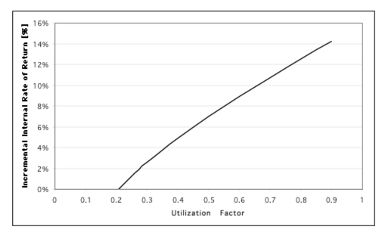
Example 2: CCGT Plant

Slide 16
Example 3: Wind farm
Investment cost | 919 $/kW
Expected plant life | 30 years
Heat rate at nominal output | 0
Expected fuel cost | 0
Initial investment cost :
919 $/kW x 100 MW = $ 91,900,000
Annual production:
0.35 x 100 MW x 8760 hours/year = 306,600 MWh
Annual revenue:
306,600 MWh x 32 $/MWh = $ 9,811,200

Slide 17
Example 3: Wind farm
Year | Investment | Production | Production cost | Revenue | Net Cash Flow
0 | $ 91,900,000 | 0 | 0 | 0 | - $ 91,900,000
1 | 0 | 306,600 | 0 | $ 9,811,200 | $ 9,811,200
2 | 0 | 306,600 | 0 | $ 9,811,200 | $ 9,811,200
3 | 0 | 306,600 | 0 | $ 9,811,200 | $ 9,811,200
… | 0 | … | … | … | …
30 | 0 | 306,600 | 0 | $ 9,811,200 | $ 9,811,200
→ IRR =10.08%.

Slide 18
Retiring generation capacity
Once a plant has been built:
Most of the investment cost becomes a sunk cost
Sunk costs are irrelevant in further decisions
A plant will be retired if it no longer recovers its operating cost and is not likely to do so in the future
Examples:
Operating cost increases because fuel cost increases
Plant utilization and/or energy price decrease because cheaper plants become available
Decision based only on prediction of future revenues and costs
Technical fitness and lifetime are irrelevant

Slide 19
Effect of a cyclical demand
Basic microeconomics:
If demand increases or supply decreases (because plants are retired) prices will increase
If prices increase, investment projects become more profitable
New generating plants are built
Difficulties
Demand for electricity is cyclical
Electrical energy cannot be stored economically
Must forecast utilization factor for each plant

Slide 20
Load Duration Curve
Number of hours per year during which the demand exceeds a certain level
PJM (Pennsylvania Jersey Maryland) system in 1999

Slide 21
Effect of cyclical demand
Peak load is much higher than average load
Total installed capacity must be much higher than average load
Cheap generators operate most of the time
More expensive generators operate during only a fraction of the time
Prices will be higher during periods of high demand
Competition will be limited during periods of high demand because most generators are already fully loaded

Slide 22
Price duration curve
PJM system, 1999
Actual peak price reached $1000/MWh for a few hours

Slide 23
What about the most expensive unit?
In a competitive market
Market price set by marginal cost of marginal generator
Infra marginal generators collect an economic profit because their marginal cost is less than the market price
Economic profit pays the fixed costs
Marginal generator does not collect any economic profit
Marginal generator does not pay its fixed costs
Price
supply
Economic
profit
demand
Infra-marginal
Quantity
Marginal producer

Slide 24
What about the most expensive unit?
Because of the cyclical demand, most units will be infra-marginal during part of the year
Most unit will therefore have an opportunity to recover their fixed costs
The unit that only runs a few hours a year to meet the peak demand is never infra-marginal
It must recover its costs by incorporating them in its price
Must be recovered over a few hours only
Prices are very high during these periods (price spikes)
Possible because market is not competitive during these periods
What if the yearly peak demand is lower than expected?

Slide 25
Example 4: Retirement
Aging 50 MW plant
Heat rate: 12,000 BTU/kWh
Fuel cost: 3.00 $/MBTU
Fixed cost: $280,000 per year
Revenue required to cover the total operating cost:
Production [MWh] x bid [$/MWh] =
fixed cost [$] + production [MWh] x heat rate [Btu/kWh] x fuel cost [$/MBtu]

Slide 26
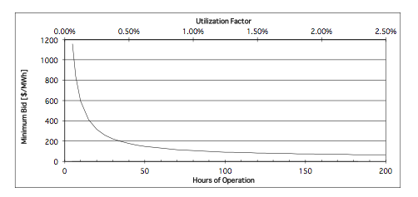
Example 4: Retirement
Compare with the marginal cost of production of 36 $/MWh

Slide 27
The consumer’s perspective

Slide 28
Meeting the peak demand
In a competitive environment, there is no obligation on generating companies to build enough capacity to meet the peak demand
The “regulatory compact” no longer applies to generators
Rely on price signals to encourage investments
What if no generation company wants to own the most expensive unit that runs only a few hours a year?
Owning that plant is not very profitable and risky
Will there be enough generation capacity available to meet the reliability expectations?

Slide 29
Consequences of not meeting the peak demand
Load must be shed (i.e. customers temporarily disconnected)
Cost of these interruptions: Value of Lost Load (VOLL)
VOLL is about 100 times larger than the average cost of electricity
Customers have a much stronger interest in having enough generation capacity than generators
Customers may be willing to pay extra to guarantee that there will be enough capacity available

Slide 30
Capacity incentives
Advantages
Capacity insurance policy: pay a little bit regularly to avoid a major problem
Disadvantages
Less economically efficient behaviour
How much should generators be paid per MW? Or
How much capacity should be available?

Slide 31
Capacity incentives
Capacity payments
Pay generators a fixed rate per MW of capacity available
Encourages them to keep available plants that don’t generate many MWh
Capacity market
Regulator determines the generation capacity required to meet a reliability target
Consumers must all “buy” their share of this capacity
Generators bid to provide this capacity
Price paid depends on how much capacity is offered
Consider demand response in the capacity market

