Slide 1
Participating in Electricity Markets
Daniel Kirschen

Slide 2
Perspective
Generator
Consumer
Retailer
Operator of a pumped-hydro plant

Slide 3
Participating in Electricity Markets: The consumer’s perspective

Slide 4
Consumer’s perspective
Microeconomic theory
VoLL
Low price elasticity of the demand
Demand reduction
Demand shifting

Slide 5
Participating in Electricity Markets: The retailer’s perspective

Slide 6
The retailer’s perspective
Sell energy to consumers, mostly at a flat rate (fixed price)
Buy energy in bulk:
  Spot market
  Contracts
Must forecast the load of its customers
Regional monopoly: traditional top-down forecasting
Retail competition: bottom-up forecasting
  Difficult problem: customer base changes
  Much less accurate than traditional load forecasting

Slide 7
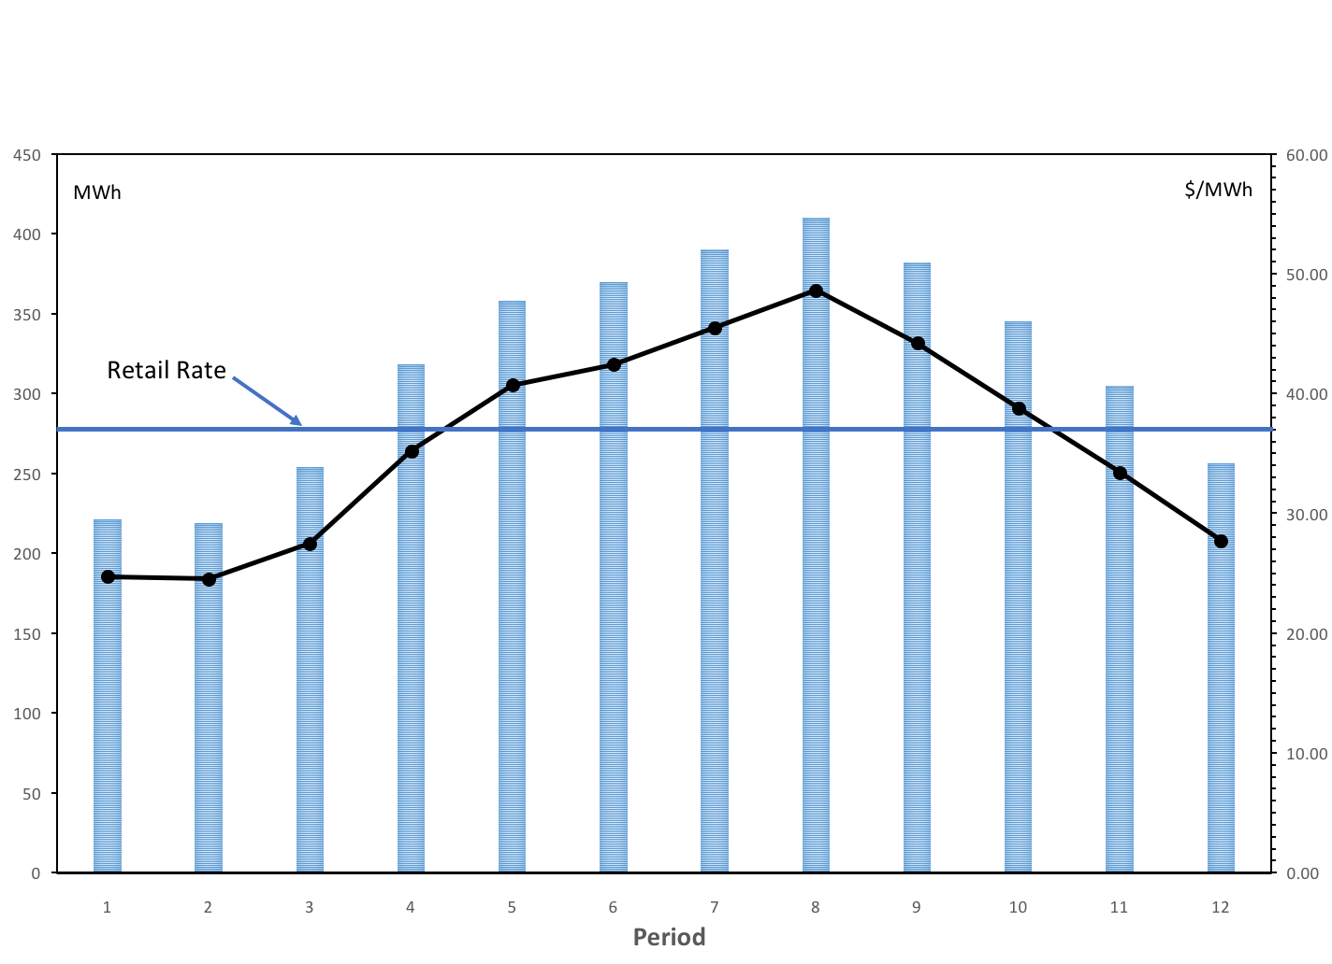
Fig. 4.1: Forecast demand, average forward purchase price and retail rate for the case of a flat retail tariff

Slide 8
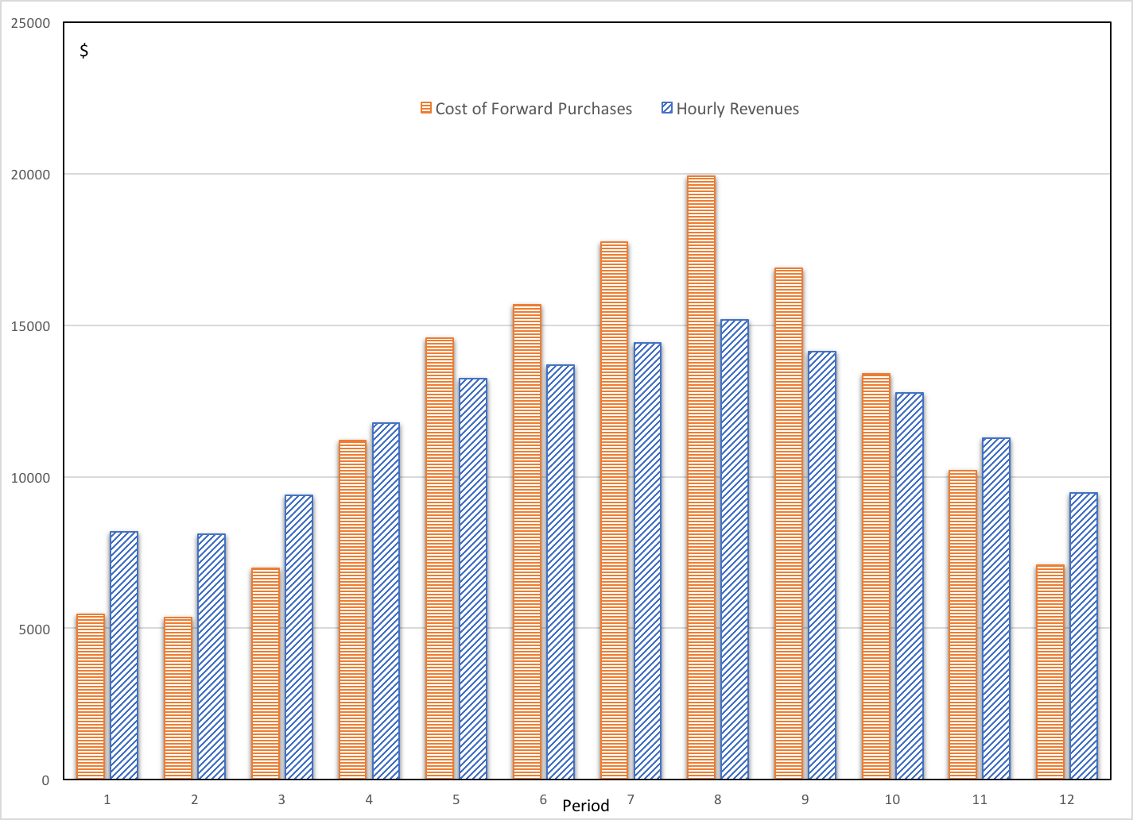
Fig. 4.2: Cost of forward purchases and retail hourly retail revenues for the case of a flat retail tariff

Slide 9
Table 4.1: Retail operations over a 12-hour period for the case of flat retail tariff of 37 $/MWh
Hour | 1 | 2 | 3 | 4 | 5 | 6 | 7 | 8 | 9 | 10 | 11 | 12 | Totals
Load Forecast (MWh) | 221 | 219 | 254 | 318 | 358 | 370 | 390 | 410 | 382 | 345 | 305 | 256 | 3828
Forward Purchases (MWh) | 221 | 219 | 254 | 318 | 358 | 370 | 390 | 410 | 382 | 345 | 305 | 256 | 3828
Average Forward Prices ($/MWh) | 24.70 | 24.50 | 27.50 | 35.20 | 40.70 | 42.40 | 45.50 | 48.60 | 44.20 | 38.80 | 33.40 | 27.70
Cost of Forward Purchases ($) | 5459 | 5366 | 6985 | 11194 | 14571 | 15688 | 17745 | 19926 | 16884 | 13386 | 10187 | 7091 | 144482
Hourly Revenues ($) | 8177 | 8103 | 9398 | 11766 | 13246 | 13690 | 14430 | 15170 | 14134 | 12765 | 11285 | 9472 | 141636
Hourly Profits ($) | 2718 | 2737 | 2413 | 572 | -1325 | -1998 | -3315 | -4756 | -2750 | -621 | 1098 | 2381 | -2846

Slide 10
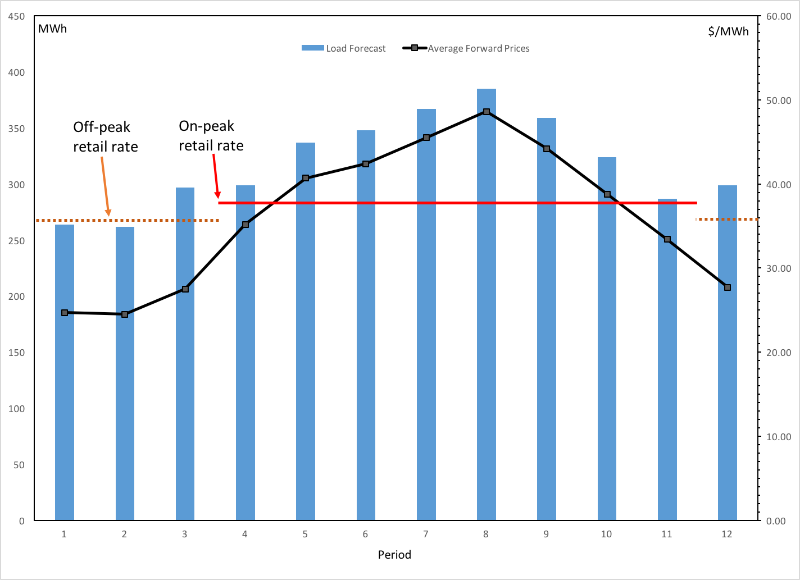
Fig 4.3: Forecast demand, average forward purchase prices and retail rate for the case of an on-peak/off-peak retail tariff

Slide 11
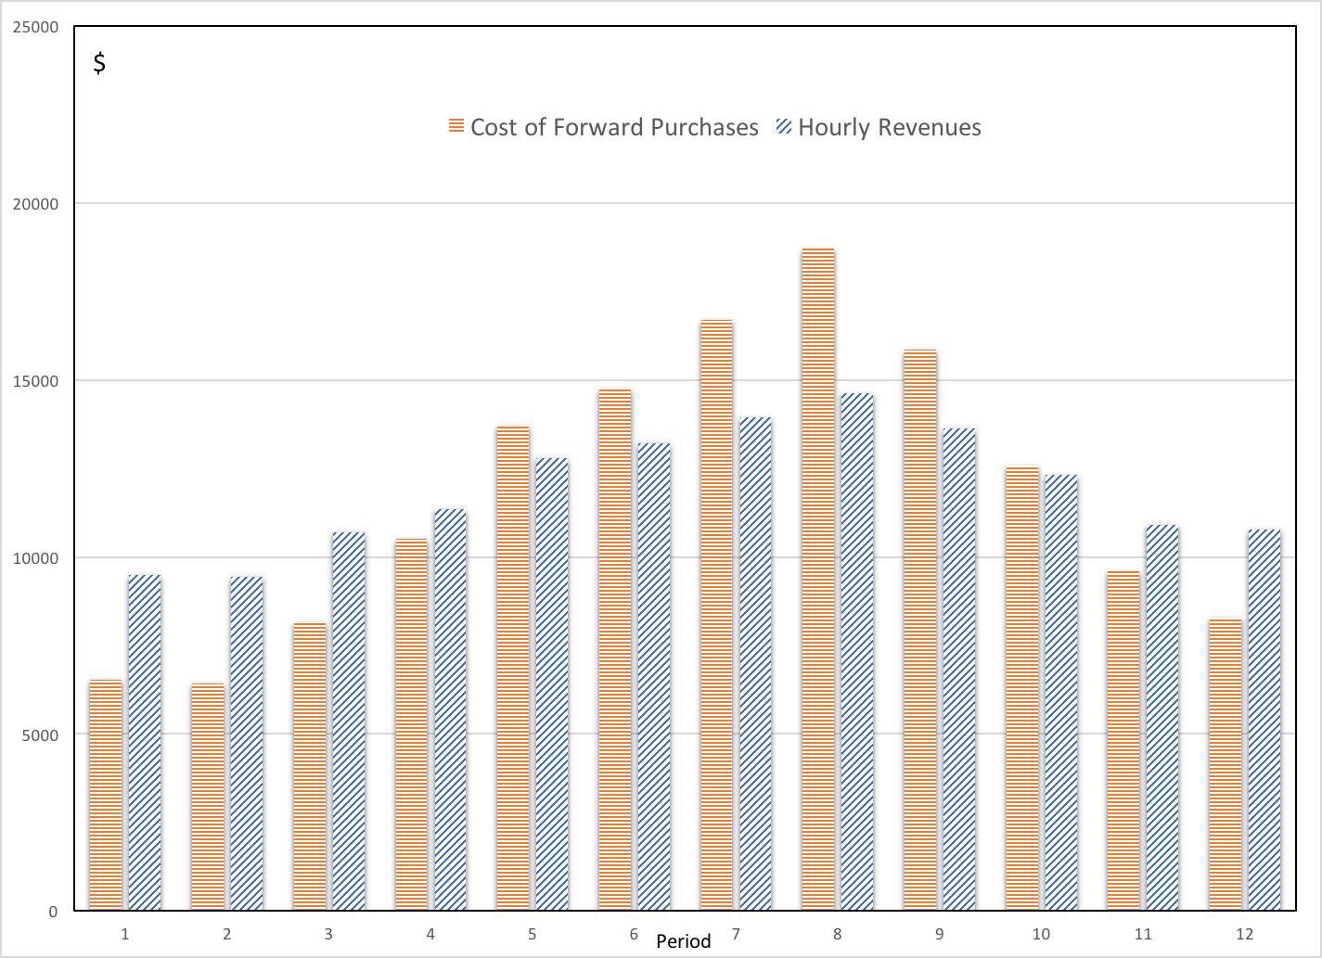
Fig 4.4: Cost of forward purchases and retail hourly retail revenues for the case of an on-peak/off-peak retail tariff

Slide 12
Table 4.2: Retail operations over a 12-hour period for an on-peak retail rate of 38 $/MWh and an off-peak retail rate of 36 $/MWh
Hour | 1 | 2 | 3 | 4 | 5 | 6 | 7 | 8 | 9 | 10 | 11 | 12 | Totals
Load Forecast (MWh) | 264 | 262 | 297 | 299 | 337 | 348 | 367 | 385 | 359 | 324 | 287 | 299 | 3828
Forward Purchases (MWh) | 264 | 262 | 297 | 299 | 337 | 348 | 367 | 385 | 359 | 324 | 287 | 299 | 3828
Average Forward Prices ($/MWh) | 24.70 | 24.50 | 27.50 | 35.20 | 40.70 | 42.40 | 45.50 | 48.60 | 44.20 | 38.80 | 33.40 | 27.70
Cost of Forward Purchases ($) | 6521 | 6419 | 8168 | 10525 | 13716 | 14755 | 16699 | 18711 | 15868 | 12571 | 9586 | 8282 | 141821
Revenues ($) | 9504 | 9432 | 10692 | 11362 | 12806 | 13224 | 13946 | 14630 | 13642 | 12312 | 10906 | 10764 | 143220
Profits ($) | 2983 | 3013 | 2524 | 837 | -910 | -1531 | -2753 | -4081 | -2226 | -259 | 1320 | 2482 | 1399

Slide 13
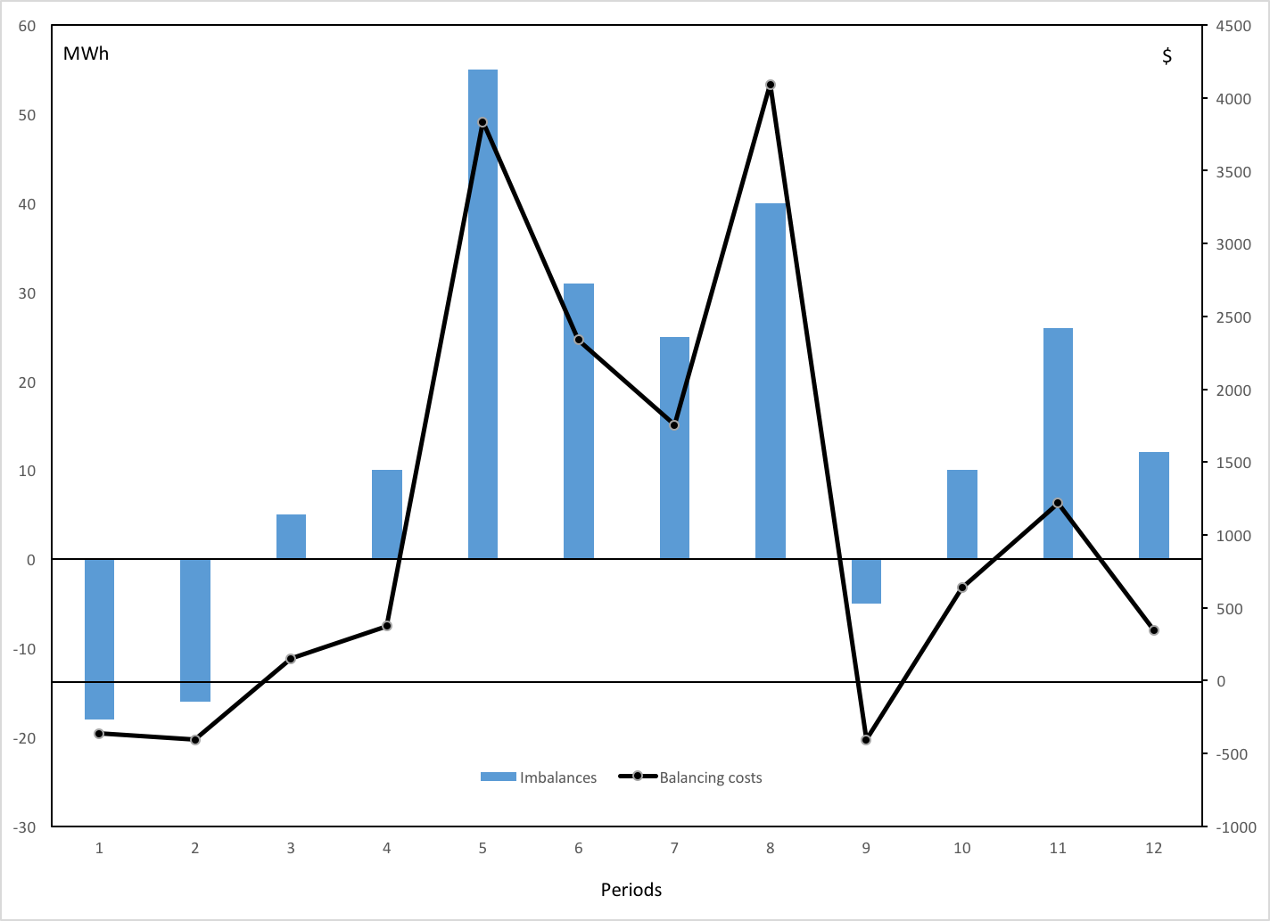
Fig 4.5: Imbalances between forward purchases and actual energy consumed and corresponding balancing costs

Slide 14
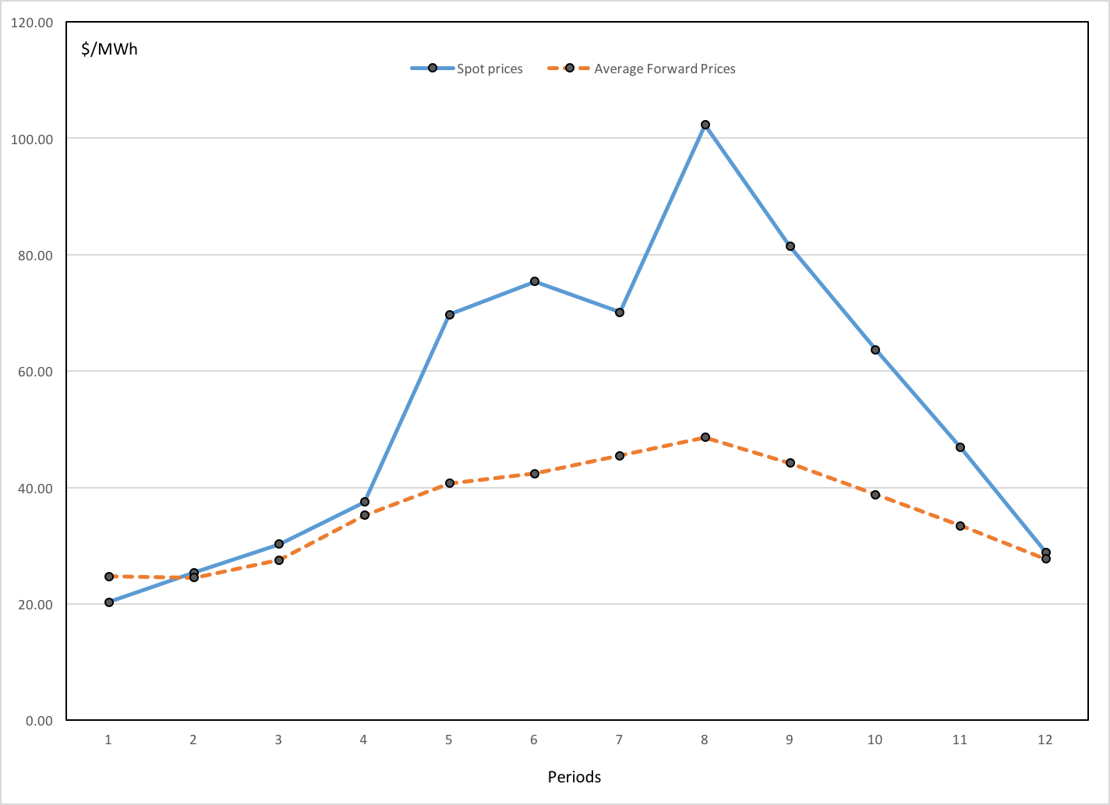
Fig. 4.6: Spot prices and average forward prices

Slide 15
Table 4.3: Retail operations over a 12-hour period for a flat retail rate of 37 $/MWh considering forecasting errors and implied spot market trades.
Hour | 1 | 2 | 3 | 4 | 5 | 6 | 7 | 8 | 9 | 10 | 11 | 12 | Totals
Forecast load | 221 | 219 | 254 | 318 | 358 | 370 | 390 | 410 | 382 | 345 | 305 | 256 | 3828
Forward energy purchases | 221 | 219 | 254 | 318 | 358 | 370 | 390 | 410 | 382 | 345 | 305 | 256 | 3828
Average forward price | 24.70 | 24.50 | 27.50 | 35.20 | 40.70 | 42.40 | 45.50 | 48.60 | 44.20 | 38.80 | 33.40 | 27.70
Forward purchase costs | 5459 | 5366 | 6985 | 11194 | 14571 | 15688 | 17745 | 19926 | 16884 | 13386 | 10187 | 7091 | 144482
Actual loads | 203 | 203 | 259 | 328 | 413 | 401 | 415 | 450 | 377 | 355 | 331 | 268 | 4003
Imbalances | -18 | -16 | 5 | 10 | 55 | 31 | 25 | 40 | -5 | 10 | 26 | 12 | 175
Spot prices | 20.30 | 25.40 | 30.30 | 37.50 | 69.70 | 75.40 | 70.10 | 102.3 | 81.40 | 63.70 | 46.90 | 28.90
Balancing costs | -365 | -406 | 152 | 375 | 3834 | 2337 | 1753 | 4092 | -407 | 637 | 1219 | 347 | 13568
Total hourly cost | 5094 | 4960 | 7137 | 11569 | 18405 | 18025 | 19498 | 24018 | 16477 | 14023 | 11406 | 7438 | 158050
Hourly revenues | 7511 | 7511 | 9583 | 12136 | 15281 | 14837 | 15355 | 16650 | 13949 | 13135 | 12247 | 9916 | 148111
Hourly profits | 2417 | 2551 | 2446 | 567 | -3124 | -3188 | -4143 | -7368 | -2528 | -888 | 841 | 2478 | -9939

Slide 16
Participating in Electricity Markets:
The Generator’s Perspective

Slide 17
Market Structure
Monopoly
Oligopoly
Perfect Competition
Monopoly:
  Monopolist sets the price at will
  Must be regulated
Perfect competition:
  No participant is large enough to affect the price
  All participants act as “price takers”
Oligopoly:
  Some participants are large enough to affect the price
  Strategic bidders have market power
  Others are price takers

Slide 18
Perfect competition
All producers have a small share of the market
All consumers have a small share of the market
Individual actions have no effect on the market price
All participants are “price takers”

Slide 19
Short run profit maximization for a price taker
Output of one of the generators
Production cost
Revenue
Independent of quantity produced because price taker
Adjust production y until the marginal
cost of production is equal to the
price π

Slide 20
Example 4.2
Coal fired unit with minimum output 100 MW and
maximum output 500 MW

Slide 21
Unit limits
?

Slide 22
Piecewise linear cost curves

Slide 23
Piecewise constant marginal cost curve

Slide 24
Dispatch with piecewise curves

Slide 25
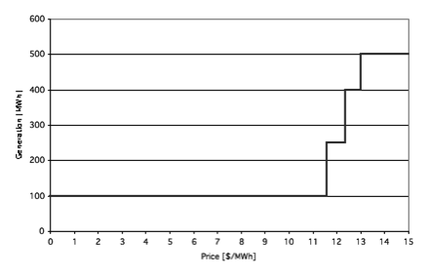
Example 4.4

Slide 26
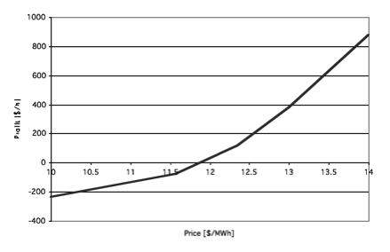
Example 4.5

Slide 27
Scheduling
Startup cost
Operating constraints
Environmental constraints
Other revenue opportunities
Forecasting errors

Slide 28
Example 4.6
Hour | 1 | 2 | 3 | 4 | 5 | 6 | 7
Price [$/MWh] | 12.0 | 13.0 | 13.5 | 10.5 | 12.5 | 13.5 | 11.5
Generation [MW] | 257.7 | 450.0 | 500.0 | 100.0 | 353.8 | 500.0 | 161.5
Revenue [$] | 3,092 | 5,850 | 6,750 | 1,050 | 4,423 | 6,750 | 1,858
Running cost [$] | 3,063 | 5,467 | 6,123 | 1,235 | 4,240 | 6,123 | 1,933
Startup cost [$] | 600 | 0 | 0 | 0 | 0 | 0 | 0
Total cost [$] | 3,663 | 5,467 | 6,123 | 1,235 | 4,240 | 6,123 | 1,933
Profit [$] | -571 | 383 | 627 | -185 | 183 | 627 | -75
Cumulative profit [$] | -571 | -188 | 439 | 254 | 437 | 1,064 | 989

Slide 29
Produce vs. Purchase
Minimize
subject to

Slide 30
Example 4.7
L = 260 MW

Slide 31
Bidding under perfect competition
Since there are lots of small producers, a change in bid causes a change in the order of the bids
If I bid at my marginal cost
  I get paid the market clearing price if marginal or infra-marginal producer
If I bid higher than my marginal cost
  I could become extra-marginal and miss an opportunity to sell at a profit
If I bid lower than my marginal cost
  I could have to produce at a loss
No incentive to bid anything else than marginal cost of production
Price
supply
demand
Quantity

Slide 32
Marginal, infra-marginal, extra-marginal producers
Everything is sold at the market clearing price
Price is set by the “last” unit sold
Marginal producer:
  Sells this last unit
  Gets exactly its bid
Infra-marginal producers:
  Get paid more than their bid
  Collect economic profit
Extra-marginal producers:
  Sell nothing
No difference between centralized auction and bilateral market
Price
supply
Extra-marginal
demand
Infra-marginal
Quantity
Marginal producer

Slide 33
Profit of an infra-marginal producer
$/MWh
Economic profit
π
MWh
Variable cost of producing energy

Slide 34
Profit of an infra-marginal producer
Selling at marginal cost covers the variable cost of production
The difference between the market price and the marginal cost must pay for the fixed costs:
  No-load cost, startup cost
  Cost of building the plant
  Interest payments for the bank, dividends for the shareholders
A plant must therefore be infra-marginal often enough to cover its fixed costs
  Market price > marginal cost for enough hours of the year

Slide 35
Profit of a marginal producer
$/MWh
No economic profit!
Variable cost of producing energy
MWh

Slide 36
Profit of a marginal producer
If a marginal generator bids at its marginal cost, it makes no economic profit
  Covers only its variable cost of production
  Does not cover its fixed cost
Generators that are too often marginal or just below marginal will not recover their fixed costs if they bid at their marginal cost of production
  They must include part of their fixed costs in their offer price
  Their offer price is therefore higher than their marginal cost
  They can do it because competition is not perfect when the load is high because most generators are already producing

Slide 37
Imperfect Competition

Slide 38
Game theory and Nash equilibrium
Each firm must consider the possible actions of others when selecting a strategy
Classical optimization theory is insufficient
Two-person non-co-operative game:
  One firm against another
  One firm against all the others
Nash equilibrium:
  Given the action of its rival, no firm can increase its profit by changing its own action

Slide 39
Imperfect Competition – Game theory
Nash equilibrium

Slide 40
Bertrand model – Game in price

Slide 41
Bertrand Competition
Example 1
  C_{A} = 35 . P_{A} $/h
  C_{B} = 45 . P_{B} $/h
Bid by A?
Bid by B?
Market price?
Quantity traded?
P_{A}
P_{B}
A
B
C_{A}(P_{A})
C_{B}(P_{B})
Inverse demand curve

Slide 42
Bertrand Competition
Example 1
  C_{A} = 35 . P_{A} $/h
  C_{B} = 45 . P_{B} $/h
Marginal cost of A: 35 $/MWh
Marginal cost of B: 45 $/MWh
A will bid just below 45 $/MWh
B cannot bid below 45 $/MWh because it would lose money on every MWh
Market price: just below 45 $/MWh
Demand: 55 MW
P_{A} = 55MW
P_{B} = 0
P_{A}
P_{B}
A
B
C_{A}(P_{A})
C_{B}(P_{B})

Slide 43
Bertrand Competition
Example 2
  C_{A} = 35 . P_{A} $/h
  C_{B} = 35 . P_{B} $/h
Bid by A?
Bid by B?
Market price?
Quantity traded?
P_{A}
P_{B}
A
B
C_{A}(P_{A})
C_{B}(P_{B})

Slide 44
Bertrand Competition
P_{A}
P_{B}
Example 2
  C_{A} = 35 . P_{A} $/h
  C_{B} = 35 . P_{B} $/h
A cannot bid below 35 $/MWh because it would lose money on every MWh
A cannot bid above 35 $/MWh because B would bid lower and grab the entire market
Market price: 35 $/MWh
Paradox of Bertrand model of imperfect competition
  Identical generators: bid at marginal cost
  Non-identical generators: cheapest gets the whole market
Is this a realistic model of imperfect competition?
A
B
C_{A}(P_{A})
C_{B}(P_{B})

Slide 45
Cournot model – Game in quantity
Cournot equilibrium

Slide 46
Short run profit maximization with market power
Production of generator i
is the total industry output
Not zero because of market power

Slide 47
Short run profit maximization with market power
is the price elasticity of demand
is the market share of generator i
< 1 → at the optimum production, the marginal cost of generator i is less than the market price.

Slide 48
Cournot competition: Example 1
P_{A}
P_{B}
C_{A} = 35 . P_{A} $/h
C_{B} = 45 . P_{B} $/h
Suppose P_{A}= 15 MW and P_{B} = 10 MW
Then D = P_{A} + P_{B} = 25 MW
π = 100 - D = 75 $/MW
R_{A}= 75 . 15 = $ 1125 C_{A}= 35 . 15 = $ 525
R_{B}= 75 . 10 = $ 750 C_{B}= 45 . 10 = $ 450
Profit of A = R_{A} - C_{A} = $ 600
Profit of B = R_{B} - C_{B} = $ 300
A
B
C_{A}(P_{A})
C_{B}(P_{B})

Slide 49
Cournot competition: Example 1
Summary:
For P_{A}=15MW and P_{B} = 10MW, we have:
Demand
Profit of A
Profit of B
Price

Slide 50
Cournot competition: Example 1
P_{A}=15
P_{A}=20
P_{A}=25
P_{A}=30
P_{B}=10
P_{B}=15
P_{B}=20
P_{B}=25

Slide 51
Cournot competition: Example 1
P_{A}=15
P_{A}=20
P_{A}=25
P_{A}=30
P_{B}=10
P_{B}=15
P_{B}=20
P_{B}=25
Price decreases as supply increases
Profits of each affected by other
Complex relation between production
and profits

Slide 52
Let’s play the Cournot game!
P_{A}=15
P_{A}=20
P_{A}=25
P_{A}=30
P_{B}=10
P_{B}=15
P_{B}=20
P_{B}=25
Equilibrium solution!
A cannot do better without B doing worse
B cannot do better without A doing worse
Nash equilibrium

Slide 53
Cournot competition: Example 1
Demand
Profit of A
P_{A}=25
C_{A} = 35 . P_{A} $/h
C_{B} = 45 . P_{B} $/h
P_{B}=15
Profit of B
Price
Generators achieve price larger than their marginal costs
The cheapest generator does not grab the whole market
Generators balance price and quantity to maximize profits
Warning: price is highly dependent on modeling of demand curve and are thus often not realistic

Slide 54
Cournot competition: Example 2
P_{A}
P_{B}
P_{N}
C_{A} = 35 . P_{A} $/h
C_{B} = 45 . P_{B} $/h
…
C_{N} = 45 . P_{N} $/h
A is a “strategic” player
  i.e. with market power
The others are “the competitive fringe”
...
A
B
N
C_{A}(P_{A})
C_{B}(P_{B})
C_{N}(P_{N})

Slide 55
Cournot competition: Example 2

Slide 56
Cournot competition: Example 2

Slide 57
Cournot competition: Example 2

Slide 58
Other competition models
Supply functions equilibrium
  Bid price depends on quantity
Agent-based simulation
  Represent more complex interactions
Maximising short-term profit is not the only possible objective
  Maximizing market share
  Avoiding regulatory intervention

Slide 59
Plants that do not burn fossil fuels
Nuclear power plants
Hydro-electric power plants

Slide 60
Wind and solar generation
Intermittency and stochasticity
Government policies and subsidies
  Renewable portfolio standards
  Investment tax credits
  Production tax credits
  Feed-in tariffs
  Contracts for difference
  Renewable energy certificates
Effects on the market

Slide 61
Self scheduling of storage

Slide 62
Centralized scheduling of storage

Slide 63
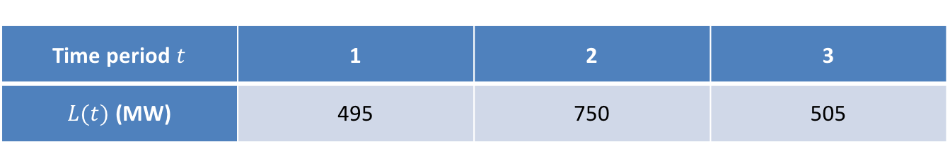
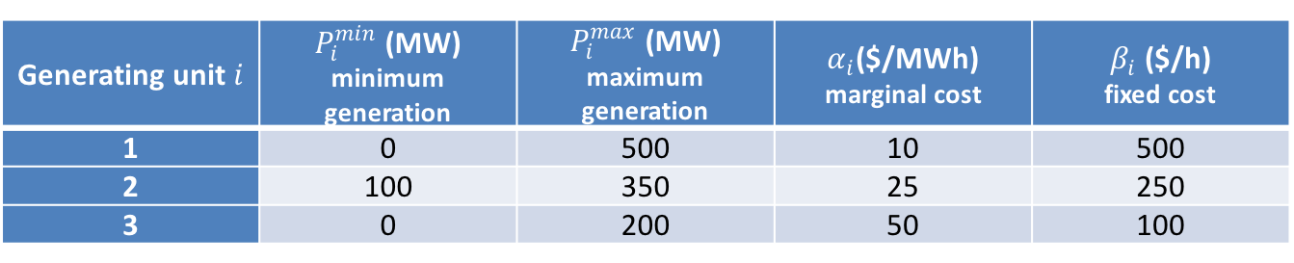
Example 4.12
Generating unit$i$ | $P_{i}^{min}$ (MW) minimum generation | $P_{i}^{max}$ (MW) maximum generation | $α_{i}$($/MWh) marginal cost | $β_{i}$ ($/h) fixed cost
1 | 0 | 500 | 10 | 500
2 | 100 | 350 | 25 | 250
3 | 0 | 200 | 50 | 100
Time period$t$ | 1 | 2 | 3
$L(t)$ (MW) | 495 | 750 | 505

Slide 64
Market settlement without storage
Hour | Price $/MWh |  | Unit 1 | Unit 2 | Unit 3
1 | 10 | Output (MWh) | 495 | 0 | 0
 |  | Revenue ($) | 4950 | 0 | 0
 |  | Cost ($) | 5450 | 0 | 0
 |  | Profit ($) | -500 | 0 | 0
2 | 25 | Output (MWh) | 500 | 250 | 0
 |  | Revenue ($) | 12500 | 6250 | 0
 |  | Cost ($) | 5500 | 6500 | 0
 |  | Profit ($) | 7000 | -250 | 0
3 | 50 | Output (MWh) | 500 | 0 | 5
 |  | Revenue ($) | 25000 | 0 | 250
 |  | Cost ($) | 5500 | 0 | 350
 |  | Profit ($) | 19500 | 0 | -100
 |  | Total profit ($) | 26,000 | -250 | -100
 |  | Total cost ($) | 23,300

Slide 65
Market settlement with a 1MW/10MWh battery
Hour | Price $/MWh |  | Unit 1 | Unit 2 | Unit 3 | Battery
1 | 10 | Output (MWh) | 496 | 0 | 0 | -1
 |  | Revenue ($) | 4960 | 0 | 0 | -10
 |  | Cost ($) | 5460 | 0 | 0 | 0
 |  | Profit ($) | -500 | 0 | 0 | -10
2 | 25 | Output (MWh) | 500 | 251 | 0 | -0.2
 |  | Revenue ($) | 12500 | 6275 | 0 | -5
 |  | Cost ($) | 5500 | 6525 | 0 | 0
 |  | Profit ($) | 7000 | -250 | 0 | -5
3 | 50 | Output (MWh) | 500 | 0 | 3.3 | 1
 |  | Revenue ($) | 25000 | 0 | 165 | 50
 |  | Cost ($) | 5500 | 0 | 265 | 0
 |  | Profit ($) | 19500 | 0 | -100 | 50
 |  | Total Profit ($) | 26,000 | -250 | -100 | 35
 |  | Total Cost ($) | 23,250

Slide 66
Market settlement with a 10MW/10MWh battery
Hour | Price $/MWh |  | Unit 1 | Unit 2 | Unit 3 | Battery
1 | 10 | Output (MWh) | 500 | 0 | 0 | -5
 |  | Revenue ($) | 5000 | 0 | 0 | -50
 |  | Cost ($) | 5500 | 0 | 0 | 0
 |  | Profit ($) | -500 | 0 | 0 | -50
2 | 25 | Output (MWh) | 500 | 251 | 0 | -1
 |  | Revenue ($) | 12500 | 6275 | 0 | -25
 |  | Cost ($) | 5500 | 6525 | 0 | 0
 |  | Profit ($) | 7000 | -250 | 0 | -25
3 | 10 | Output (MWh) | 500 | 0 | 0 | 5
 |  | Revenue ($) | 5000 | 0 | 0 | 50
 |  | Cost ($) | 5500 | 0 | 0 | 0
 |  | Profit ($) | -500 | 0 | 0 | 50
 |  | Total Profit ($) | 6,000 | -250 | 0 | -25
 |  | Total Cost ($) | 23,025

Slide 67
Flexible consumer’s perspective
Storage vs. flexible demand
Remunerating flexible demand
  Price-based
  Incentive-based

Slide 68
Overall market perspective

Slide 69
Offer curve
Offer Price (US $/MWh)

Slide 70
Variations in the price of electricity
Load
Peak load
Minimum load
Time
00:00
06:00
12:00
18:00
24:00

Slide 71
Bid curve
Bid Price (US $/MWh)
Hour 3
Hour 11

Slide 72
Market clearing
Offer Price (US $/MWh)
Hour 3
Hour 11

Slide 73
ISO-NE Price-duration curve

Slide 74
AESO Price duration curve

Slide 75
Price spikes because of increased demand
$/MWh
π_{ext}
Extreme
peak
Normal peak
π_{nor}
Small increases in peak demand cause
large changes in peak prices
MWh

Slide 76
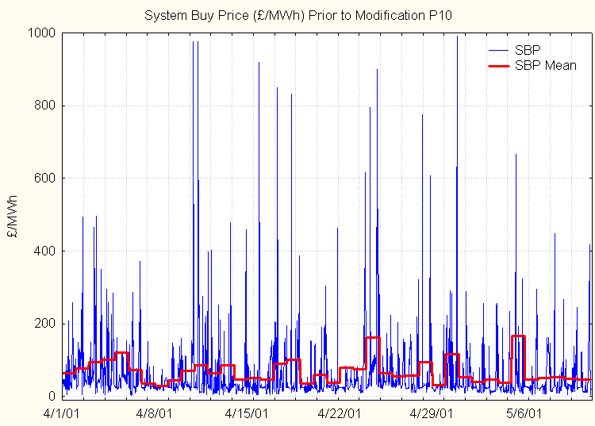
Price volatility in the balancing mechanism

Slide 77
Market power
A firm exercises market power when
  It reduces its output (physical withholding)
  or
  It raises its offer price (economic withholding)
in order to change the market price

Slide 78
Example
If a firm sells 10 units, the market price is $15
  Option 1: offer to sell only 9 units and hope that the price rises enough to compensate for the loss of volume
  Option 2: offer to sell the 10th unit for a price higher than $15 and hope that this will increase the price
Profit increases if price rises sufficiently to compensate for possible decrease in volume

Slide 79
Price spikes because of reduced supply
$/MWh
Normal supply
π_{ext}
Reduced supply
π_{nor}
Normal peak
Small reductions in supply cause
large changes in peak prices
MWh

Slide 80
When is market power more likely?
Imperfect correlation with market share
Demand does not have a high price elasticity
Supply does not have a high price elasticity:
  Highly variable demand
  All capacity sometimes used
  Output cannot be stored
→Electricity markets are more vulnerable than others to the exercise of market power

Slide 81
Mitigating market power
Increase elasticity
Increase number of competitors

Slide 82
Increasing the elasticity reduces price spikes and the generators’ ability to exercise market power
$/MWh
π_{max}
π_{min}
MWh

Slide 83
Increasing the elasticity of the demand
Obstacles
  Fixed prices
  Need for communication
  Need for storage (heat, intermediate products, dirty clothes)
Not everybody needs to respond to price signals to get substantial benefits
Increased elasticity reduces the average price
  Not in the best interests of generating companies
  Impetus will need to come from somewhere else

Slide 84
Further comments on market power
ALL firms benefit from the exercise of market power by one participant
Unilaterally reducing output or increasing offer price to increase profits is legal
Collusion between firms to achieve the same goal is not legal
Market power interferes with the efficient dispatch of generating resources
  Cheaper generation is replaced by more expensive generation

